Slide 1
Submitted by Nabajyoti Nath Anubhav Khanikar Sukanya Priya Devi Evarani Payeng
Lakhimpur Telahi Kamalabaria College
Department of physics
Topic– Magnetic properties of matter Dia,Para and ferrimagnetism

Slide 2
Contents:
Introduction
Types of Magnetic Materials
Diamagnetic materials
Paramagnetic materials
ferromagnetic materials
Usages of magnetic materials
Conclusion

Slide 3
Introduction
Matter is made of atoms which contain charged particles called electrons revolving round the nucleus. These moving electrons produce magnetic field. Also, a current carrying conductor produces magnetic field. All materials are affected in some way or the other by a magnetic field. However, not all materials react the same way.

Slide 4
Types of Magnetic Materials: Materials can be classified into following categories based on the magnetic properties shown by them:
1. Paramagnetic materials
2. Diamagnetic materials
3. Ferromagnetic materials

Slide 5
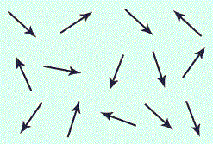
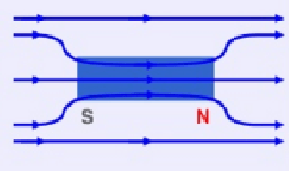
1. Paramagnetic materials
The materials which are not strongly attracted to a magnet are known as paramagnetic material. For example: aluminum , tin magnesium etc.
Such materials are magnetized only when placed on a super strong magnetic field and act in the direction of the magnetic field.
Paramagnetic materials have individual atomic dipoles oriented in a random fashion as shown below:
The resultant magnetic force is therefore zero.
When a strong external magnetic field is applied , the permanent magnetic dipoles orient them self parallel to the applied magnetic field and give rise to a positive magnetization.
Magnetic field through a paramagnetic material :>

Slide 6
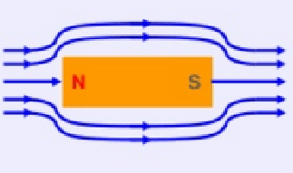
2. Diamagnetic materials
The materials which are repelled by a magnet such as zinc. mercury, lead, sulfur, copper, silver, bismuth, wood etc., are known as diamagnetic materials.
They are slightly magnetized when placed in a very string magnetic field and act in the direction opposite to that of applied magnetic field.
Permanent magnetic dipoles are absent in them, Diamagnetic materials have very little to no applications in electrical engineering.
Magnetic field through a diamagnetic material

Slide 7
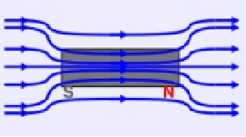
3. Ferromagnetic materials
The materials which are strongly attracted by a magnetic field or magnet is known as ferromagnetic material for example : iron, steel , nickel, cobalt etc.
The opposite magnetic effects of electron orbital motion and electron spin do not eliminate each other in an atom of such a material. There is a relatively large contribution from each atom which aids in the establishment of an internal magnetic field, so that when the material is placed in a magnetic field, it’s value is increased many times the value that was present in the free space before the material was placed there
Magnetic field through a ferromagnetic material

Slide 8
Usages of paramagnetic
Paramagnetic pharmaceuticals ( magneto pharmaceuticals ) that are suitably distributed into specific organ systems or diseased sites might be clinically useful for tissue contrast enhancement in nuclear magnetic resonance images.

Slide 9
Usages of Diamagnetic
These magnets are used as elements of most Magnetic Resonance Imaging (MRI) systems
Bismuth, which shows the strongest diamagnetism, is used in guns.
Pyrolytic graphite is also a strongly diamagnetic material that can float in a magnetic field.
These materials are temperature independent, so they do not melt in the heat.

Slide 10
Usages of ferromagnetic
Ferromagnetism is very important in industry and modern technology and is the basis for many electrical and electromechanical devices such as electromagnets, electric motors, generators, transformers, and magnetic storage such as tape recorders, and hard disks, and nondestructive testing of ferrous materials.

Slide 11
Conclusion
Dia , Para and ferromagnetic materials are very much needed in daily life, using it we can do a lot of things, which are very important for the technology of the country.

Slide 12
Thank you 🙏

