Slide 1
Miller Indices
Submitted By:
JYOTI PROSAD MORANG
BHAITI PEGU

Slide 2
Introduction:
*Set of 3 integers (hkl) used to designate different planes in a crystal.
*Miller indices are a symbolic vector representation for the orientation of an atomic plane in a crystal lattice and are defined as the reciprocals of the fractional intercepts which the plane makes with the crystallographic axes.

Slide 3
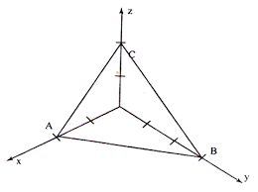
Steps to determine miller indices of a plane:
*Determine the intercepts of the plane
along each of the three crystallographic
axis and express in terms of multiples of
axial length OA : OB : OC= pa : qb : rc
*Note the coefficients of intercepts p q r
*Take the reciprocals of the coefficients
of intercepts 1/p 1/q 1/r
*If fractions result, multiply with LCM to get smallest integer.
*Write it in paranthesis (hkl).

Slide 4
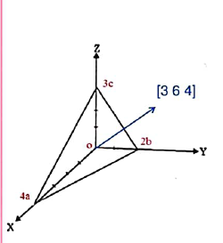
Miller indices:
Plane intercepts axes at 4a 2b 3
Reciprocal of coefficient:
Multiply with LCM:
Indices of the plane (Miller): (3 6 4 )
Indices of the direction :[3 6 4]

Slide 5
Axis | X | Y | Z
Coefficient of Intercept | 1
Reciprocals | 1/1
Smallest Ratio | 1 | 0 | 0
Miller Indices (100)

Slide 6
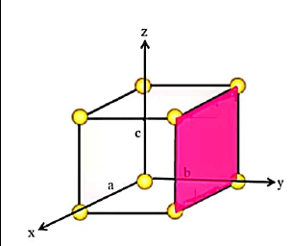
Axis | X | Y | Z
Coefficient of intercept |  | 1
Reciprocals |  | 1/1
Smallest Ratio | 0 | 1 | 0
Miller Indices (010)

Slide 7
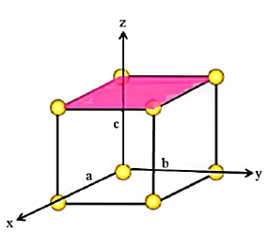
Axis | X | Y | Z
Coefficient of Intercepts |  |  | 1
Reciprocals |  |  | 1/1
Smallest Ratio | 0 | 0 | 1
Miller Indices (001)

Slide 8
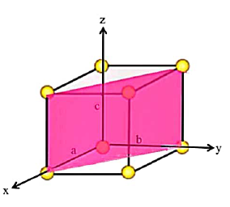
Axis | X | Y | Z
Coefficient of intercept | 1 | 1
Reciprocals | 1/1 | 1/1
Smallest Ratio | 1 | 1 | 0
Miller Indices (110)

Slide 9
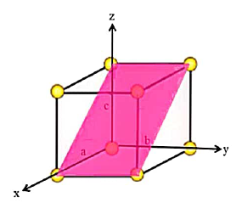
Axis | X | Y | Z
Coefficient of Intercept | 1 |  | 1
Reciprocals | 1/1 |  | 1/1
Smallest Ratio | 1 | 0 | 1
Miller Indices (101)

Slide 10
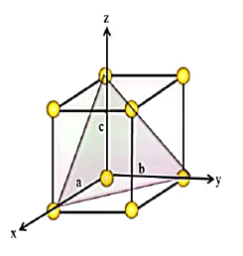
Axis | X | Y | Z
Coefficient of intercept | 1 | 1 | 1
Reciprocals | 1/1 | 1/1 | 1/1
Smallest Ratio | 1 | 1 | 1
Miller Indices (111)

Slide 11
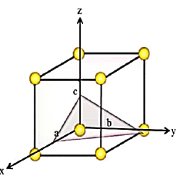
Axis | X | Y | Z
Coefficient of intercept | 1/2 | 1 | ½
Reciprocals | 2 | ½ | 2
Smallest Ratio | 2 | 1 | 2
Miller Indices (212)

Slide 12
THANK YOU
THANK YOU

