Slide 1
Presented by Nabajyoti Nath Anubhav Khanikar Sukanya Priya Devi Evarani Payeng
LAKHIMPUR TELAHI KAMALABARIA COLLEGE
Department of physics
Presentation on astronomical distances

Slide 2
Astronomical Distances
The SI unit for length, the meter, is a very small unit to measure astronomical distances since the distances between astronomical objects are really really large.
When dealing with the great distances within our Solar System, astronomical units (AU), which are multiples of the distance from the Earth to the Sun, are used.

Slide 3
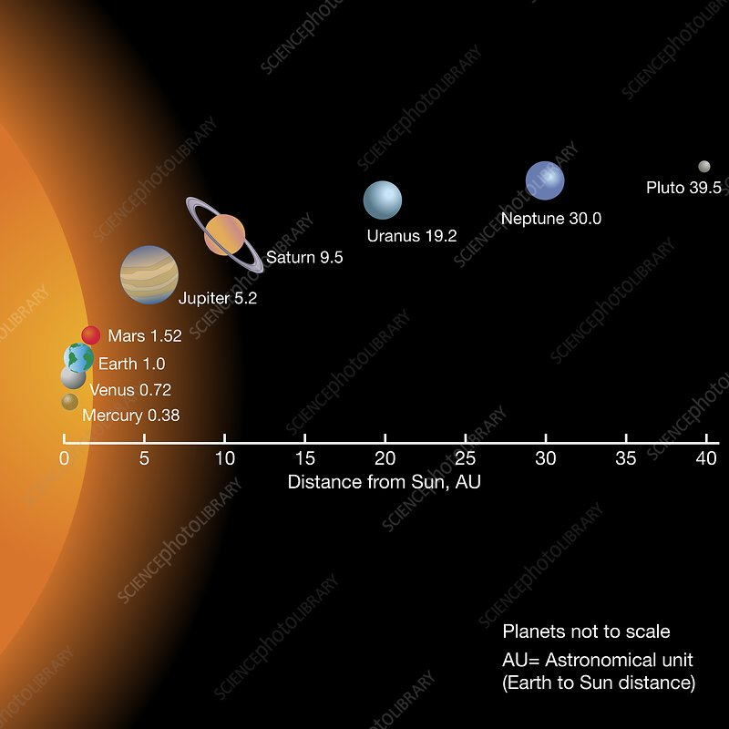
Astronomical distances
The Astronomical Unit (AU)- this is the average distance between the Earth and the Sun. This unit is more used within the Solar System.
1AU= 150 000 000 km
or
1AU= 1.5×10^11 m

Slide 4
Astronomical distances
The light year (ly) –This is the distance travels by light in one year.
A light year is also equals 63,241 AU

Slide 5
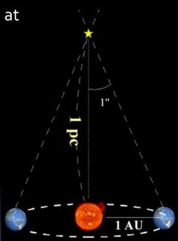
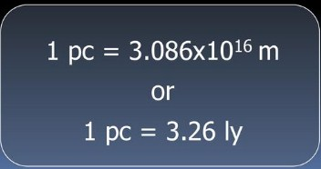
Astronomical distances
The parsec (pc) – this the distance at which 1AU subtends an angle of 1 arc second.

Slide 6
Conclussion
The great distances measured in Astronomy require units much larger than kilometers or miles. For distances within our Solar System, astronomical units (AU) or multiples of the distance from the Earth to the Sun are used. For distances to stars or galaxies, light years are used. A third unit that is preferred by astronomers is the parsec, which is even greater than a light year in distance.

Slide 7
THANK YOU

