Slide 1
THE MILKY WAY (GALAXY)
SUBIMMITED BY :
GUNIN CHANGMAI
ROLL NO: 228
BSc 5th sem, Dept. Of Physics

Slide 2
CONTAINS:
INTRODUCTION
STRUCTURE
CENTER OF THE MILKY WAY
COMPONENTS OF MILKY WAY

Slide 3
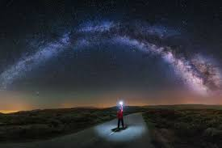
Introduction:
The Milky Way is our home galaxy. It is a beautiful spiral galaxy that is about 100,000 light years across. It contains about 200 billion stars and is one of billions of galaxies in the universe.
MILKY WAY FROM EARTH

Slide 4
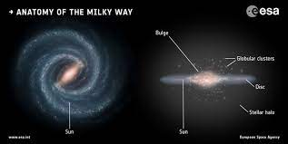
STRUCTURE
The Milky Way is a spiral galaxy. The Milky Way is the home of our solar system. It is a large barred spiral galaxy. The Milky Way has two main stellar components: a disk and a central bulge. The disk is made up of stars, gas, and dust. The central bulge is a spherical region of stars. The disk has a spiral structure. The spiral arms are regions where there are more stars. The Milky Way has a mass of about 150 to 200 billion solar masses.

Slide 5
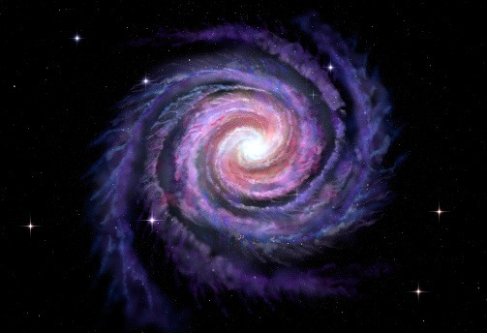
SPRIAL ARMS:
The disk is divided into spiral arms. The Milky Way has two main spiral arms, the Scutum–Centaurus Arm and the Carina–Sagittarius Arm. These arms are connected by a bridge of gas and dust called the Orion Spur.

Slide 6
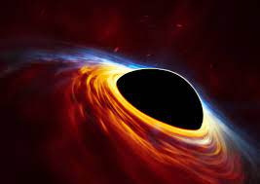
CENTER OF MILKY WAY:
The center of Milky Way is call Galactic Center .The Galactic Center is the rotational center, the barycenter, of the Milky Way galaxy. Its central massive object is a supermassive black hole of about 4 million solar masses, which is called Sagittarius , a compact radio source which is almost exactly at the galactic rotational center.

Slide 7
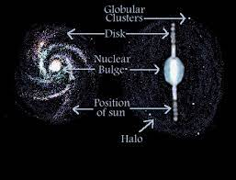
COMPONENTS OF MILKY WAY:
The Milky Way is made up of a few hundred billion stars, a few hundred billion planets, a few hundred billion asteroids, a few hundred billion comets, and a few hundred billion pieces of interstellar gas and dust.

Slide 8
STARS AND STAR CLUSTERS IN THE MILKY WAY:
A groups of ten or more stars that were formed from the same interstellar cloud. The large globular clusters found orbiting galaxies may have hundreds of thousands or millions of stars, including some of the oldest stars yet observed.
The Milky Way is home to more than 1,000 known open clusters, but astronomers think the actual number could be ten times higher. That's because they tend to live in the thick part of the galactic disk, where the density of stars, gas, and dust prevents us from seeing all there is to see.

Slide 9
LOCATION OF SOLAR SYSTEM IN THE MILKY WAY:
Our Sun lies near a small, partial arm called the Orion Arm. The Solar System is located at a radius of about 27,000 light-years (8.3 kpc) from the Galactic Center, on the inner edge of the Orion Arm, one of the spiral-shaped concentrations of gas and dust.

Slide 10
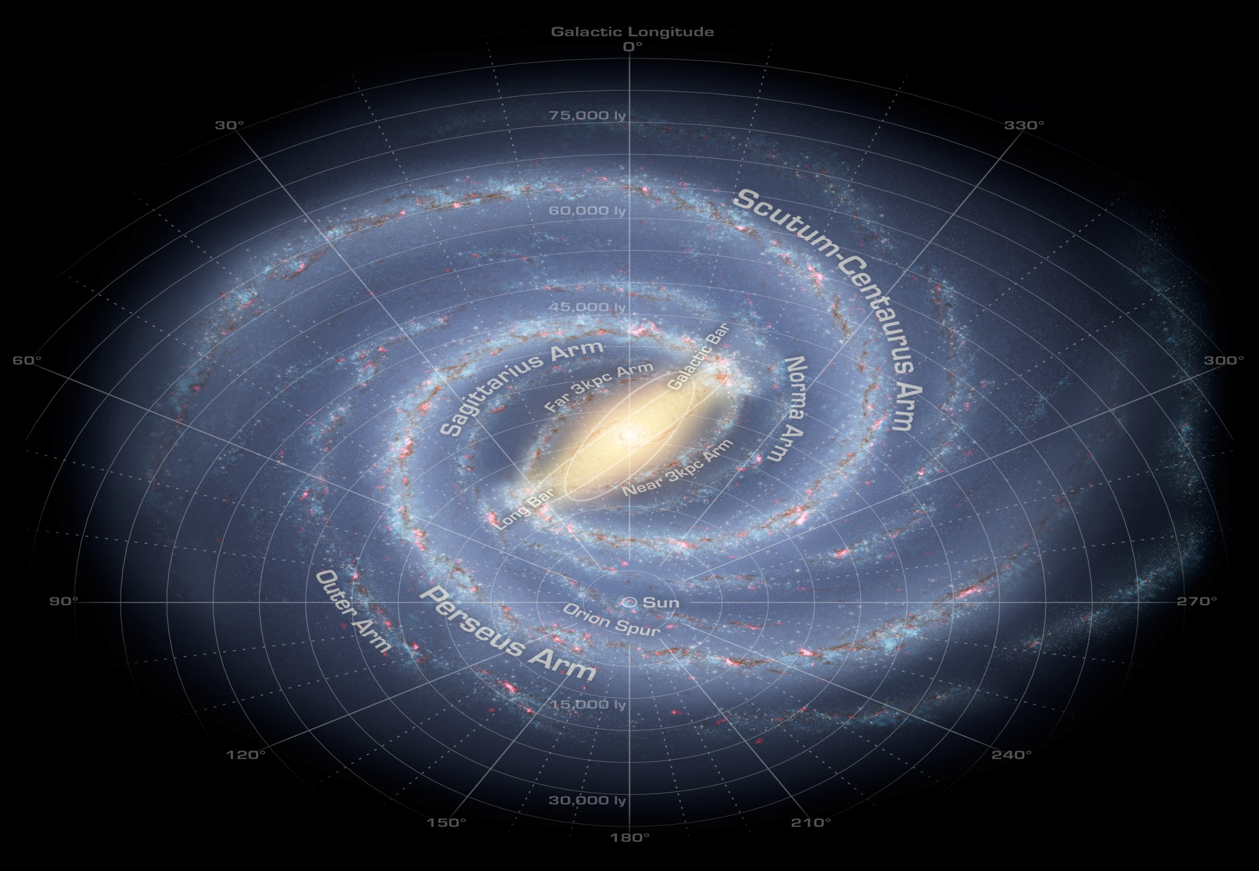
SOLAR SYSTEM IN MILKY WAY:

Slide 11
THANK YOU !

