Slide 1
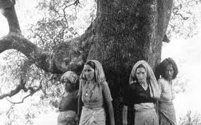
Chipku Movement –An Environmental Movement of India
Chipku Movement also known as Chipku Andolan is a non violent social movement led by rural women of Uttarankhand
The name of the movement comes from the word ‘chipku” which means “embrace” or “Hug”

Slide 2
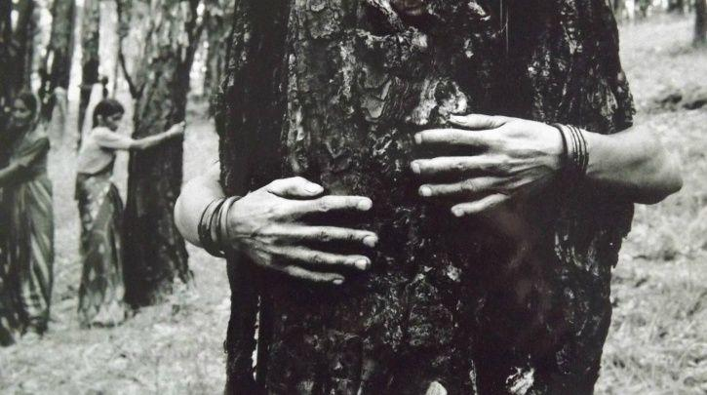
Basic Aim of the Chipku movement
To protect the environment.
To secure their rights.
To protect the trees and forest from government backed logging.

Slide 3
Background of the Movement
Due to colonial forest policy forest land in the Himalayan Region reduced rapidly .After independence the Govt. of India started forest destruction in this region in the name of development of transport &communication particularly in the decade of 1960.As a result the rural villagers had to face many problems regarding their food and fuel directly and soil erosion ,rain&water indirectly.In search of food and fuel the local people of this region had to migrate to the plain areas.In such experience people came out against deforestation activities of government.

Slide 4
Course of the Movement
In 1964 environmentalist and Gandhian social activist Chandi Prasad Bhatt founded a cooperative organization, Dasholi Gram Swarajya Sangh (later renamed Dasholi Gram Swarajya Mandal [DGSM]), to foster small industries for rural villagers, using local resources. When industrial logging was linked to the severe monsoon floods that killed more than 200 people in the region in 1970, DGSM became a force of opposition against the large-scale industry. The first Chipko protest occurred near the village of Mandal in the upper Alaknanda valley in April 1973.
cont….

Slide 5
With the success in Mandal, DGSM workers and Sunderlal Bahuguna, a local environmentalist, began to share Chipko’s tactics with people in other villages throughout the region. One of the next major protests occurred in 1974 near the village of Reni, where more than 2,000 trees were scheduled to be felled. Following a large student-led demonstration, the government summoned the men of the surrounding villages to a nearby city for compensation, ostensibly to allow the loggers to proceed without confrontation. However, they were met with the women of the village, led by Gaura Devi, who refused to move out of the forest and eventually forced the loggers to withdraw.
cont…

Slide 6
As the movement continued, protests became more project-oriented and expanded to include the entire ecology of the region, ultimately becoming the “Save Himalaya” movement. Between 1981 and 1983, Bahuguna marched 5,000 km (3,100 miles) across the Himalayas to bring the movement to prominence. Throughout the 1980s many protests were focused on the Tehri dam on the Bhagirathi River and various mining operations, resulting in the closure of at least one limestone quarry. Similarly, a massive reforestation effort led to the planting of more than one million trees in the region.

Slide 7
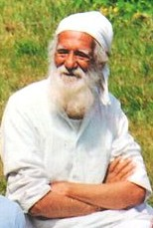
A brief introduction to Sunderlal Bahuguna
Sunderlal Bahuguna was born in village Maroda near Tehri, Uttarakhand on 9 January 1927. He claimed in a function arranged at Kolkata, that his ancestors bearing surname Bandyopadhyaya, migrated from Bengal to Tehri, some 800 years ago. Early on, he fought against untouchability and later started organising hill women in his anti-liquor drive from 1965 to 1970. He started social activities at the age of thirteen, under the guidance of Shri Dev Suman, who was a nationalist spreading message of non-violence and he was with the Congress party of Uttar Pradesh (India) at the time of Independence.Bahuguna also mobilised people against colonial rule before 1947.He adopted Gandhian principles in his life and married his wife Vimla with the condition that they would live among rural people and establish ashram in village.Inspired by Gandhi, he walked through Himalayan forests and hills, covering more than 4,700 kilometres on foot and observed the damage done by mega developmental projects on the fragile eco-system of the Himalayas and subsequent degradation of social life in villages.

Slide 8
He changed the former Motto of the movement- “ Ecology is permanent Economy”.
Soil is ours, water is ours, ours are these forests, our forefathers raised them, its our duty to protect them.
Forest Satyagrah- named by the media.
In 1987 Chipko movement was awarded ‘ Right Livelihood Award’.

Slide 9
Effect of the movement
The news soon reached the state capital, where the then state Chief Minister, Hemwati Nandan Bahuguna, set up a committee to look into the matter, which eventually ruled in favour of the villagers. This became a turning point in the history of eco-development struggles in the region and around the world.
The movement achieved a victory when the government issued a ban on felling of trees in the Himalayan regions for fifteen years in 1980 by then Prime Minister Indira Gandhi, until the green cover was fully restored. One of the prominent Chipko leaders, Gandhian Sunderlal Bahuguna, took a 5,000 kilometre trans-Himalaya foot march in 1981–83, spreading the Chipko message to a far greater area.

Slide 10
Features of the movement
Active participation of women
Democratic movement
Non-Violent and Social movement.
Expose environmental consciousness.

Slide 11
Thank You

