Slide 1
BLACKBODY RADIATION
SUBMITTED BY
Arunjyoti Nath
Naseer Ali Hazarika
Partha Pratim Khanikar
Moffijul Ali
Gunin Changmai
Rosan Bista
BSC 4th semester
Department of physics
L.T.K College

Slide 2
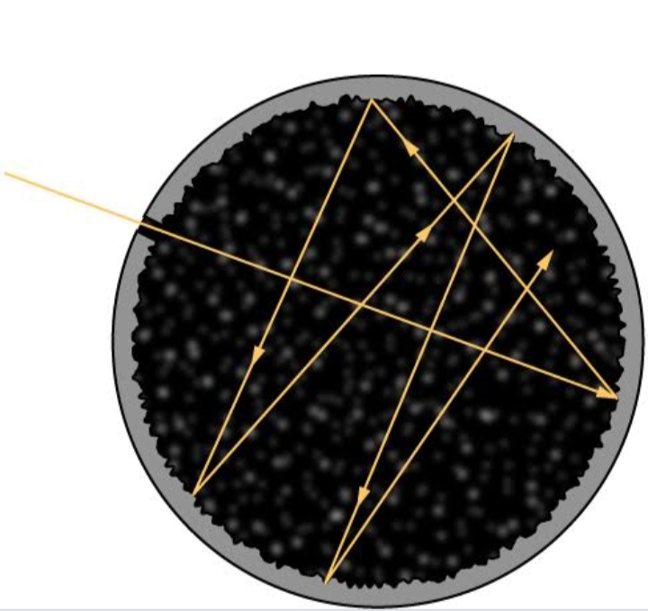
INTRODUCTION:-
The first clue to the quantum nature of radiation came from the study of thermal radiation emitted by a Blackbody.
A body, which absorbs radiation of all frequencies without reflecting back any radiation is known as a Blackbody. Radiation emitted by such a body is called blackbody radiation .
In fact, there is no absolute blackbody but some bodies can approximately be treated as blackbodies. A good physical approximation of a blackbody is a cavity with a tiny hole and no other opening.
Fig: Approximation of a blackbody

Slide 3
Characteristics of Blackbody radiation:-
At a given temperature, the radiated intensity increases with increasing frequency, reaches a maximum at a certain frequency “νmax” and the decreases towards the high frequency end of the spectrum.
With rise in temperature, the rang of frequencies becomes wider.
As the temperature is increased, the peak of the curve shifts towards the direction of higher frequencies.
The intensity or power of the emitted radiation increases with temperature.

Slide 4
Laws of blackbody radiation:-
❶ Kirchhoff’s Law:-
The emissivity of a blackbody,
ε=E_{E}/E_{A}
Here, emissive power (E_{E}) means the energy emitted by the body per unit area per unit time and absorptive power (E_{A}) refers to the incident energy absorbed by the body per unit area per unit time.

Slide 5
❷ Stefan-Boltzmann Law :-
According to the Stefan-Boltzmann Law,
energy radiated,
I = σT⁴
Where σ = 5.67×10⁻⁸ W/m²K⁴ is the Stefan-Boltzmann constant and T is the absolute temperature of the blackbody.

Slide 6
❸ Wien’s Displacement Law :
Wien’s Displacement Law is expressed as,
λ_{max} = b/T
Where, b = 2.898 × 10⁻³ m K is Wien’s Displacement Constant.
This law can be expressed in terms of frequency as :
ν_{max} = cT/b {λ_{max} = c/ ν_{max} }
Where, c is the speed of light in vacuum and ν_{max} is the frequency corresponding to the maximum spectral intensity.

Slide 7
❹ Wien’s Distribution Law :
Wien suggested that the energy density of radiation emitted by a black body can be expressed as –
u( ν,T ) = A ν³ e^{-hν/kT}
where, A is a constant and k = 1.38 × 10⁻²³ JK⁻¹ is the Boltzmann constant.

Slide 8
❺ Rayleigh Jeans Law :
Rayleigh – Jeans formula is expressed as,
u(ν,T ) = 8πkTν²/c³
where k = 1.38 × 10⁻²³ JK⁻¹ is the Boltzmann constant.

Slide 9
Uses of Blackbody Radiation :
The black bodies are used for -
lighting,
heating,
security,
thermal imaging etc.

Slide 10
Conclusion: Although the blackbody is an idealization , because no physical object absorbs 100% of incident radiation. A blackbody is physically realized by a small hole in the wall of a cavity radiator.

Slide 11
Conclusion: Although the blackbody is an idealization , because no physical object absorbs 100% of incident radiation. A blackbody is physically realized by a small hole in the wall of a cavity radiator.

Slide 12
THANK YOU

