Slide 1
Complex number
Presented by :-
Nabajyoti Nath
Anubhav Khanikar
Jyotiprasad Moran
Evarani Payeng,
Sukanya priya Devi
BSC 4th semester
Department of Physics
L.T.K. College

Slide 2
Definition :-
A complex number is a number of the form z = x + iy , where x and y are real umbers, and i is an imaginary unit satisfying i²=-1.
If x=0, then the number said to be purely imaginary. Again if y=0 then the number x is purely a real number.
For example, 2 + 3i is a complex number.

Slide 3
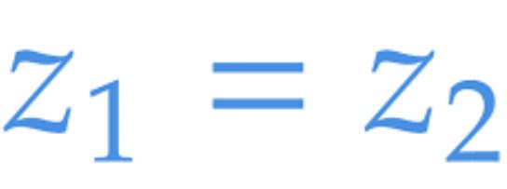
Equality of complex number :-
Two complex number are equal if their real part and imaginary parts are individually equal.
i.e. The two complex number
a + ib = c + id
if and only if a = c and b = d.
For example, if x + iy = 8 – i,
then equating the real and imaginary parts, we get
x = 8 and y = -1

Slide 4
Algebra of complex number :-
Complex Number is an algebraic expression including the factor i = √-1.
Let z₁ = a + ib and z₂ = c + id, are two complex numbers, then
Addition of Complex Numbers
The sum of this two complex numbers
z₁+ z₂ = (a + ib) + (c + id)
=(a + c) + i(b + d)
Addition of complex numbers can be another complex number.
Difference of two Complex Numbers
Difference of this two complex numbers
z₁- z₂= (a + ib) - (c + id)
= (a – c) + i (b – d)
Difference of complex numbers can be another complex number.

Slide 5
Algebra of complex number :-
Multiplication of two Complex Numbers
multiplication of this two complex numbers
z₁× z₂ = (a + ib) ×(c + id)
z₁×z₂= (ac – bd) + i(ad + bc)
Division of Complex Numbers
division of this two complex numbers

Slide 6
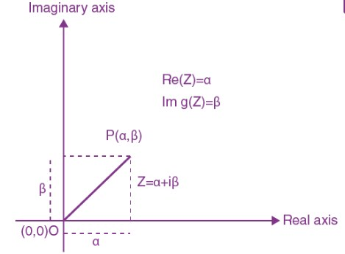
Geometrical representation :-
A complex number z = α + iβ can be denoted as a point P(α, β) in a plane called Argand plane, where α is the real part and β is an imaginary part. The value of i = √-1.

Slide 7
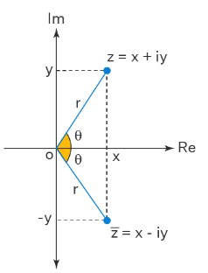
Conjugate of Complex Number :-
Conjugate of a complex number is the number with an same real part and opposite sign of imaginary part but equal in magnitude. The complex conjugate of complex number z is denoted by z¯.
The complex conjugate of x + iy is x – iy.
Mirror image of Z = x + iy along real axis will represent conjugate of given complex number
Fig: Complex conjugate

Slide 8
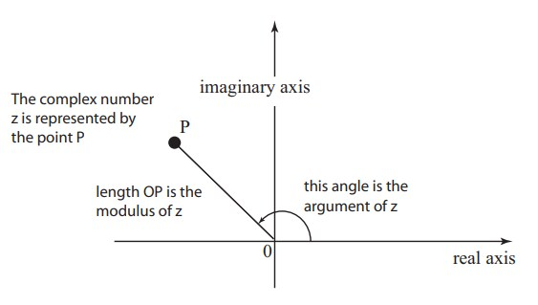
MODULUS AND ARGUMENT OF COMPLEX NUMBER :-
The length of the line segment, that is OP, is called the modulus of the complex number, z=( x + iy) and is denoted by |z|=| x+ iy|
The angle from the positive axis to the line segment is called the argument of the complex number, z. It is denoted by arg. (z).
Θ=tan⁻¹ (y/x)
r

Slide 9
Properties of Modulus :-
|z| = 0 => z = 0 + i0
|z₁ – z₂ | denotes the distance between z₁ and z₂ .
–|z| ≤ Re(z) ≤ |z| ; equality holds on right or on left side depending upon z being positive real or negative real.
–|z| ≤ Imz ≤ |z| ; equality holds on right side or on left side depending upon z being purely imaginary and above the real axes or below the real axes.
|z| ≤ |Re(z)| + |Im(z)| ≤ |z| ; equality holds on left side when z
is purely imaginary or purely real and equality holds on right side when |Re(z)| = |Im(z)|.
|z|² = z
|z₁z₂| = |z₁| |z₂|

Slide 10
Properties of Argument:
arg(z₁z₂) = Θ₁ + Θ₂ = arg(z₁) + arg(z₂)
arg (z₁/z₂) = Θ₁ – Θ₂ = arg(z₁) – arg(z₂)
arg (z^{n}) = n arg(z), n inclusing of all
For Example:
Find the argument of the complex number 2 + 2√3i.
Solution: Let z = 2 + 2√3i.
Here, the real part, x = 2
Imaginary part, y = 2√3
We know that the formula to find the argument of a complex number is
arg (z) = tan⁻¹(y/x) = tan⁻¹(2√3/2)= tan⁻¹(√3)
arg (z) = tan⁻¹(tan π/3)
= π/3
Therefore, the argument of the complex number is π/3 radian

Slide 11
conclusion
Complex numbers are numbers of the form a + bi, where, a and b are real numbers and i=√-1.
The theory of function of complex variable is very important in solving a large number of practical problems in different branches of Physics like theory of heat, analysis of A.C circuit, electronics, quantum mechanics etc.

