Slide 1
SUBMITTED BY
MOFIJUL ALI
ARUNJOYTI NATH
NASEER ALI HAZARIKA
PARTHA PRATIM KHANIKAR
GUNIN CHANGMAI
ROSAN BISTA
BSC 4TH SEMESTER
DEPARMENT OF PHYSICS
L.T.K. COLLEGE
SEMI-CONDUCTOR

Slide 2
REFERENCE
Introduction
Types of Semi-conductors
Energy band picture of an intrinsic semi-conductor
Extrinsic semi-conductor
Conclusion

Slide 3
INTRODUCTION
Materials having resistivity in between conductors and insulators are called semi-conductor.Most commonly used semi-conductors are Germanium and Silicon.
Semi-conductor Atomic number Electrons distribution
Silicon(Si) 14 2,8,4
Germanium(Ge) 32 2,8,18,4
In terms of energy bands,semi-conductors can be defined as those materials which have almost and empty conduction band and almost filled valence band with a very narrow energy gape seperating the two.

Slide 4
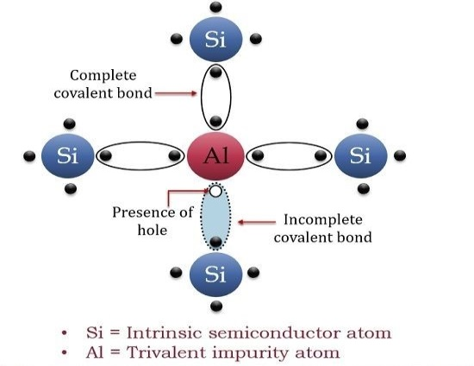
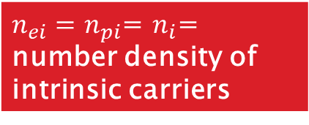
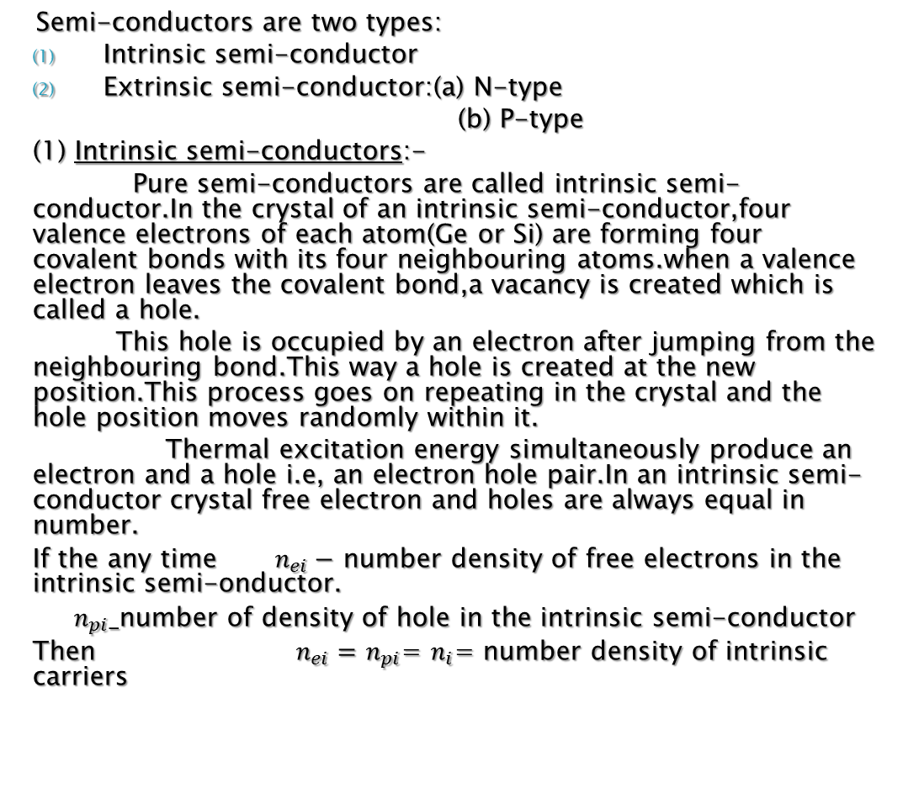
TYPES OF SEMI-CONDUCTORS
Semi-conductors are two types:
Intrinsic semi-conductor
Extrinsic semi-conductor:(a) N-type
(b) P-type
(1) Intrinsic semi-conductors:-
Pure semi-conductors are called intrinsic semi-conductor.In the crystal of an intrinsic semi-conductor,four valence electrons of each atom(Ge or Si) are forming four covalent bonds with its four neighbouring atoms.when a valence electron leaves the covalent bond,a vacancy is created which is called a hole.
This hole is occupied by an electron after jumping from the neighbouring bond.This way a hole is created at the new position.This process goes on repeating in the crystal and the hole position moves randomly within it.
Thermal excitation energy simultaneously produce an electron and a hole i.e, an electron hole pair.In an intrinsic semi-conductor crystal free electron and holes are always equal in number.
If the any time $n_{ei}−$ number density of free electrons in the intrinsic semi-onductor.
$n_{pi}_$number of density of hole in the intrinsic semi-conductor
Then $n_{ei}=$ $n_{pi}$= $n_{i}$= number density of intrinsic carriers
Fig-Intrinsic semi-conductor
$n_{ei}=$ $n_{pi}$= $n_{i}$= number density of intrinsic carriers

Slide 5
ENERGY BAND PICTURE OF AN INTRINSIC SEMI-CONDUCTOR
At 0 K V.B energy levels are filled and those of C.B. are unoccupied.With the rise of temperature availibility of thermal of excitation energy starts the transition of electrons from V.B. to C.B. through forbidden energy gape.To surmount the forbidden gape,a least amount of excitation energy is require and this much least energy is required by an electron to leave the covalent bond.Which the the transition of an electron from V.B. and C.B.,a vacancy called hole,is created in the V.B. A hole in V.B. and an electron is the C.B. are free to move in their respective bond.

Slide 6
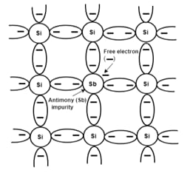
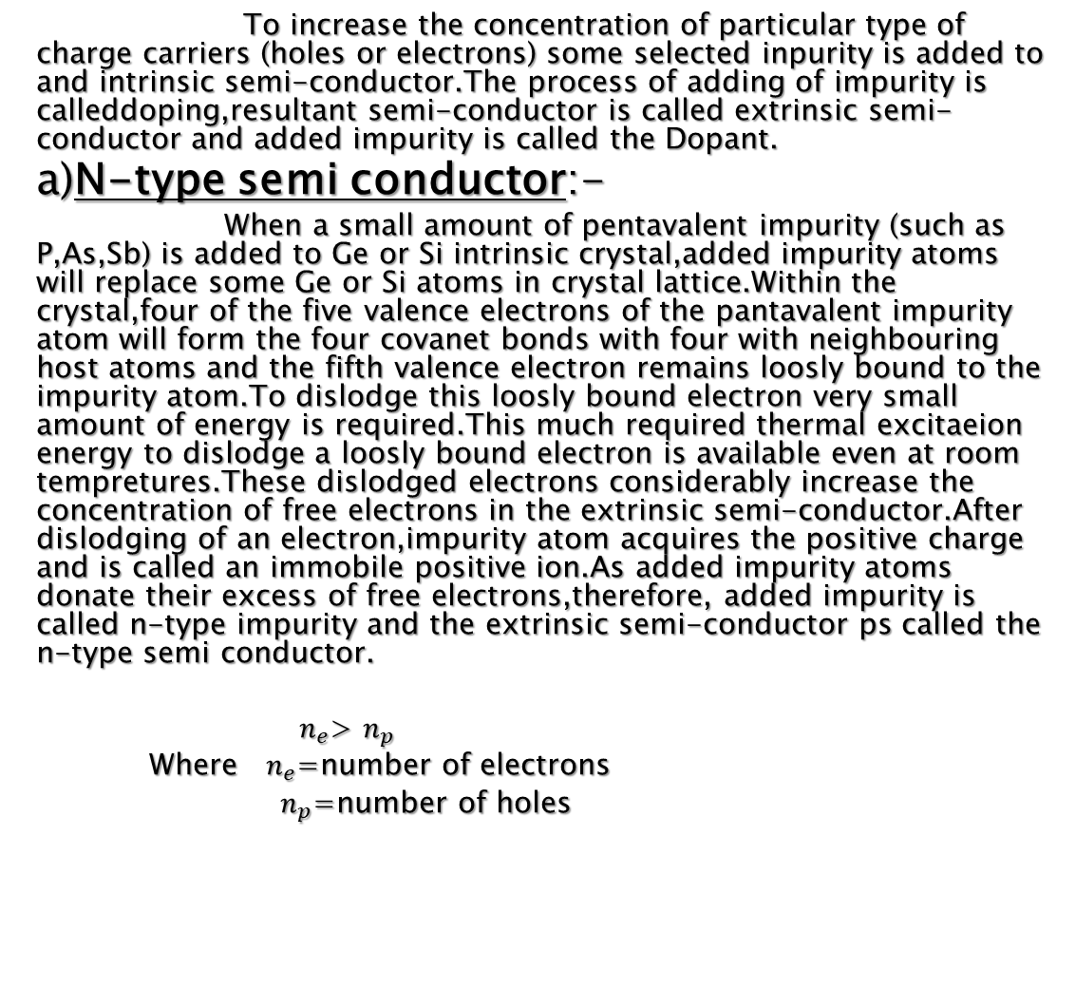
(2) Extrinsic semi-conductors:-
To increase the concentration of particular type of charge carriers (holes or electrons) some selected inpurity is added to and intrinsic semi-conductor.The process of adding of impurity is calleddoping,resultant semi-conductor is called extrinsic semi-conductor and added impurity is called the Dopant.
a)N-type semi conductor:-
When a small amount of pentavalent impurity (such as P,As,Sb) is added to Ge or Si intrinsic crystal,added impurity atoms will replace some Ge or Si atoms in crystal lattice.Within the crystal,four of the five valence electrons of the pantavalent impurity atom will form the four covanet bonds with four with neighbouring host atoms and the fifth valence electron remains loosly bound to the impurity atom.To dislodge this loosly bound electron very small amount of energy is required.This much required thermal excitaeion energy to dislodge a loosly bound electron is available even at room tempretures.These dislodged electrons considerably increase the concentration of free electrons in the extrinsic semi-conductor.After dislodging of an electron,impurity atom acquires the positive charge and is called an immobile positive ion.As added impurity atoms donate their excess of free electrons,therefore, added impurity is called n-type impurity and the extrinsic semi-conductor ps called the n-type semi conductor.
$n_{e}$> $n_{p}$
Where $n_{e}$=number of electrons
$n_{p}$=number of holes
Fig-Semi-conductor

Slide 7
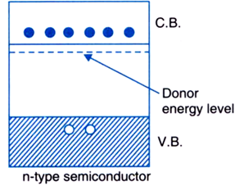
ENERGY BAND PICTURE OF N-TYPE SEMICOND UCTORS :
Added n-type impurity in the semi-conductor(Ge or Si),introduces the energy levels corresponding to the loosly bound electrons of the impurity atoms in forbidden gapjust below the lower edge of the conduction band.These introduced energy levels are called doner levels and very small amount of energy is required to causc the transition of an electron from a donor level to the unoccupied levels of the conduction band.After transition of an electron,donor atoms becomes ionised with positive charge on it.At room temperature almost all donor energy levels are unoccupied i.e all donor atoms are ionised indicating the presence of extra conduction electrons in the conduction band.

Slide 8
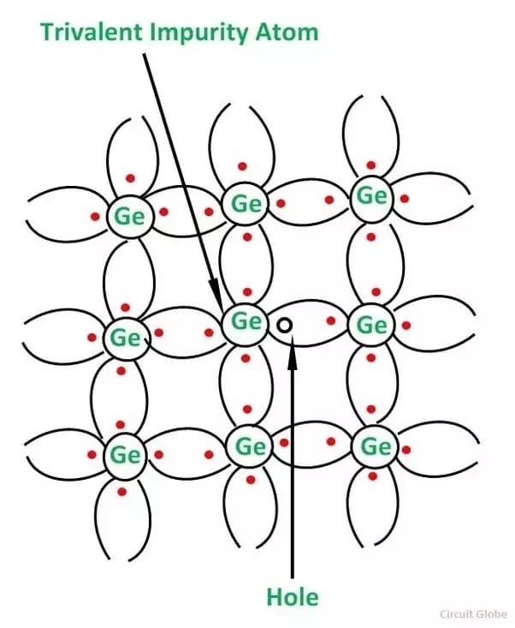
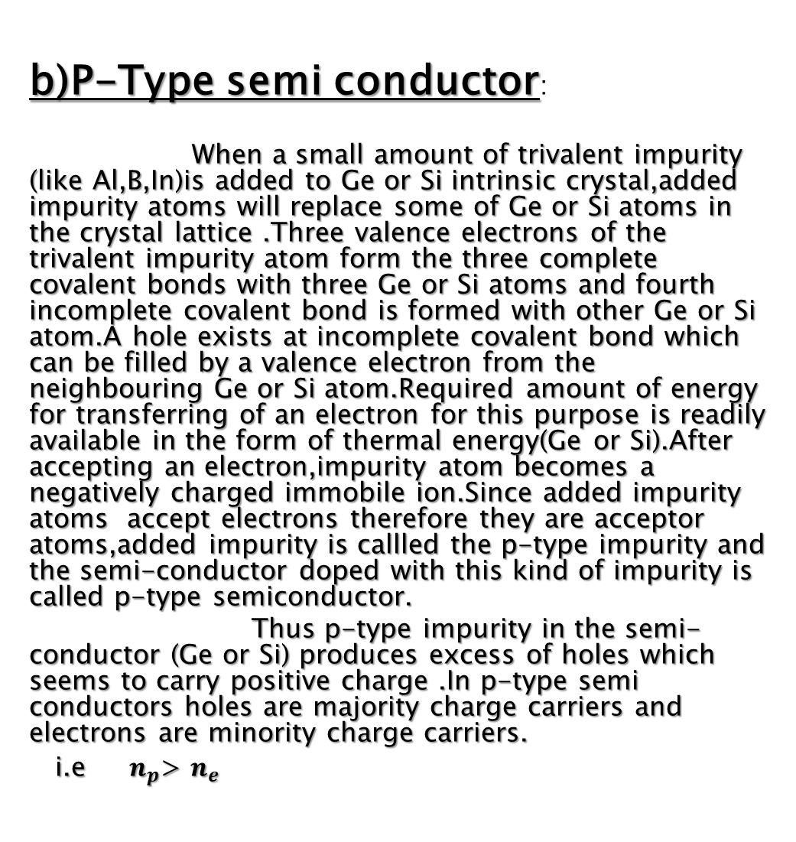
b)P-Type semi conductor:
When a small amount of trivalent impurity (like Al,B,In)is added to Ge or Si intrinsic crystal,added impurity atoms will replace some of Ge or Si atoms in the crystal lattice .Three valence electrons of the trivalent impurity atom form the three complete covalent bonds with three Ge or Si atoms and fourth incomplete covalent bond is formed with other Ge or Si atom.A hole exists at incomplete covalent bond which can be filled by a valence electron from the neighbouring Ge or Si atom.Required amount of energy for transferring of an electron for this purpose is readily available in the form of thermal energy(Ge or Si).After accepting an electron,impurity atom becomes a negatively charged immobile ion.Since added impurity atoms accept electrons therefore they are acceptor atoms,added impurity is callled the p-type impurity and the semi-conductor doped with this kind of impurity is called p-type semiconductor.
Thus p-type impurity in the semi-conductor (Ge or Si) produces excess of holes which seems to carry positive charge .In p-type semi conductors holes are majority charge carriers and electrons are minority charge carriers.
i.e $n_{p}$> $n_{e}$
Fig-P-type semi-conductor

Slide 9
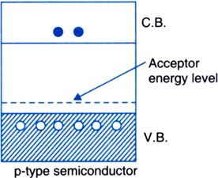
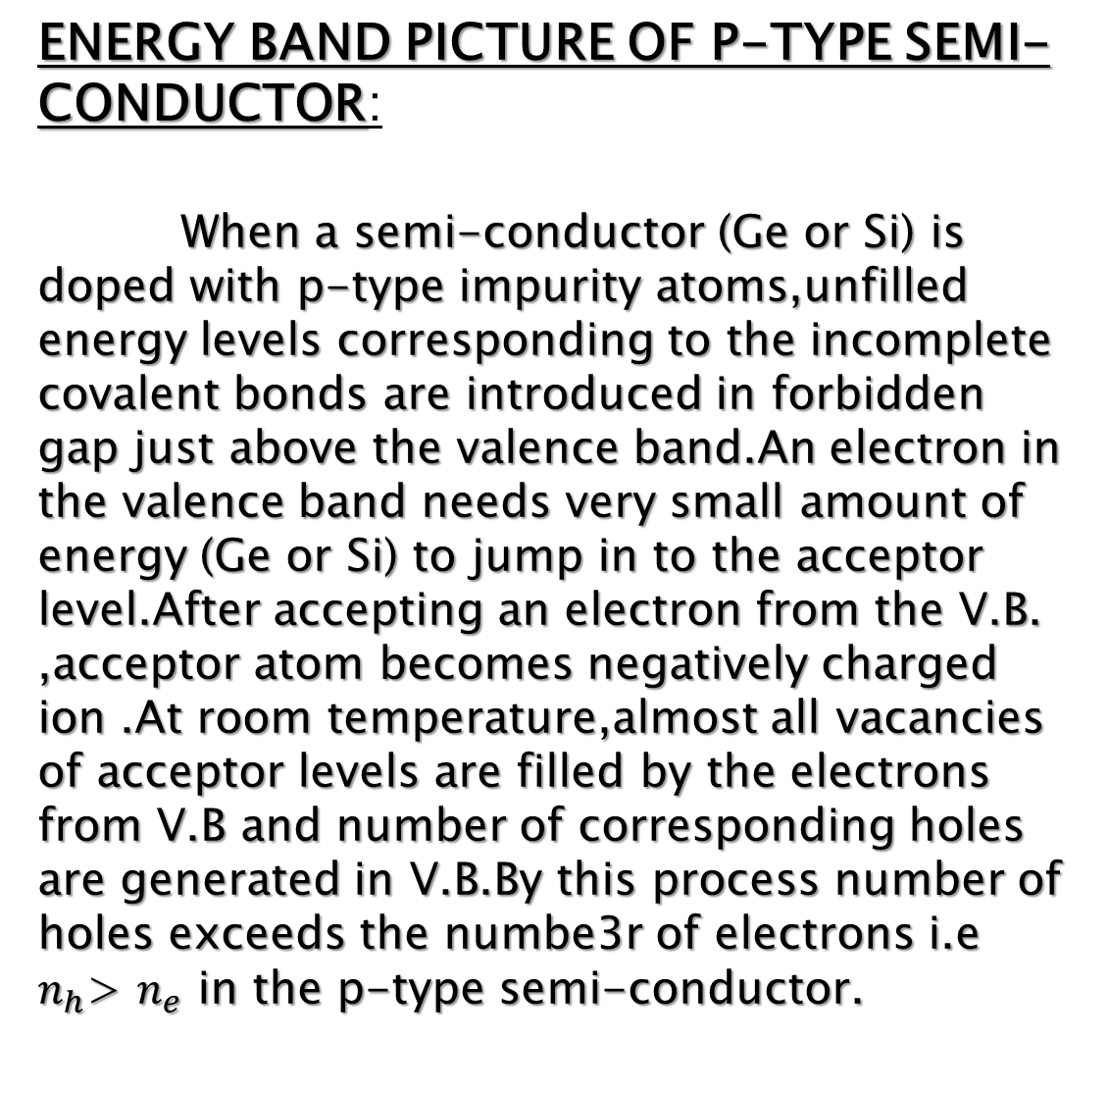
ENERGY BAND PICTURE OF P-TYPE SEMI-CONDUCTOR:
When a semi-conductor (Ge or Si) is doped with p-type impurity atoms,unfilled energy levels corresponding to the incomplete covalent bonds are introduced in forbidden gap just above the valence band.An electron in the valence band needs very small amount of energy (Ge or Si) to jump in to the acceptor level.After accepting an electron from the V.B. ,acceptor atom becomes negatively charged ion .At room temperature,almost all vacancies of acceptor levels are filled by the electrons from V.B and number of corresponding holes are generated in V.B.By this process number of holes exceeds the numbe3r of electrons i.e $n_{h}$> $n_{e}$ in the p-type semi-conductor.

Slide 10
CONCLUSION
The Semi-conductors have been boon to our technogical development ,it has reduced the size of our gad gets and made them more efficient.

Slide 11
THANK YOU

