Slide 1
New Tools and Techniques introduces to improve quality research
Presented By
Dr. Debajit Dutta
Safvan PT
Chitwel Salma
Tuvvara Mounika
Swati Digambr Yadav

Slide 2
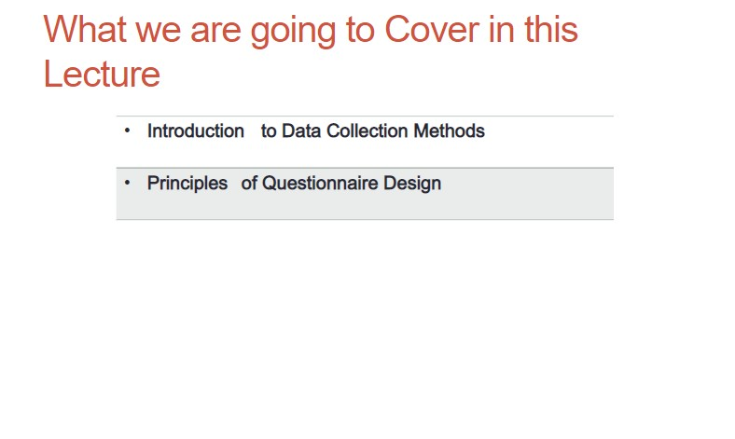
Presentation

Slide 3
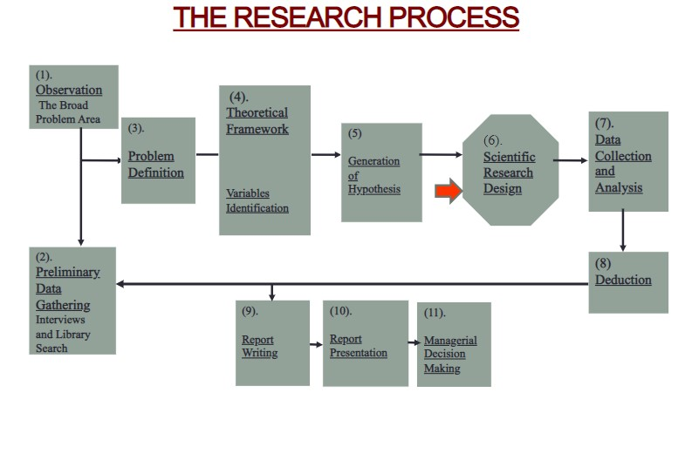

Slide 4
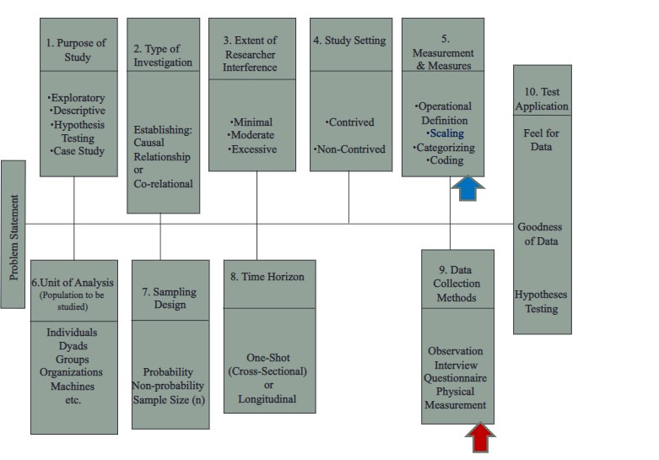

Slide 5
Data Collection Methods
Questionnaires and Questionnaire Design
Interviews
Observations
Physical Measurement

Slide 6
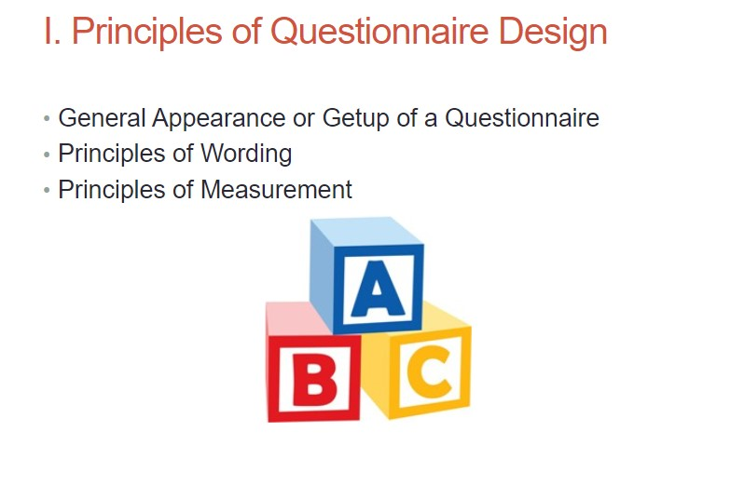

Slide 7
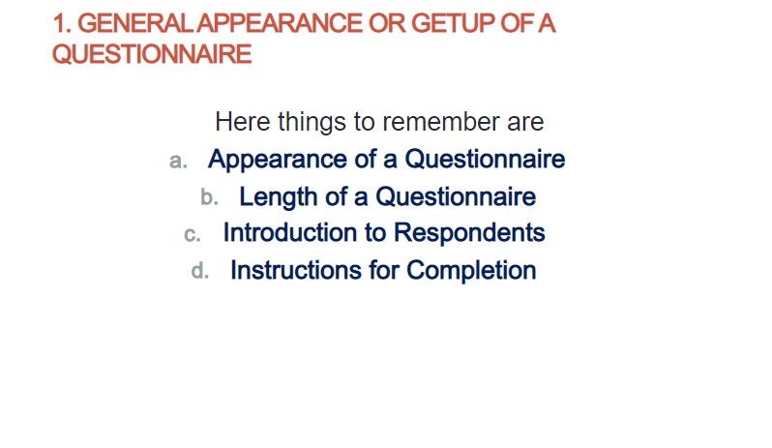

Slide 8
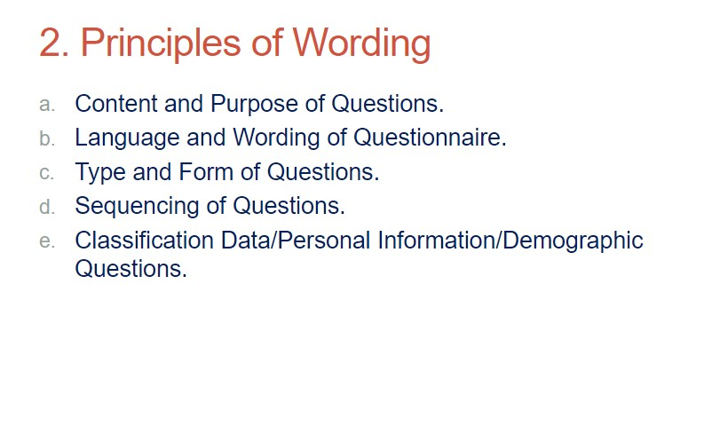

Slide 9
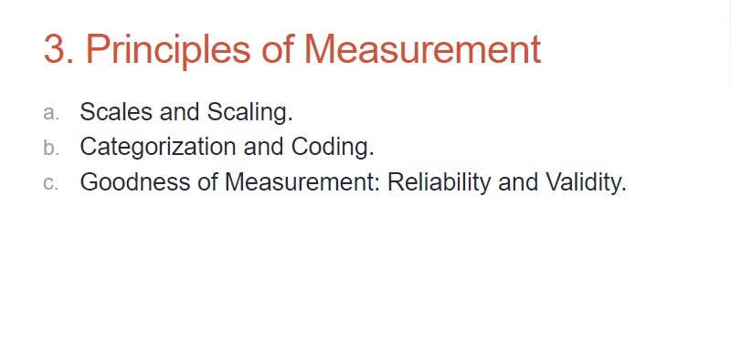

Slide 10
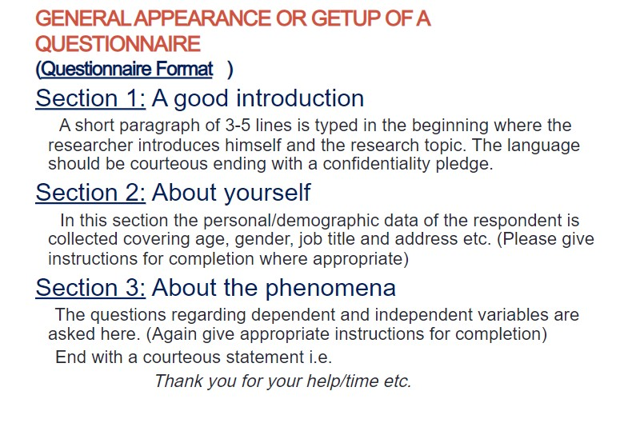

Slide 11
