Slide 1
FIVE METHOD OF PREPARATION OF ALCOHOLS
Presented By
Dr. Debajit Dutta
HOD, Dept. of Chemistry
L.T.K. College, Lakhimpur Assam

Slide 2
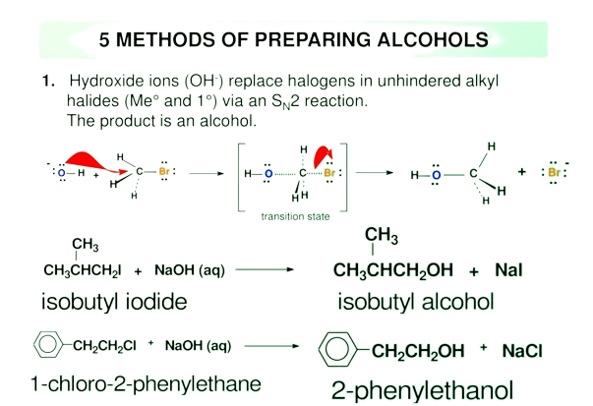

Slide 3
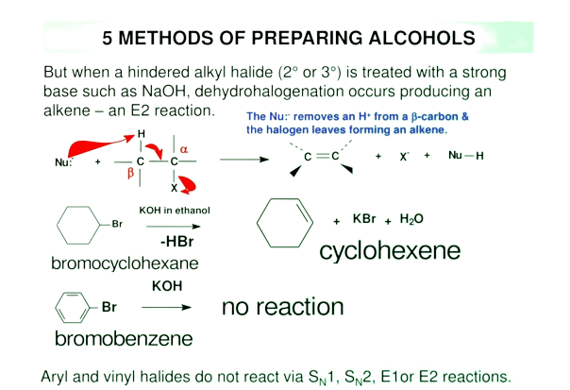

Slide 4
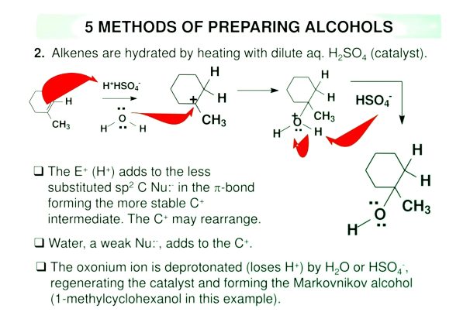

Slide 5
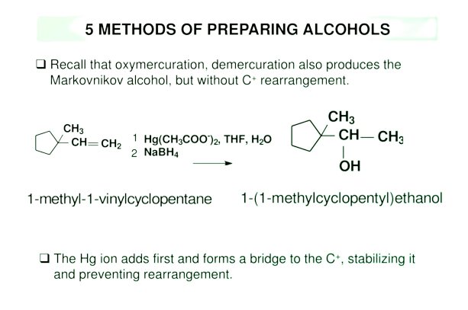

Slide 6
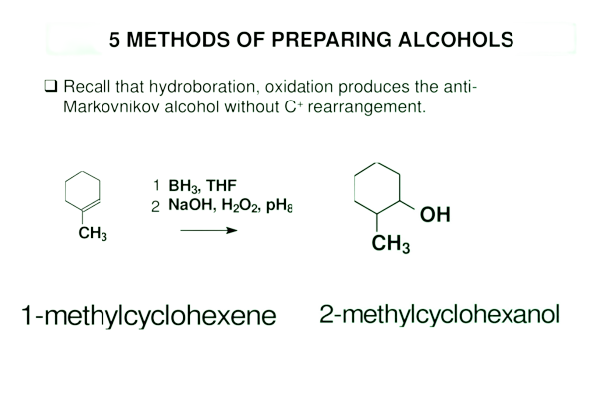

Slide 7
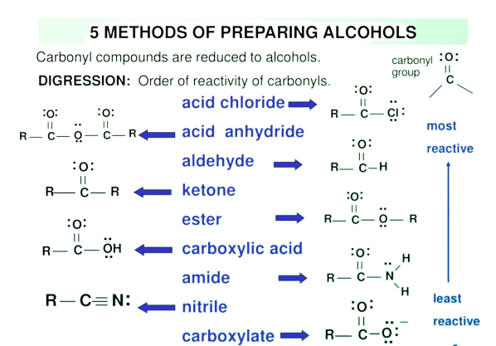

Slide 8
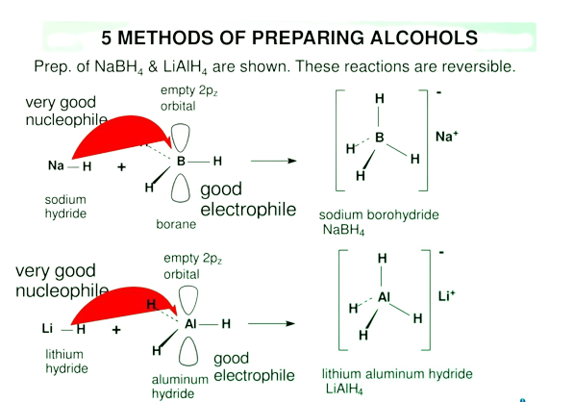

Slide 9
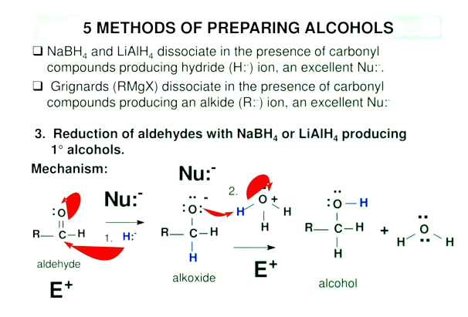

Slide 10
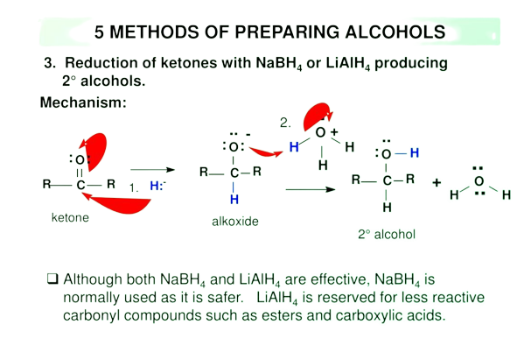

Slide 11
Thank You

