Slide 1
SYLLABUS
FAMILY NUTRITION (501)
DIETETICS AND DIETARY
MANAGMENT (502)
FAMILY RESOURCE MANAGMENT (503)
PRACTICAL (504)

Slide 2


FAMILY NUTRITION (501)
Dr. Swapna Dutta
HoD, Dept. of Home Science

Slide 3
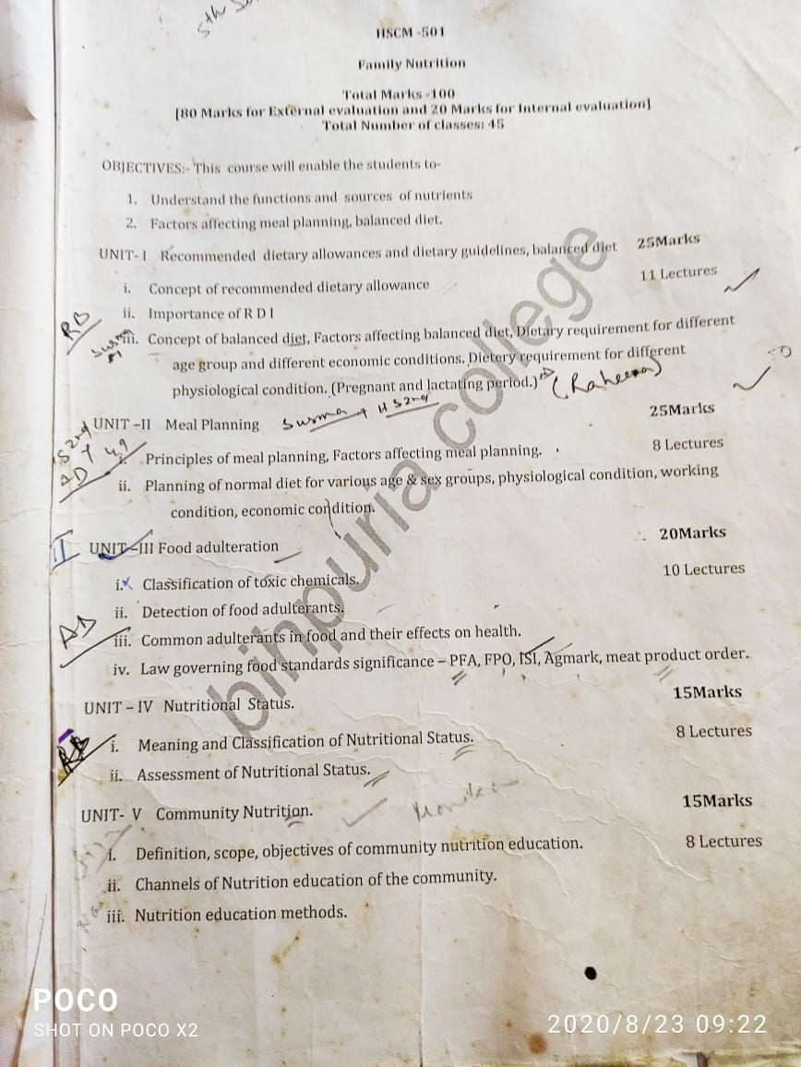

Slide 5
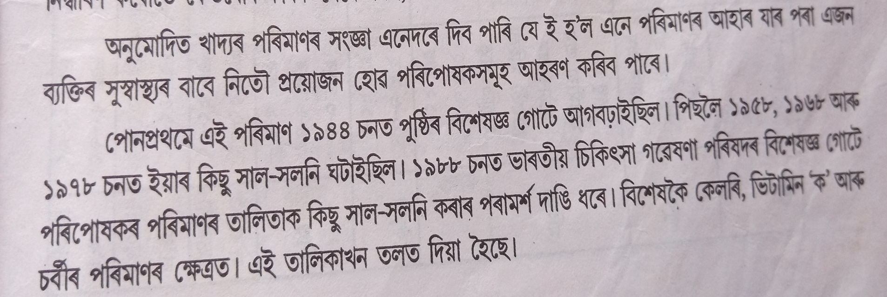
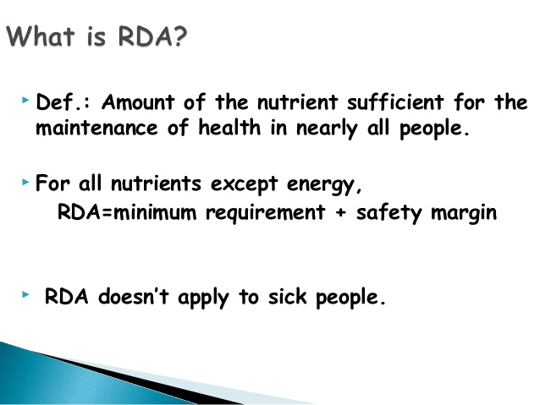

CONCEPT OF RECOMENDED DIETARY ALLOWANCES

Slide 6
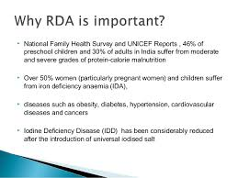
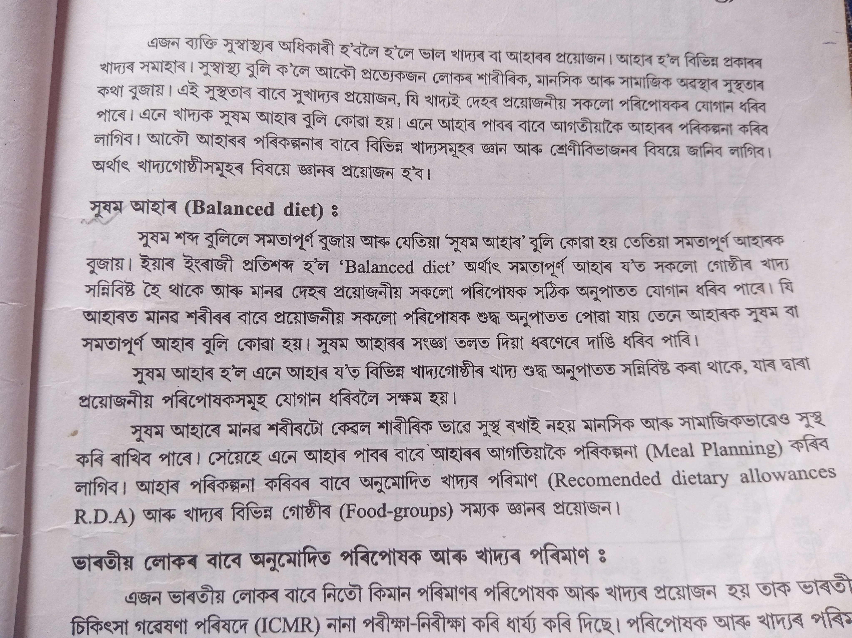
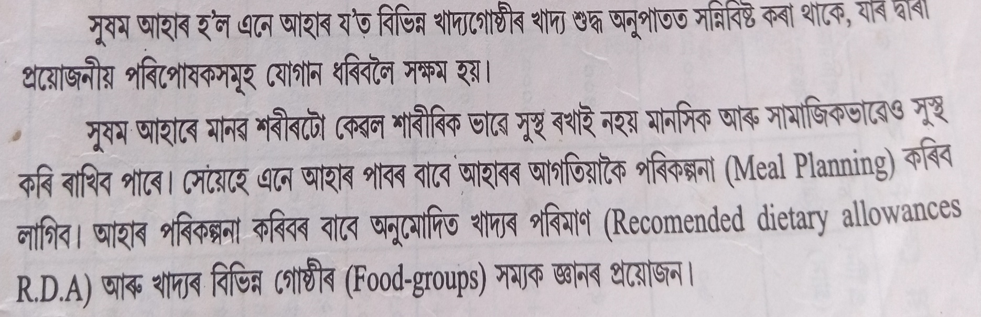
Importance of
RDA

Slide 7
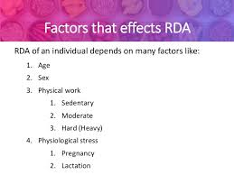
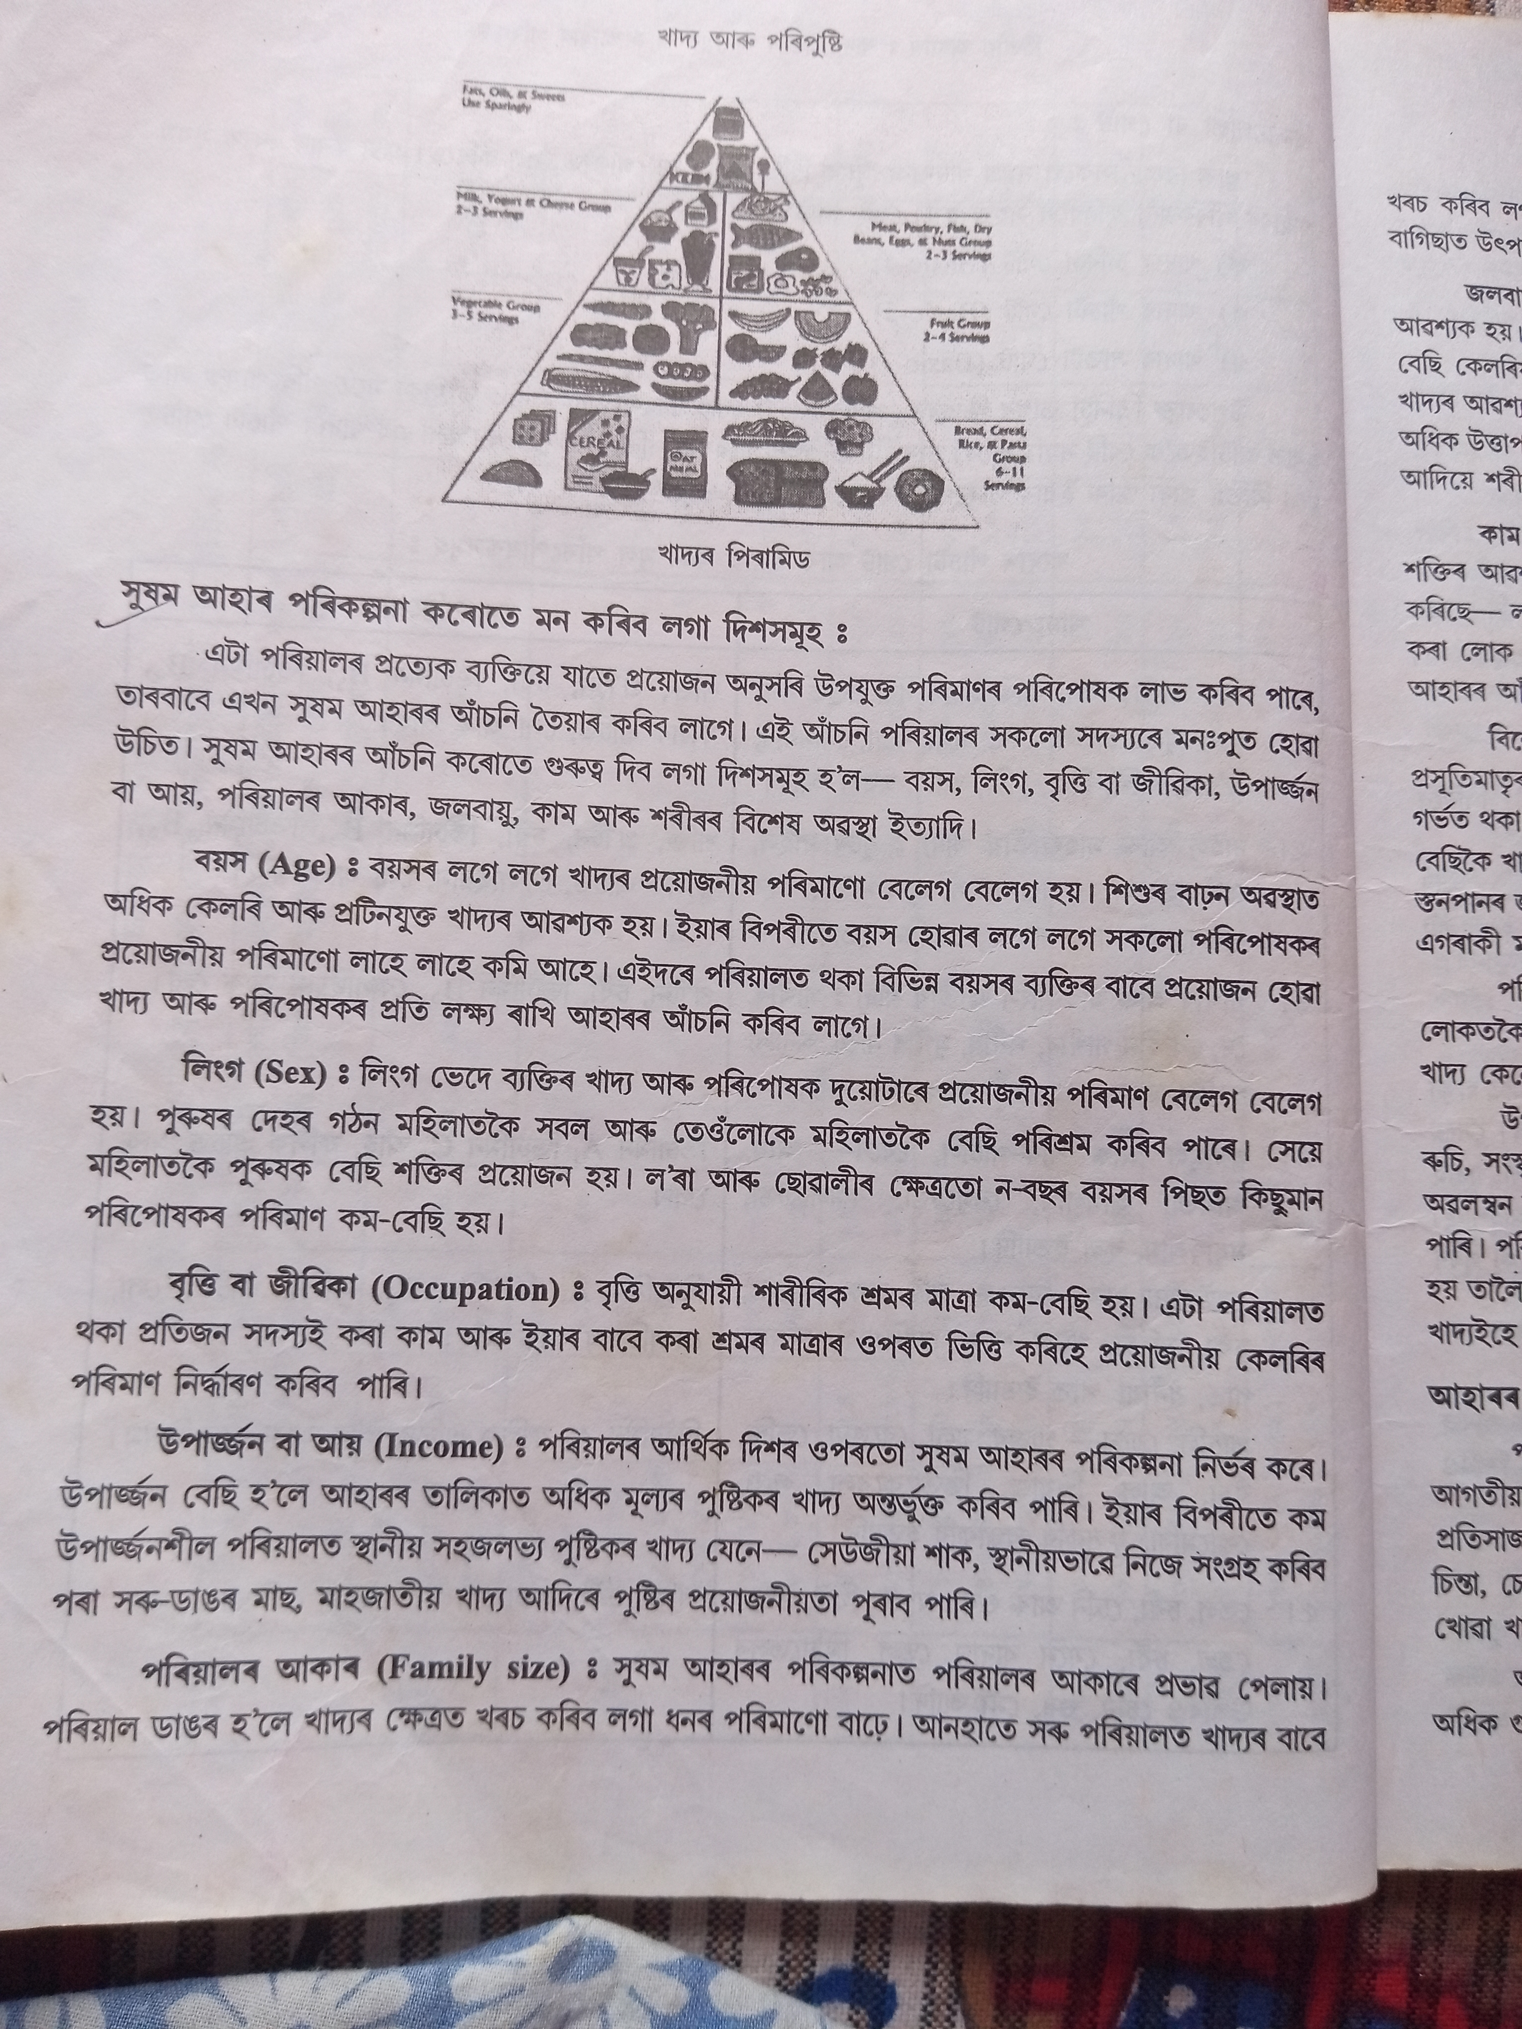

Slide 8

BALANCED DIET

Slide 9
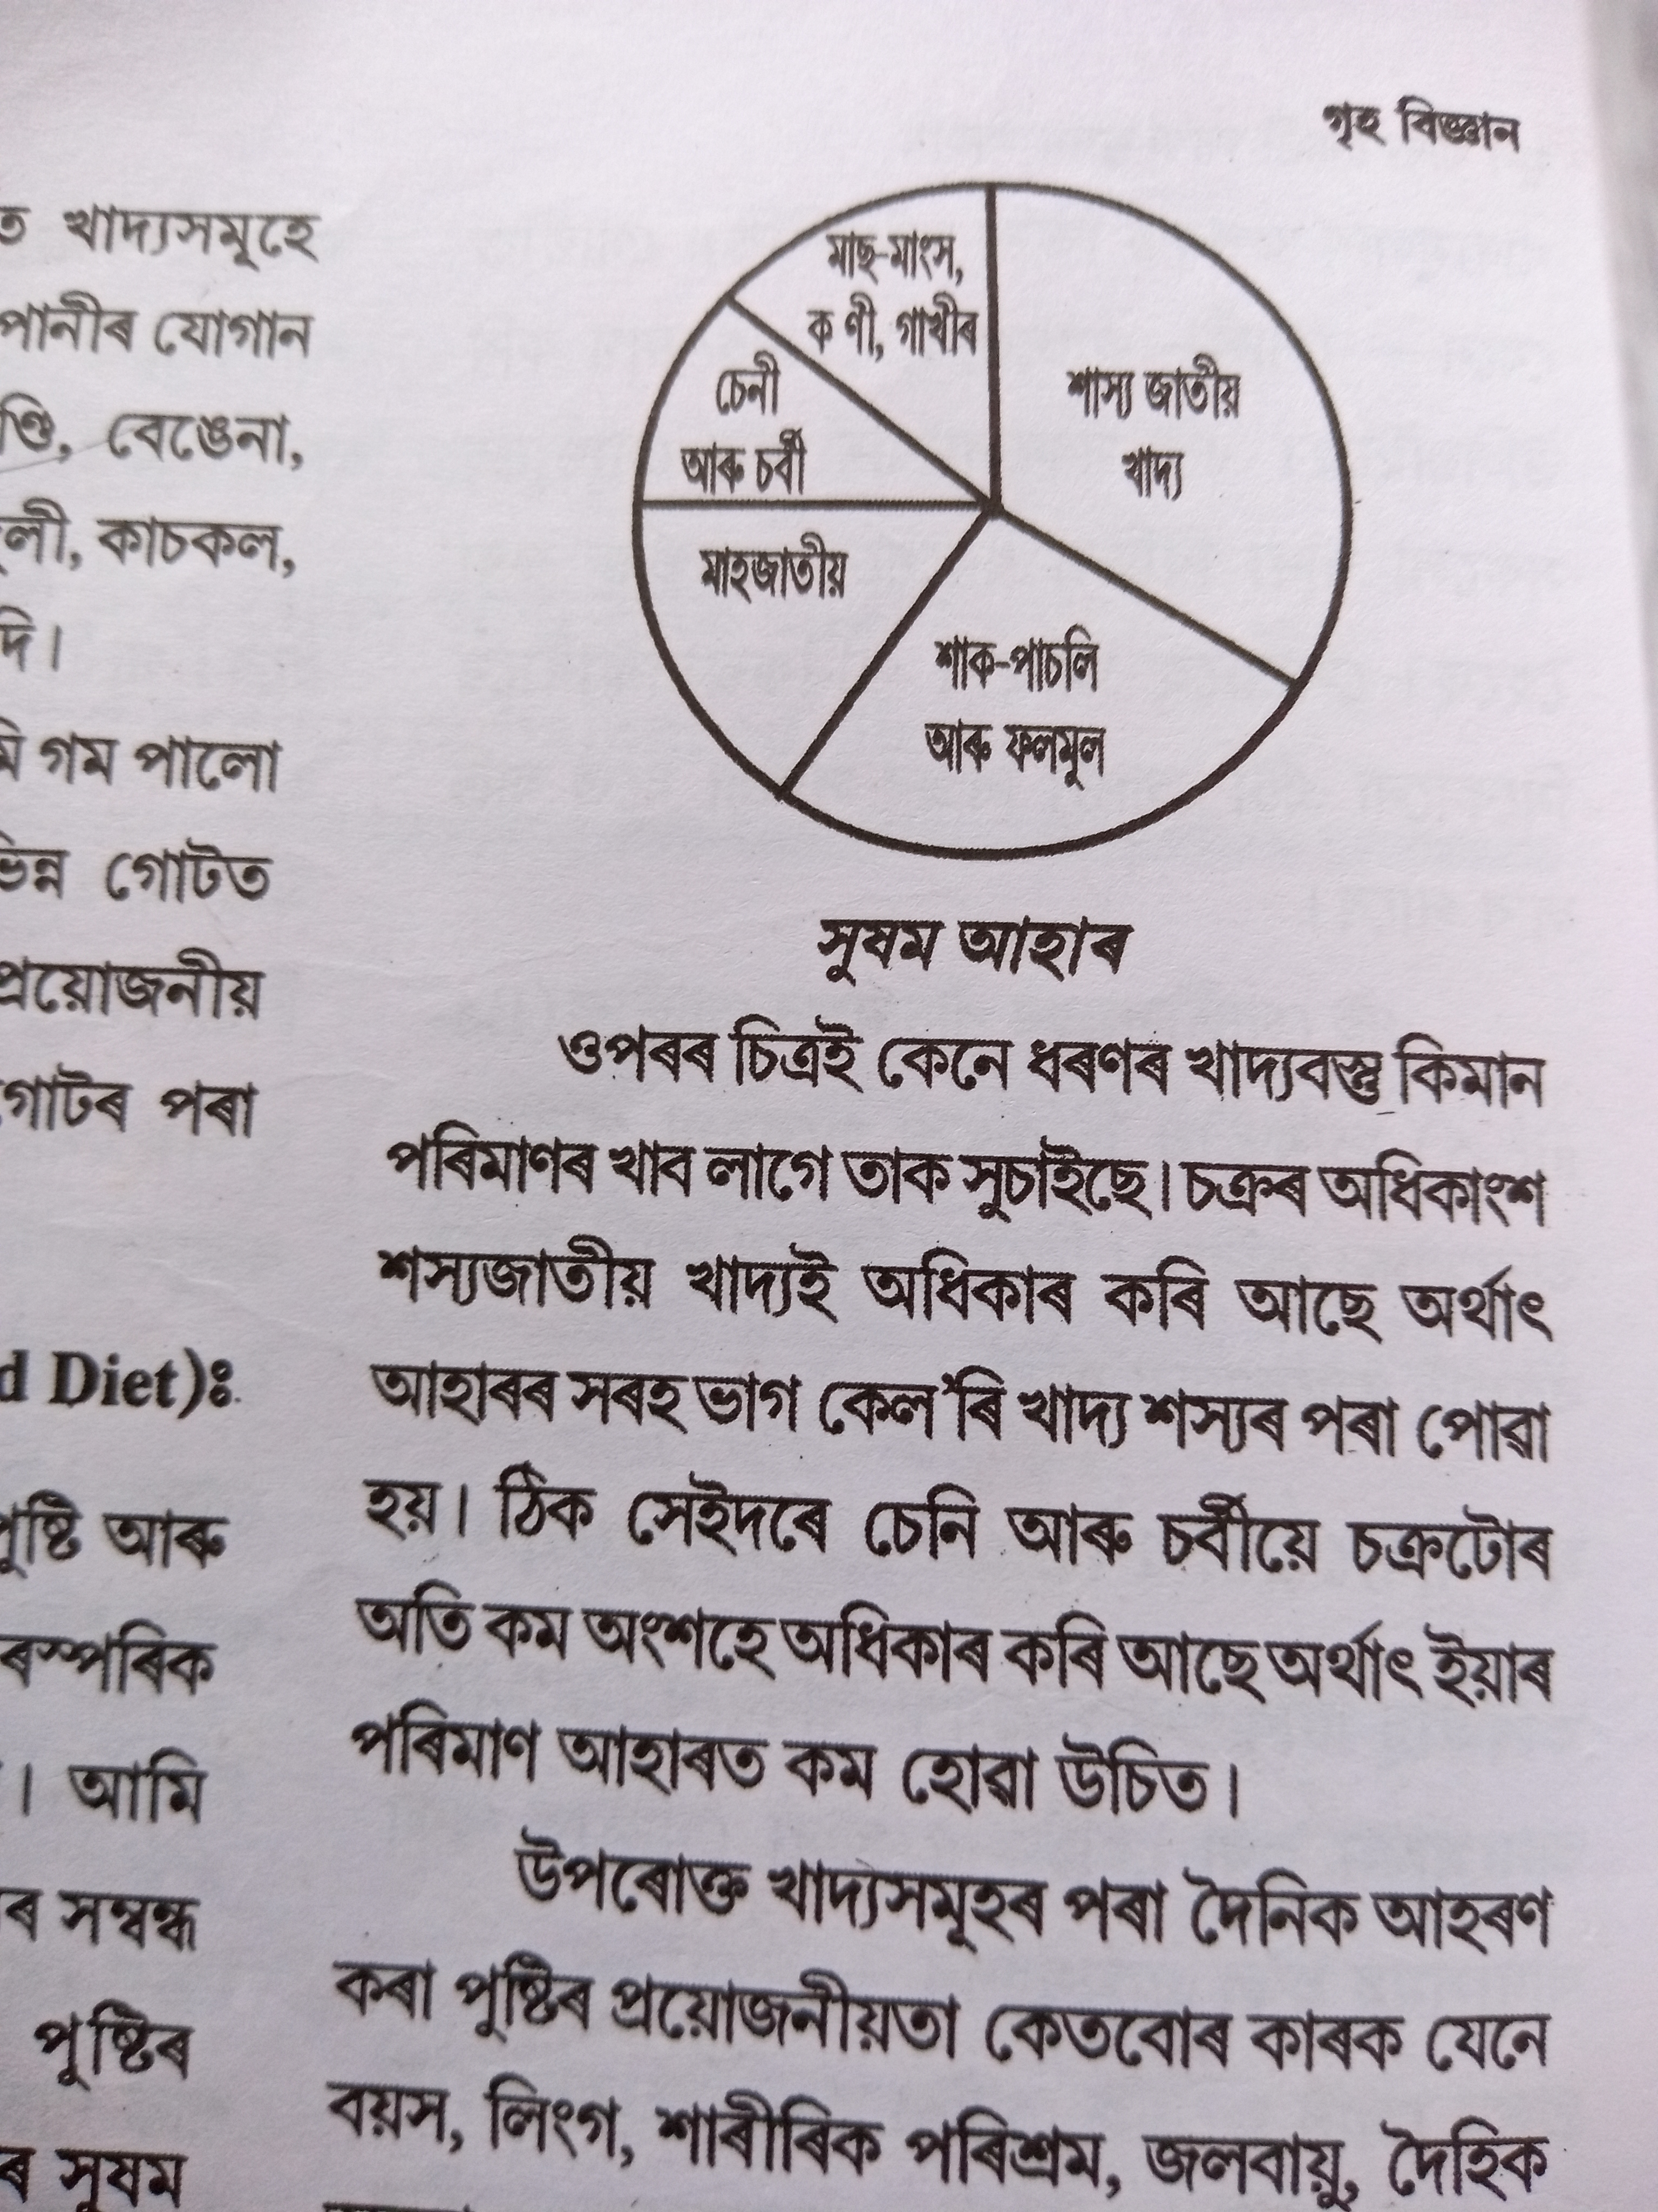

Slide 10
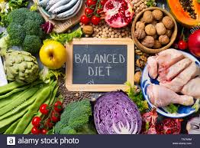

Slide 11
FACTORS AFFECTING BALANCED DIET

Slide 13
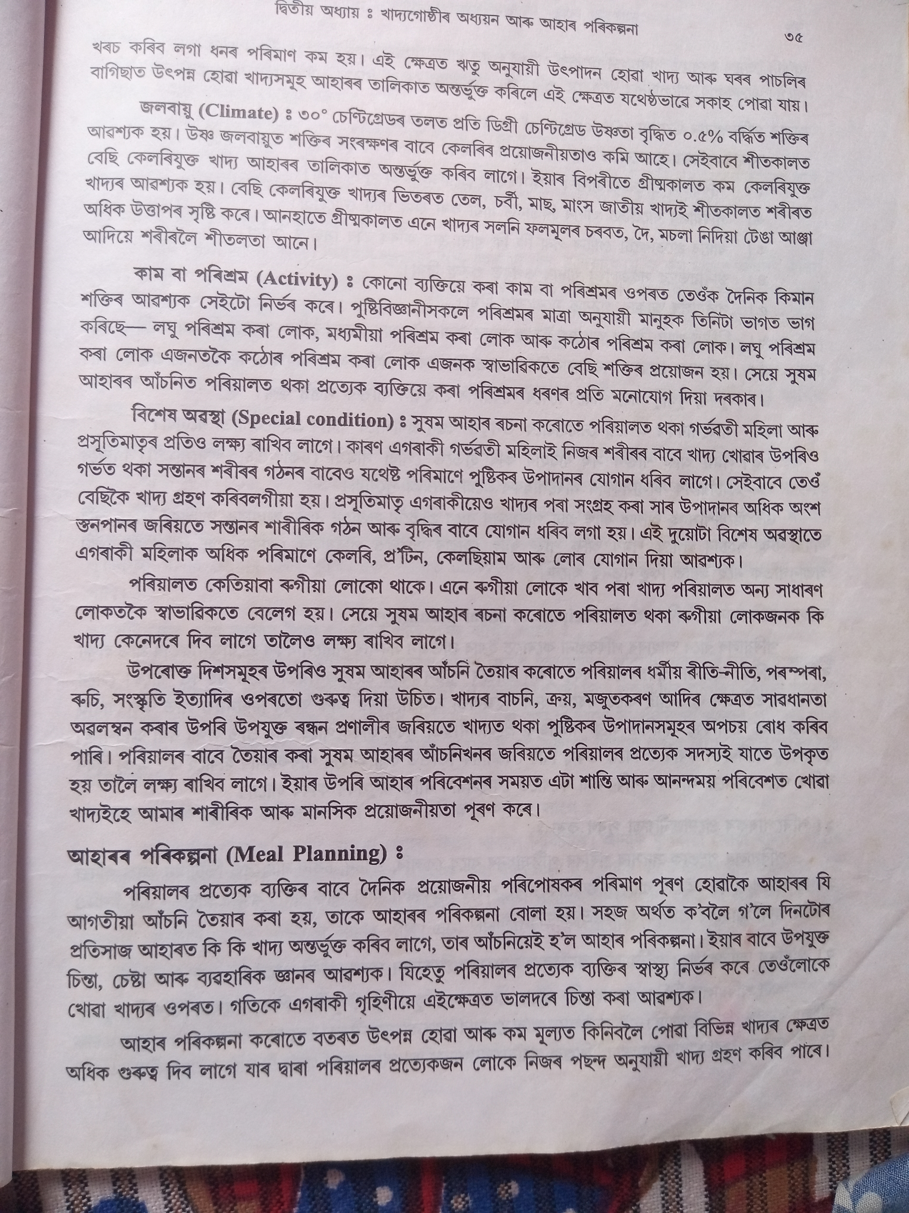

Slide 16
Questions
What is RDA?
Why RDA is Important?
What are the factors affecting RDA?
What is Balance Diet?
What are the factors affecting Balance Diet? Explain Briefly.

Slide 17
THANK YOU

