Slide 1

FACTORS AFFECTING MEAL PLANNING
Dr. Swapna Dutta
HoD, Dept. of Home Science

Slide 2
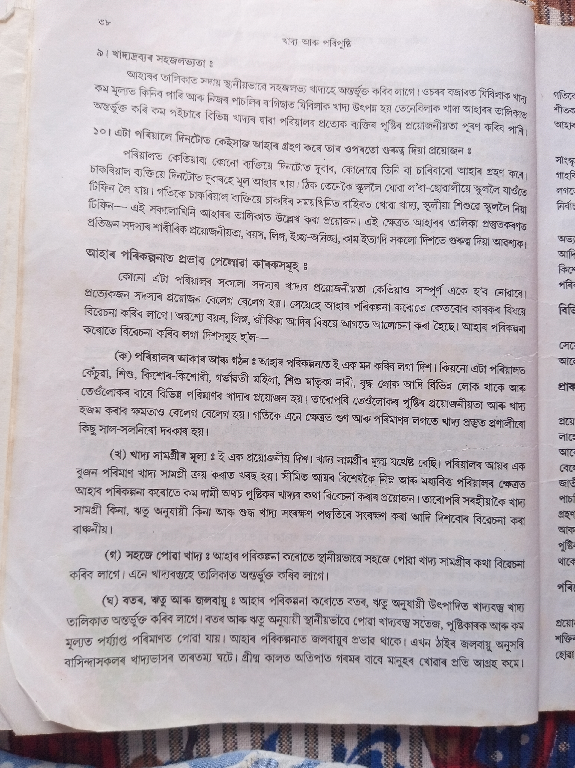
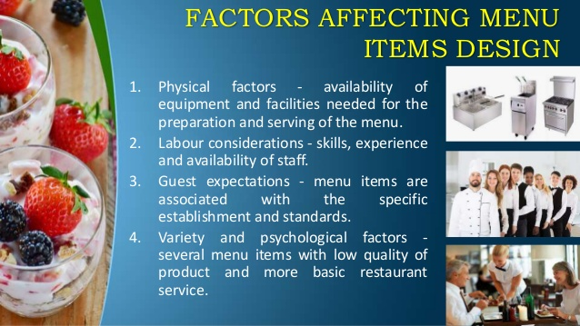

Slide 3
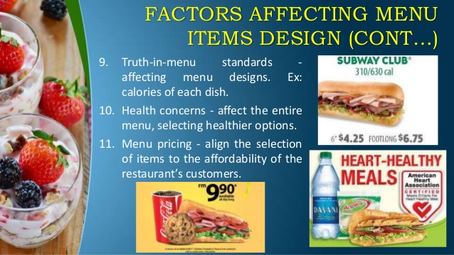

Slide 4
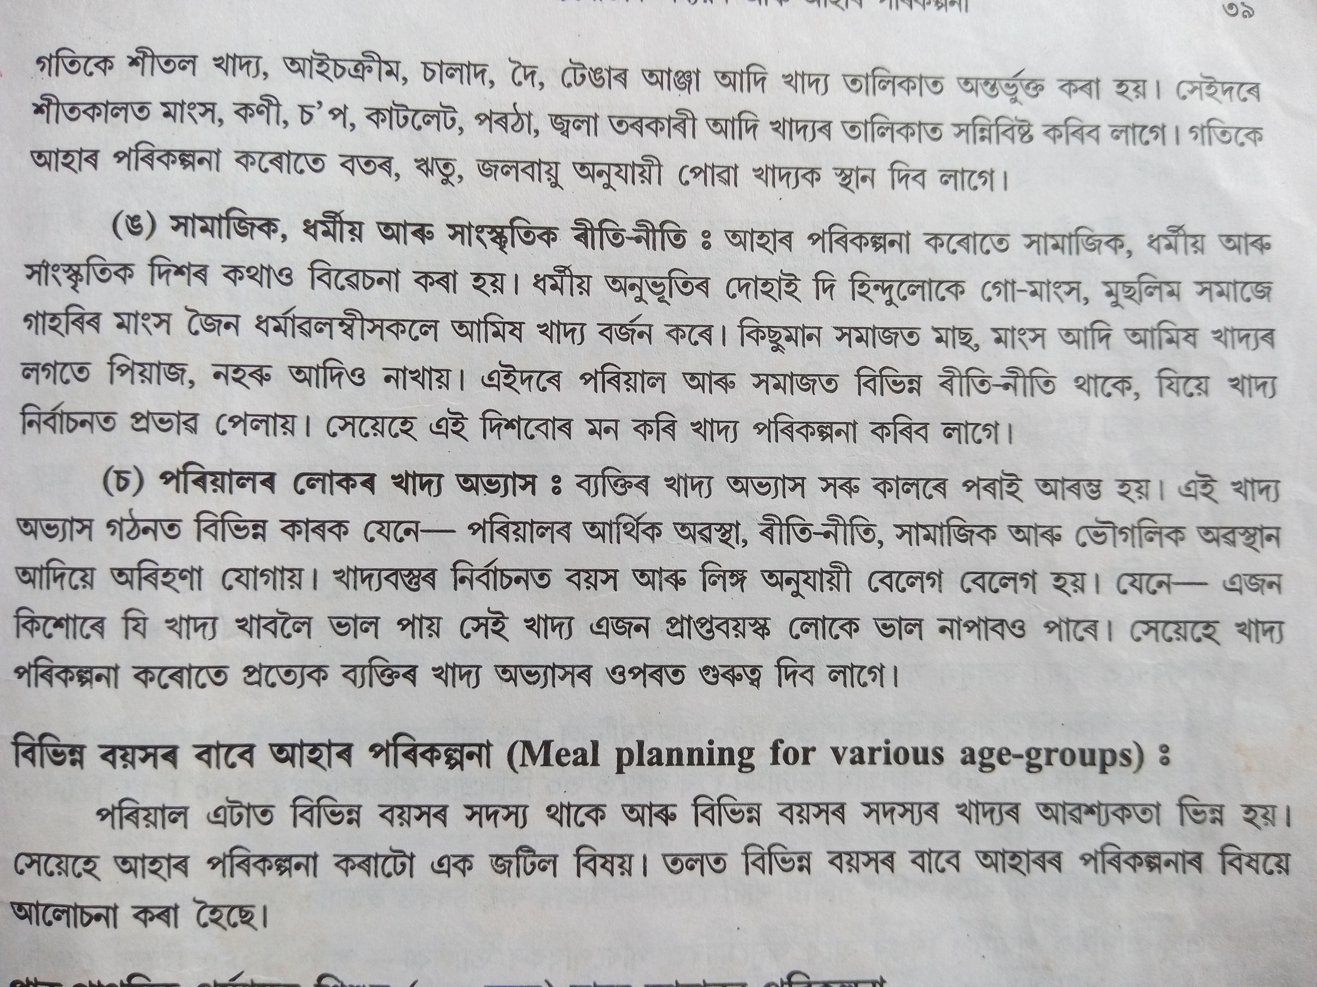

Slide 7
QUESTIONS
What are the factors affecting in meal planning. Discuss with example.

Slide 8
Thank You

