Slide 1

Dr. Swapna Dutta
Dept. of Home Science

Slide 2
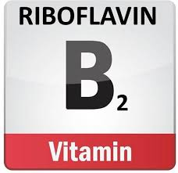


Slide 3
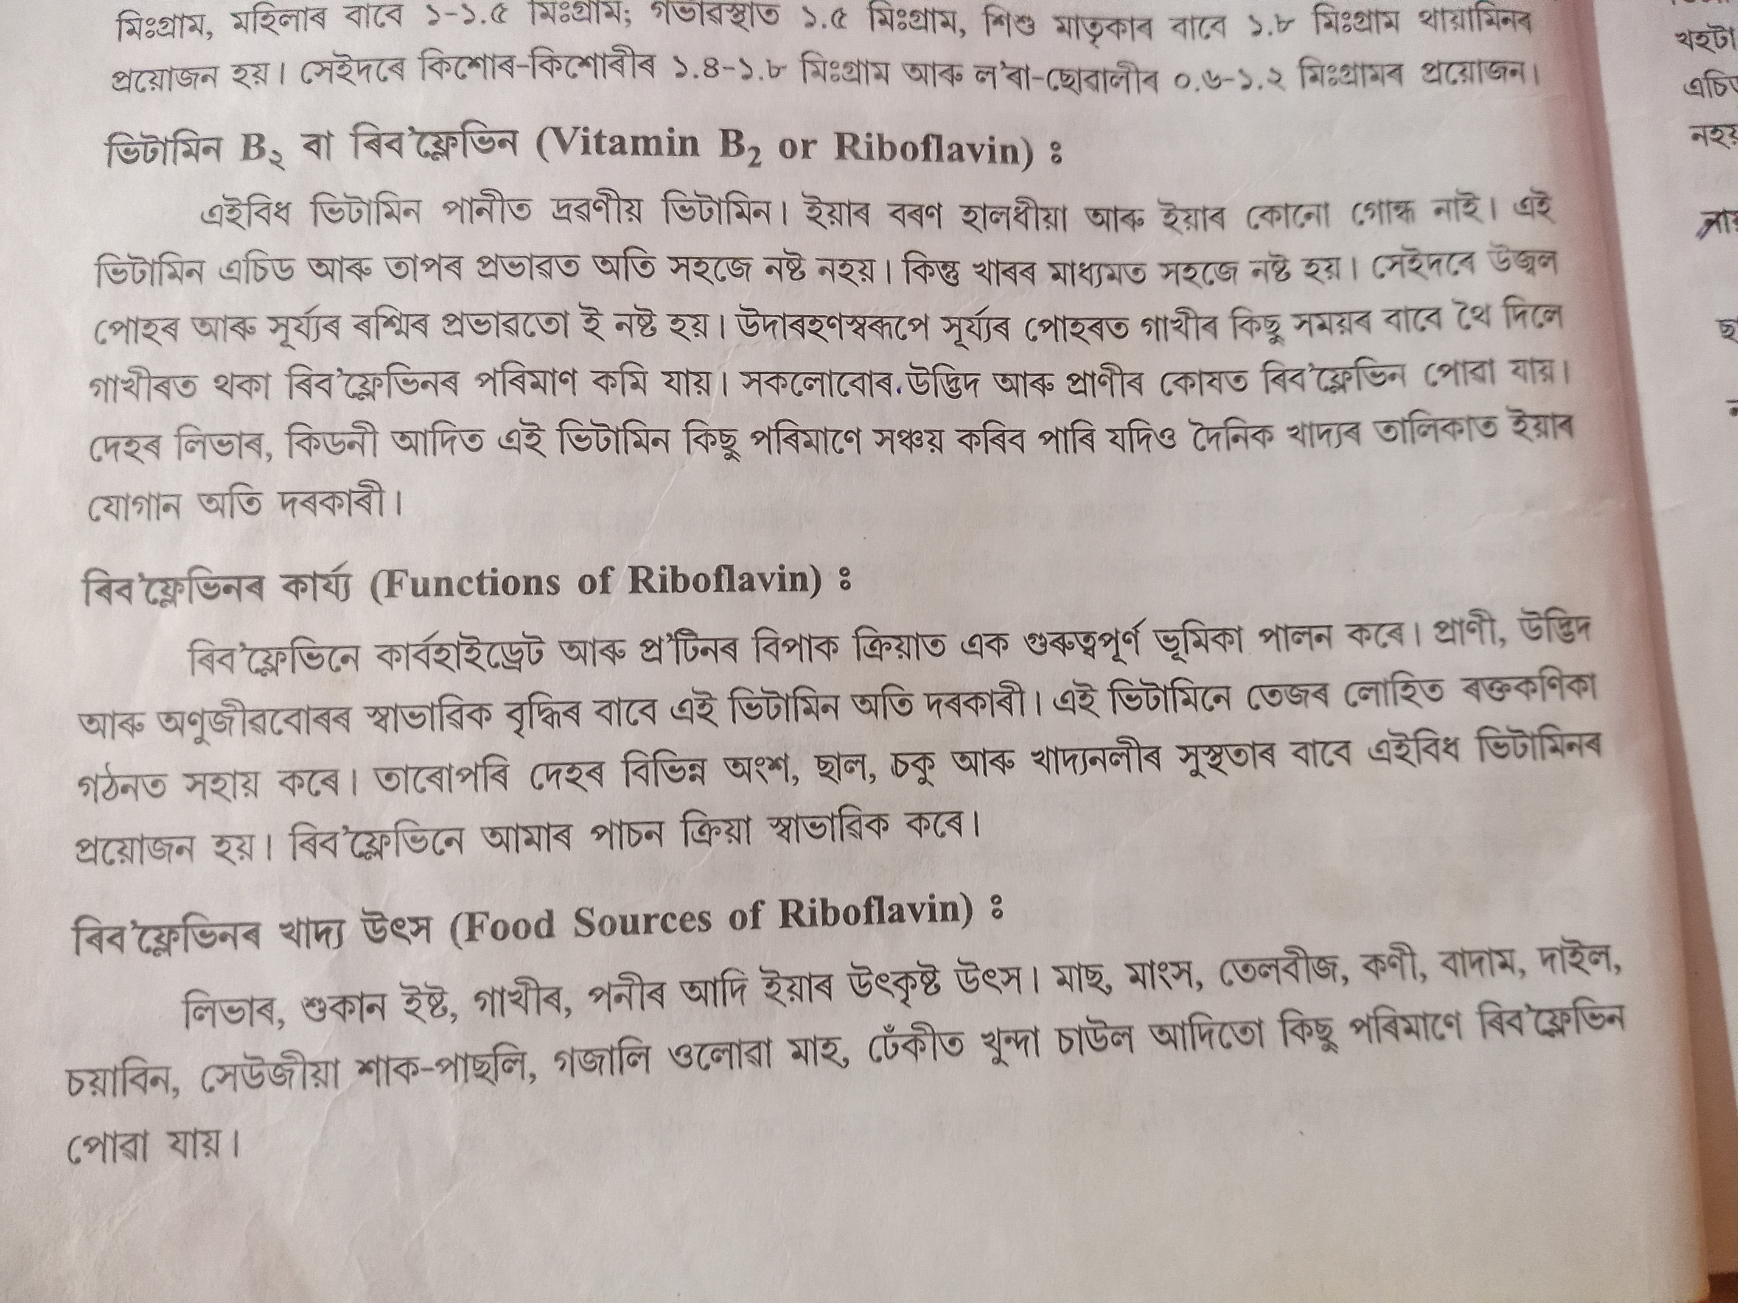

Slide 5

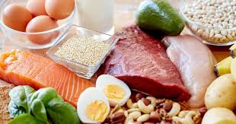

Slide 6
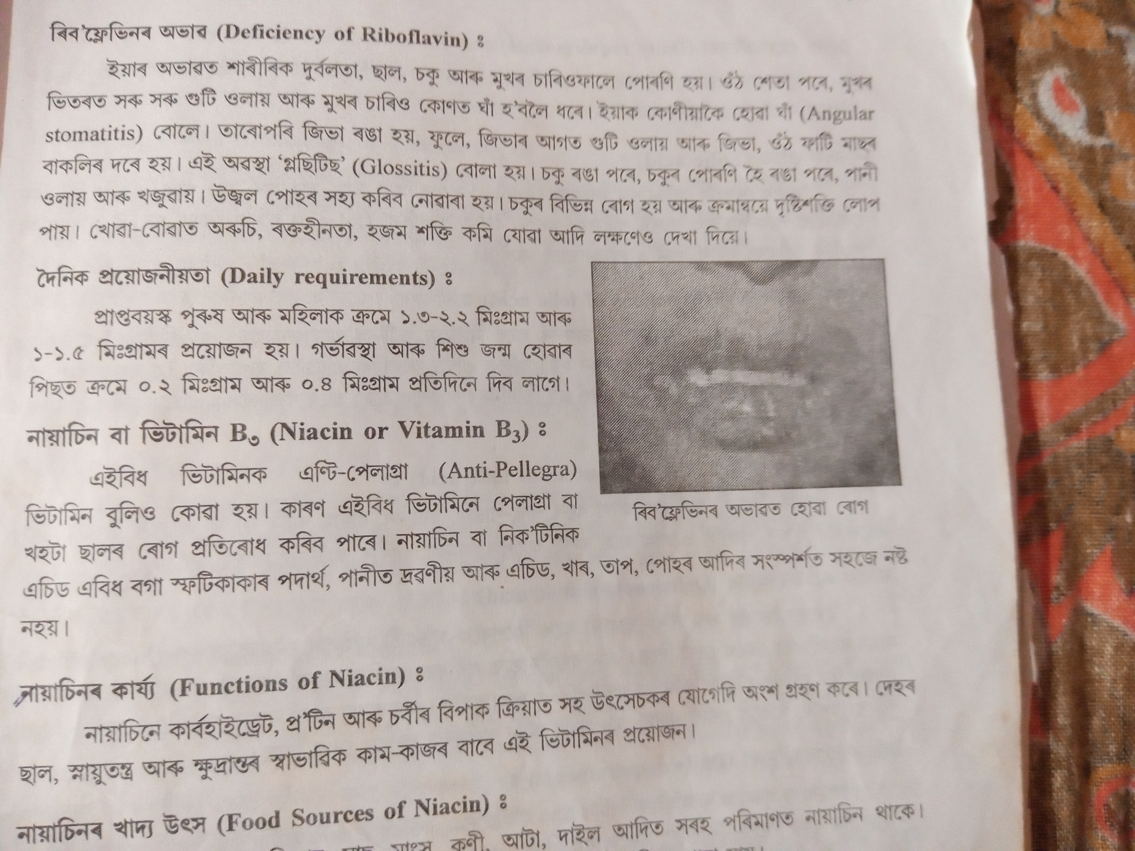
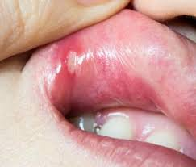
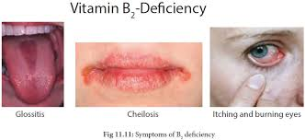
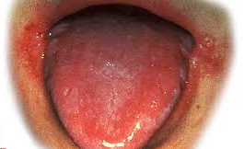

Slide 8


Slide 9
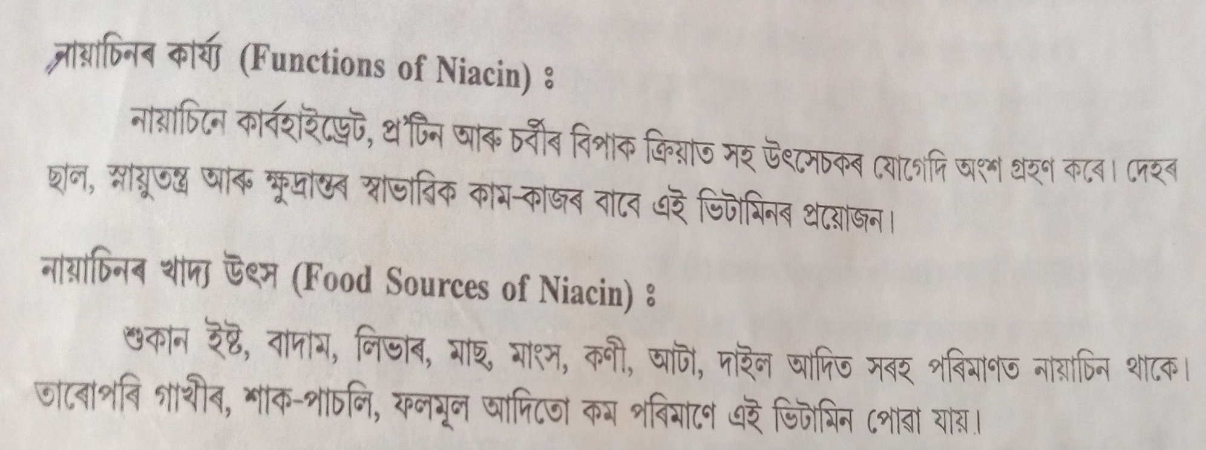
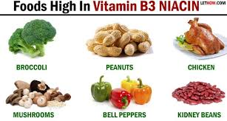

Slide 10
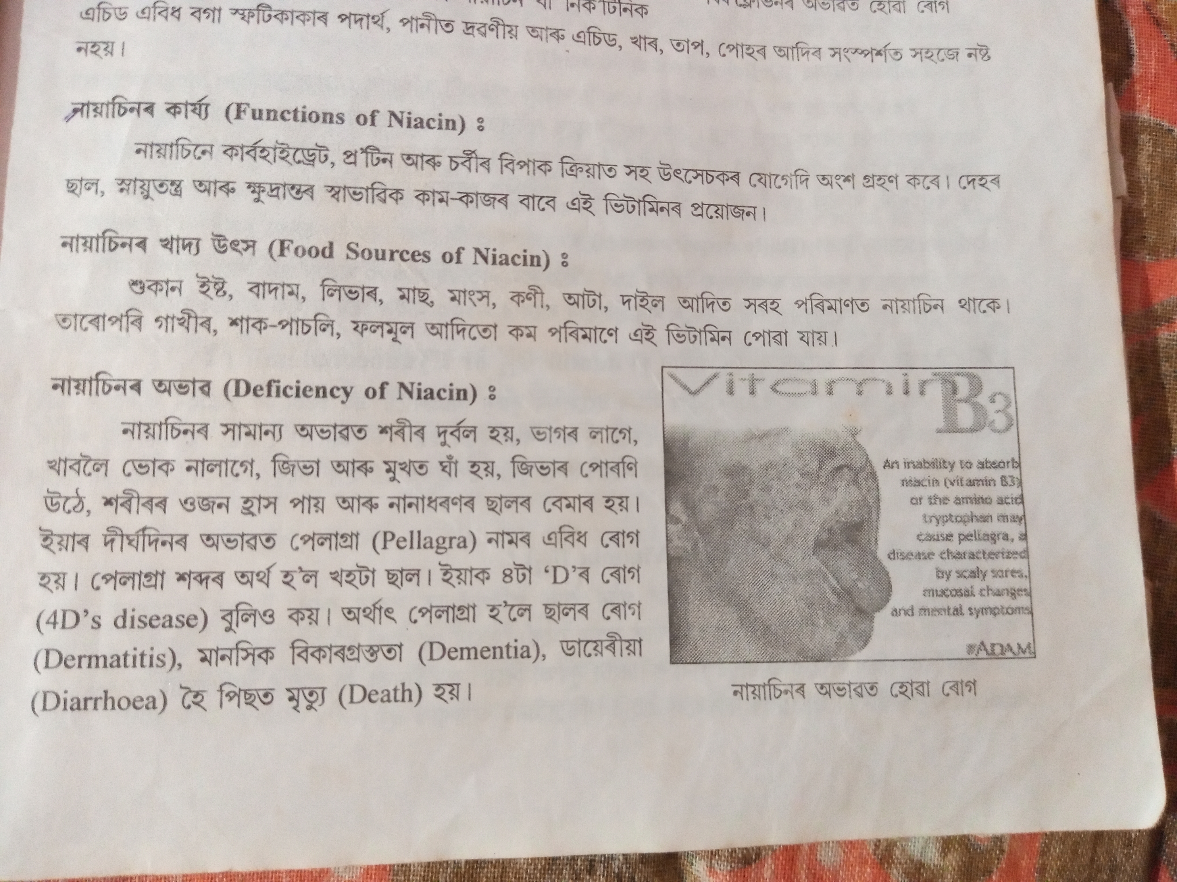

Slide 11


Slide 12
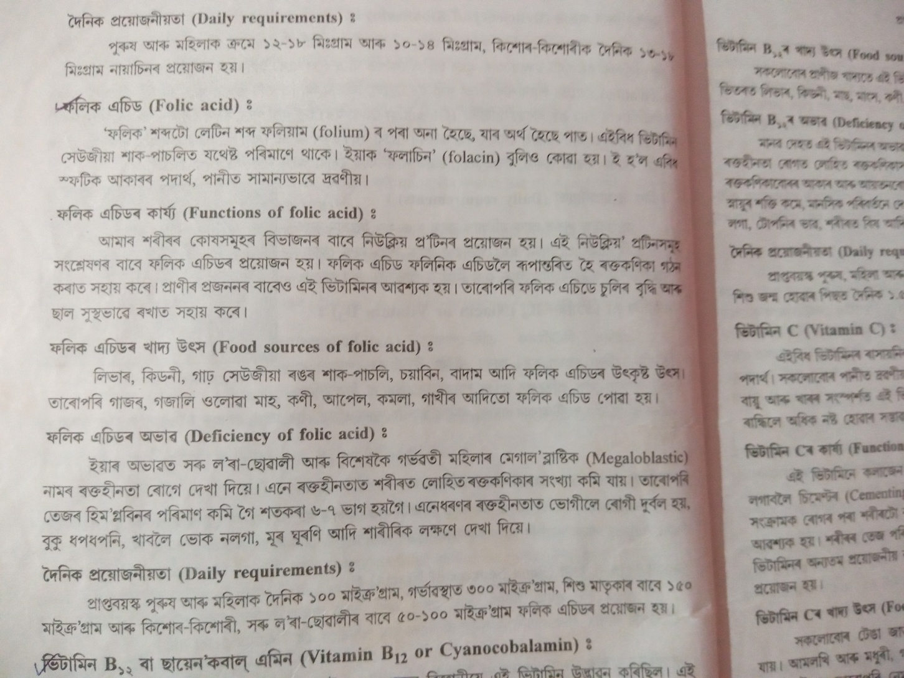
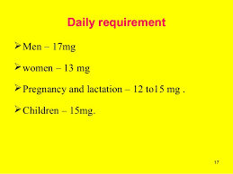

Slide 13
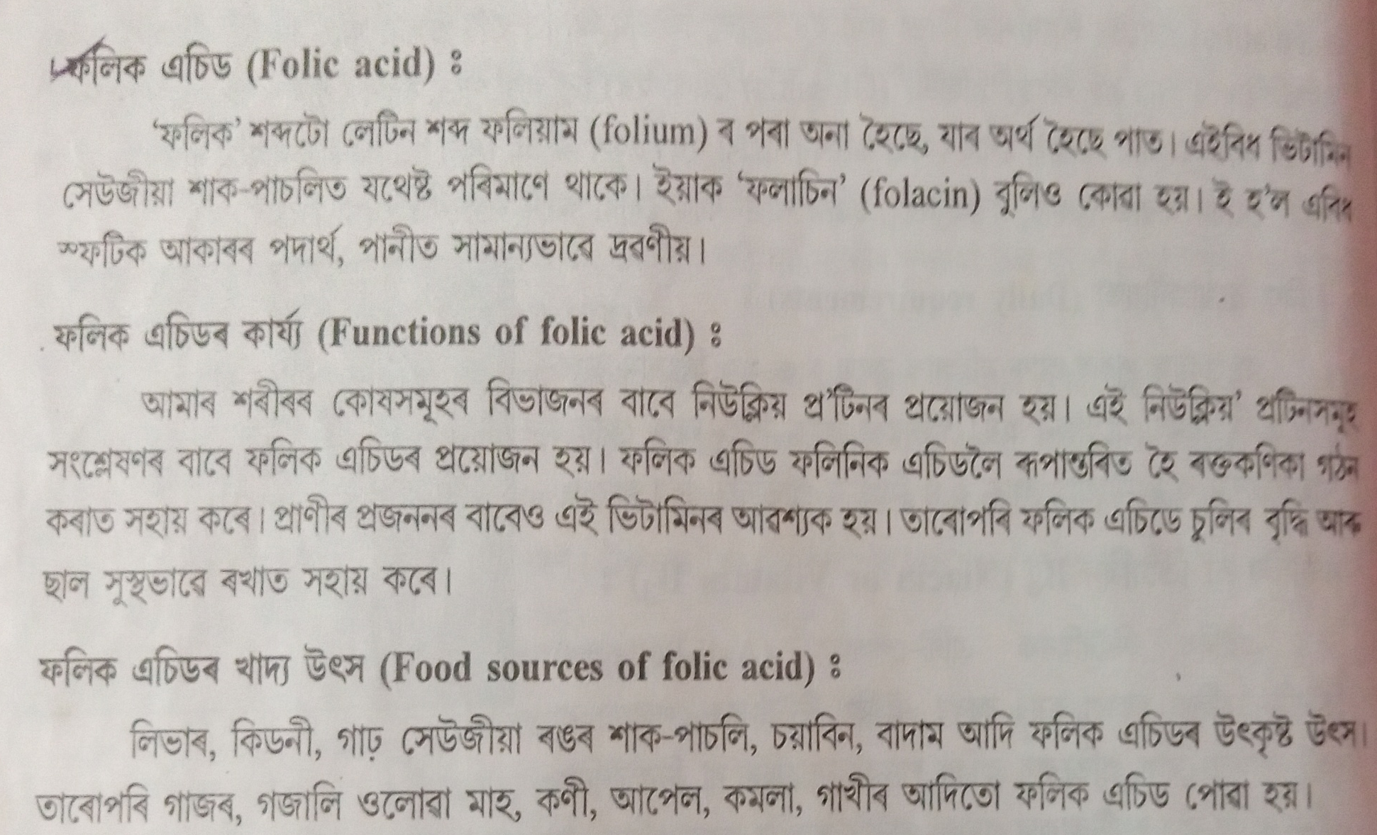
Folic Acid

Slide 14


Slide 15
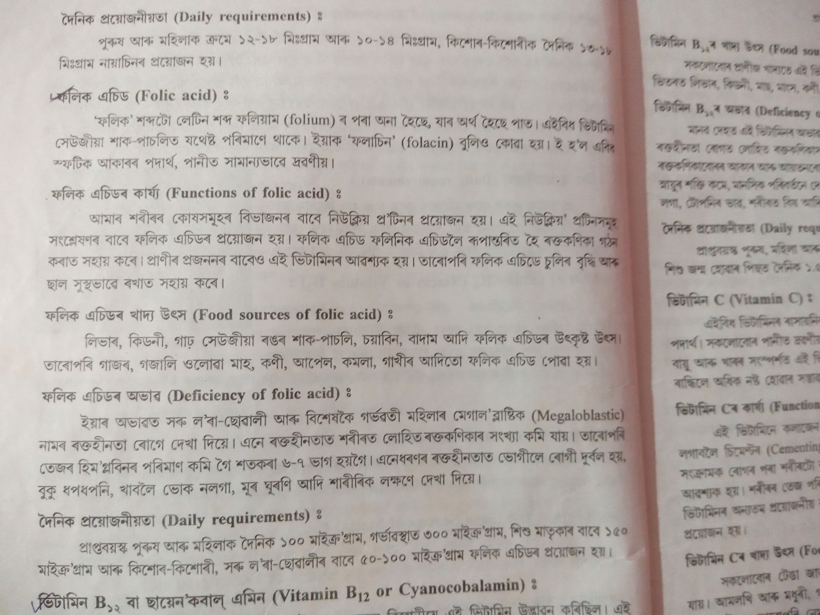

Slide 16
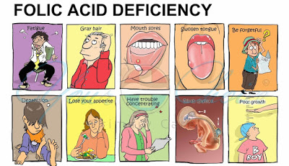

Slide 17
QUESTIONS
Write short answers:
Define nutrition.
Write two types of food that protects our body from diseases.
Write the deficiency diseases of Vit A
What do you mean by simple protein?
Write the food sources of Vitamin C.
Define food.

Slide 18
Write short answer
How you classify the nutrition
Classify food. Explain it.
Write the food sources of carbohydrate, protein, and fats.
How you classify protein.
What do mean by essential fatty acid. Give example.
Write the functions of fats
7. Explain the deficiency diseases of protein.
8. Classify Vitamin. Discuss the role of Vitamin A in your body.

Slide 19
Thank you

