Slide 1
Home Science (Honours)
Core- 2 (Theory)
Course Title: FOOD AND NUTRITION
Dr. Swapna Dutta
HoD, Dept. of Home Science

Slide 2
Unit I:
Basic concepts in food and nutrition
Basic terms used in study of food and nutrition
Understanding relationship between food, nutrition and health
Functions of food-Physiological, psychological and social

Slide 3
Unit II: Nutrients
Functions, Dietary Sources and clinical manifestations of deficiency/ excess of the following nutrients:
Energy, Carbohydrates, lipids and proteins
Fat soluble vitamins-A, D, E and K
Water soluble vitamins – thiamin, riboflavin, niacin, pyridoxine, folate, vitamin B12 and vitamin C
Minerals – calcium, iron, zinc and iodine

Slide 4
Unit III: Methods of cooking
Dry, moist, frying and microwave cooking
Advantages, disadvantages and the effect of various methods of cooking on foods

Slide 5
Unit IV: Food Groups
Structure, composition, Products, nutritional contribution, selection and changes during cooking of the following food groups:
Cereals
Pulses
Fruits and vegetables
Milk & milk products
Eggs
Meat, poultry and fish
Fats and Oils
Spices and herbs
Beverages

Slide 6
Unit V: Nutrient losses in cooking and enhancing the nutritional quality of foods
Supplementation, Germination, Fermentation, Fortification and GM foods

Slide 7
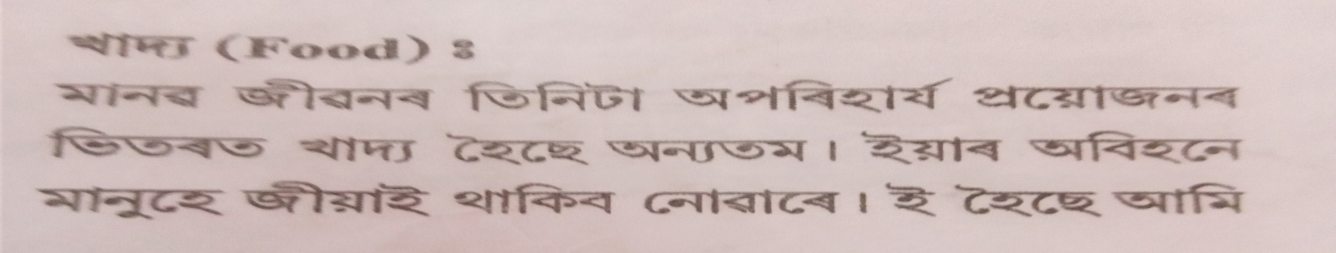
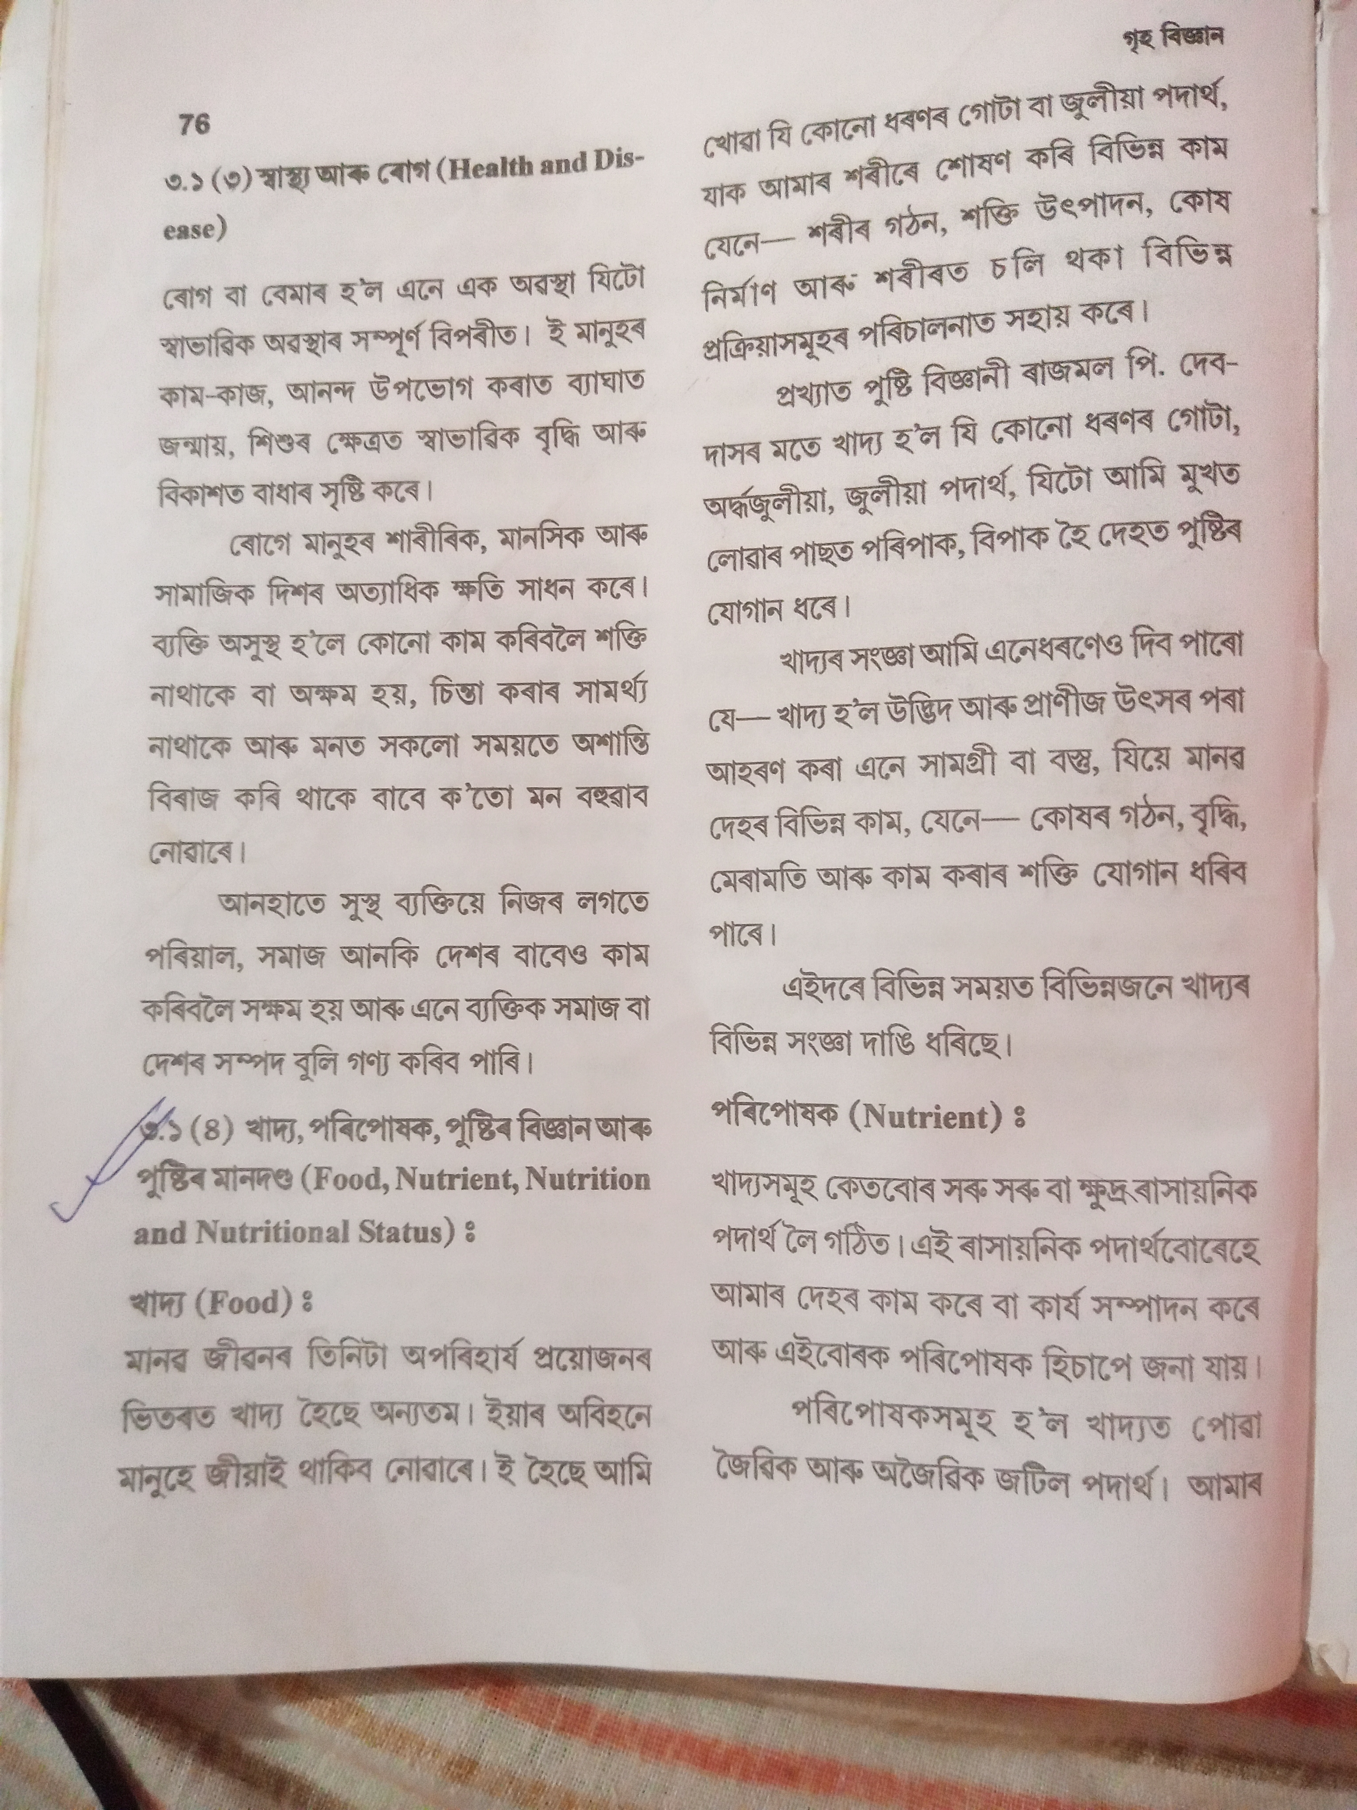
Basic terms used in study of food and nutrition

Slide 9
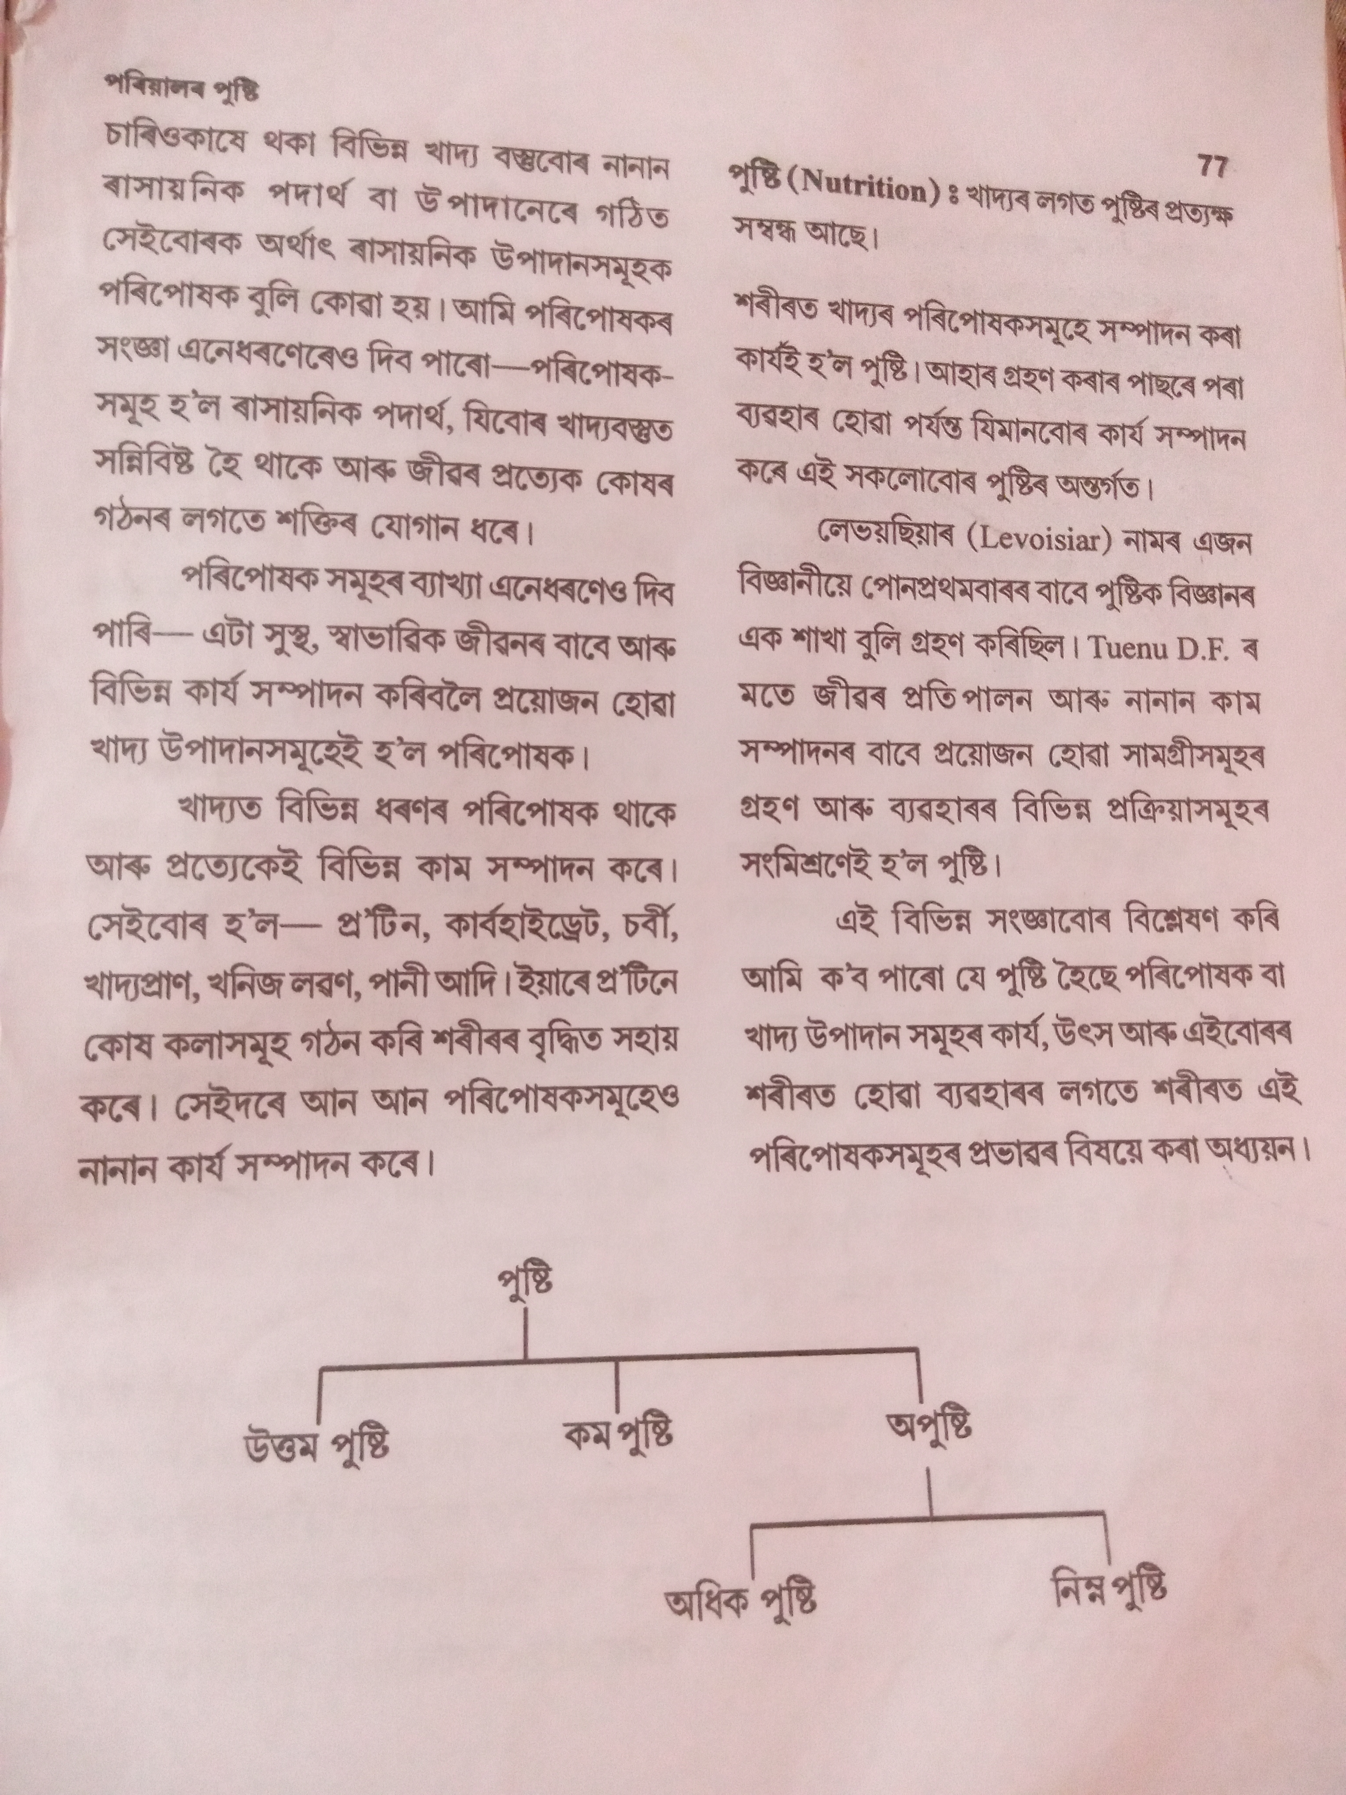

Slide 10
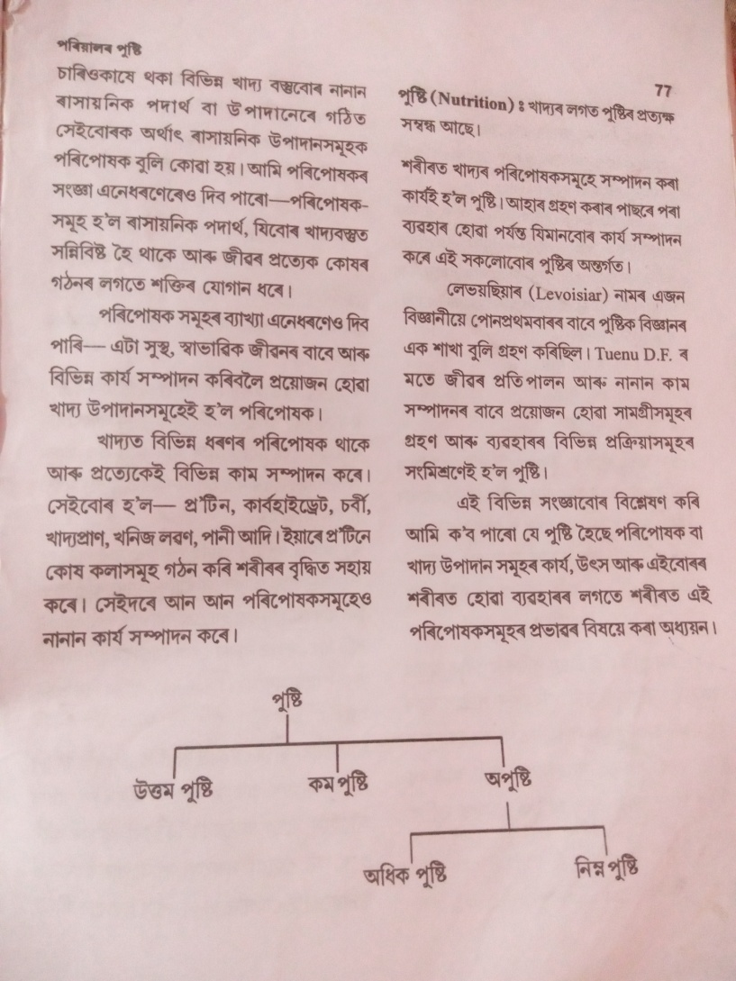

Slide 11
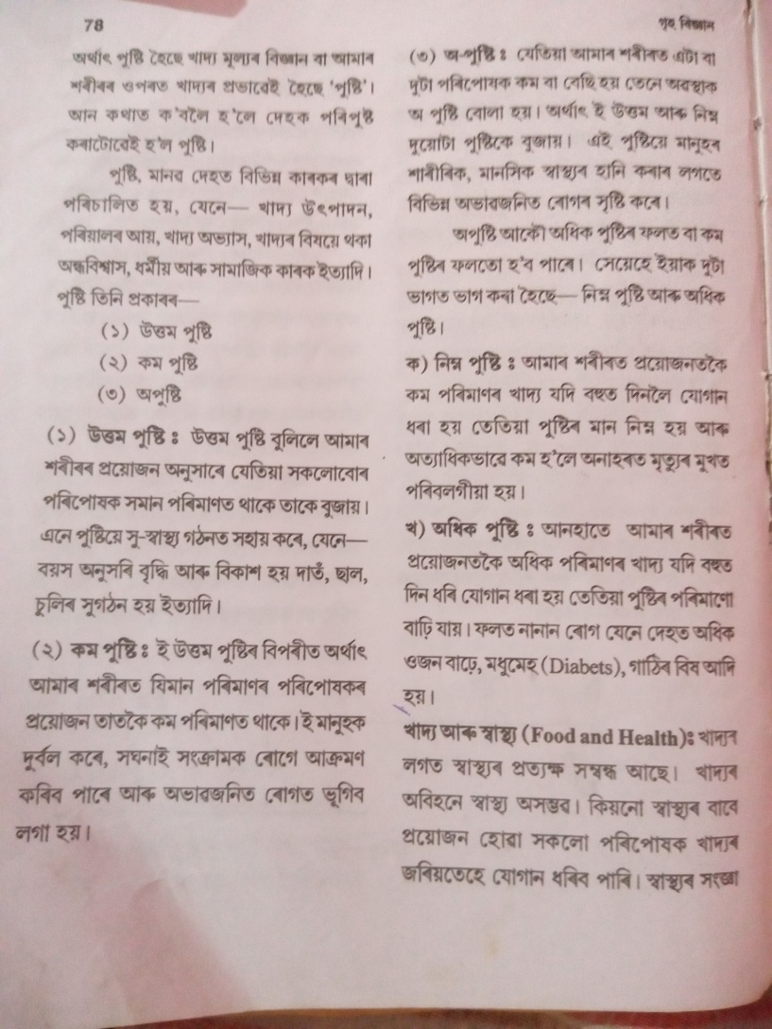
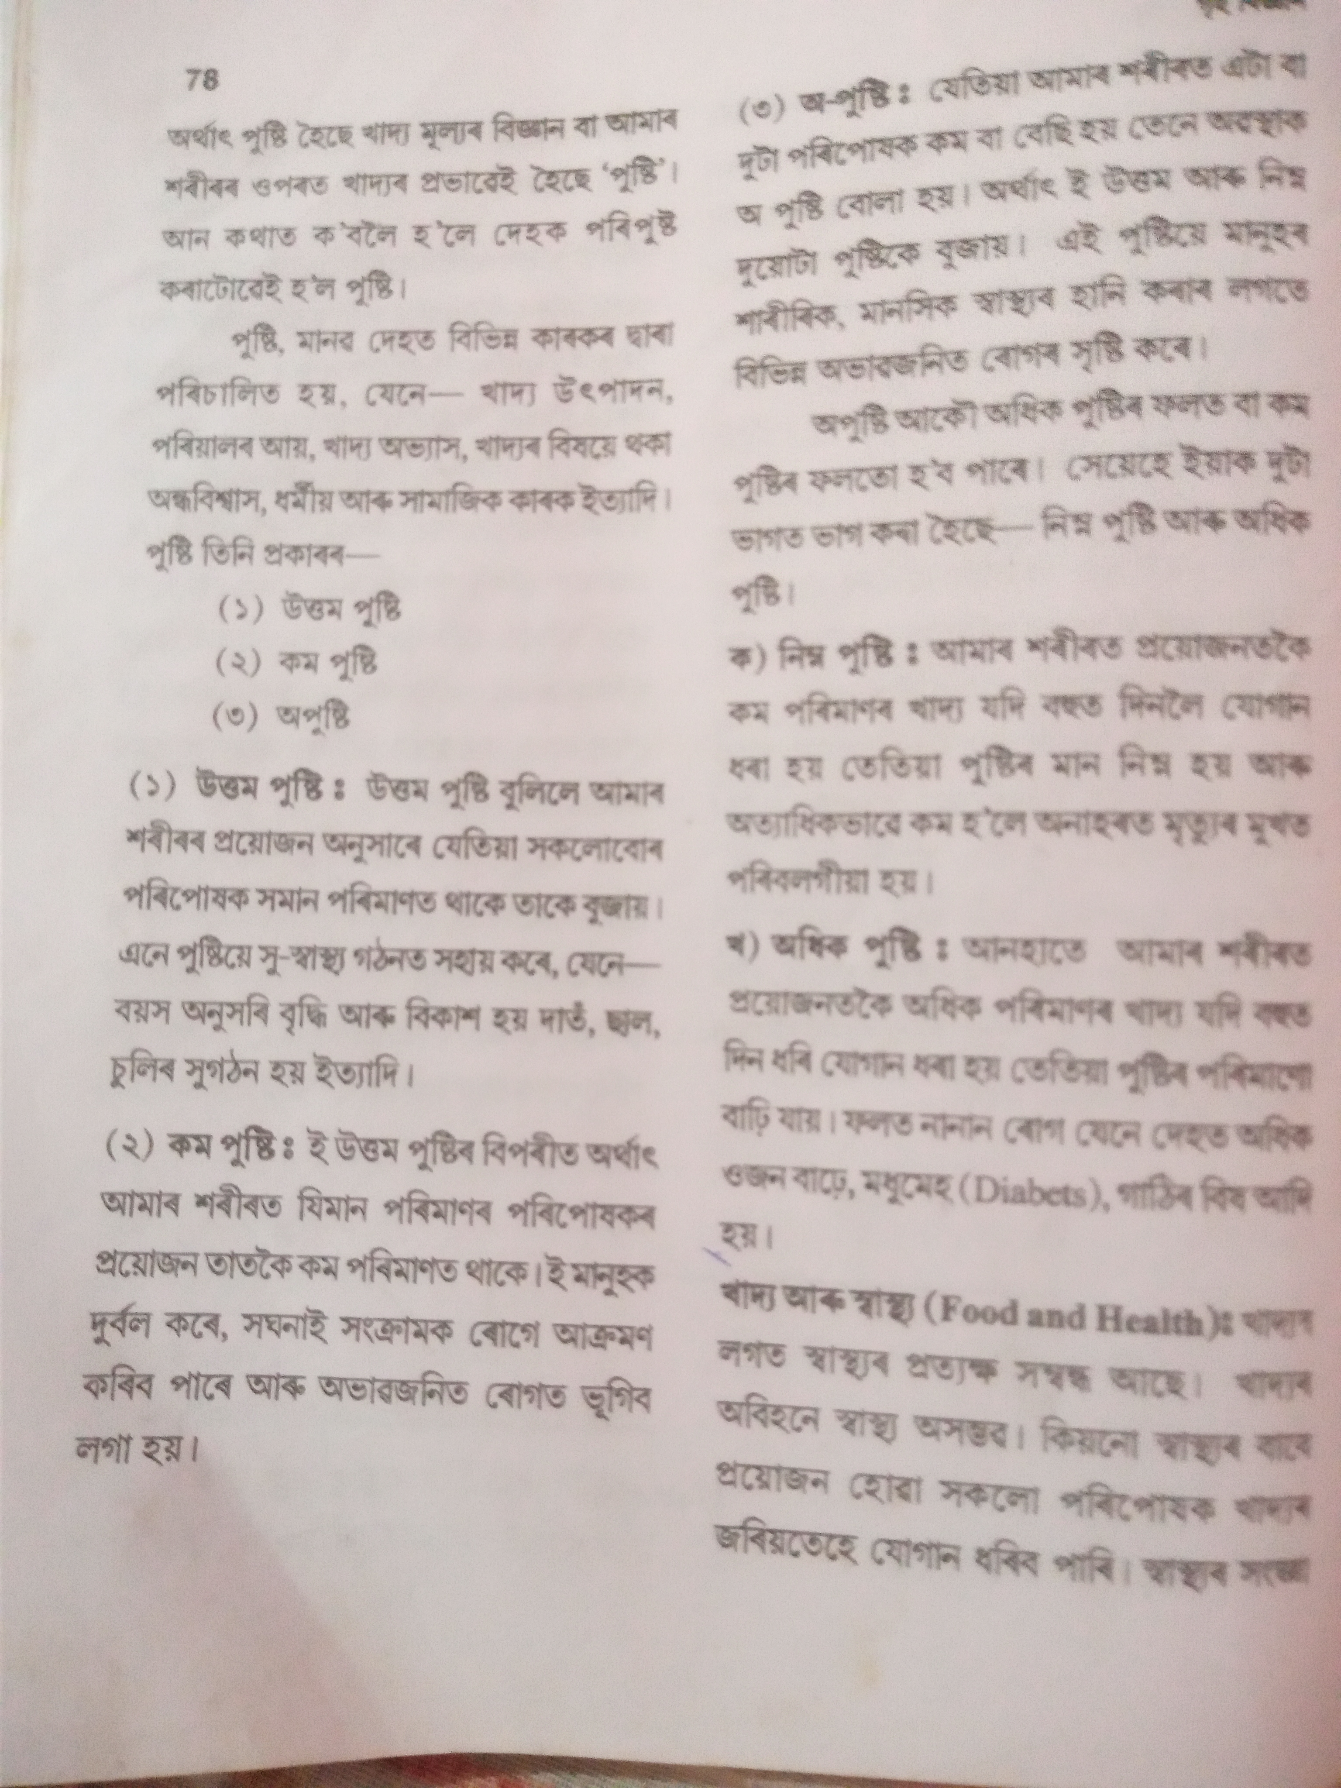

Slide 12
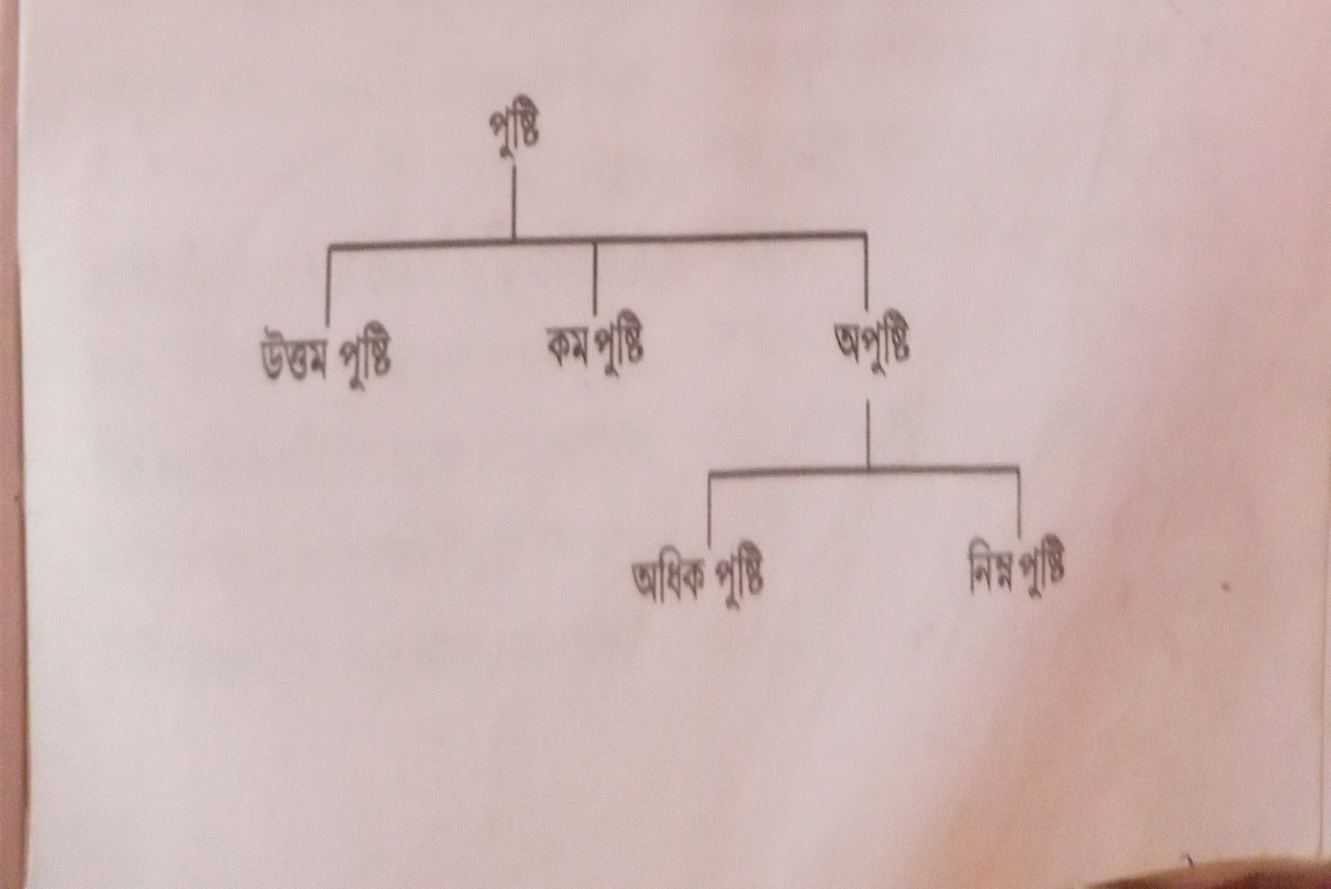

Slide 13
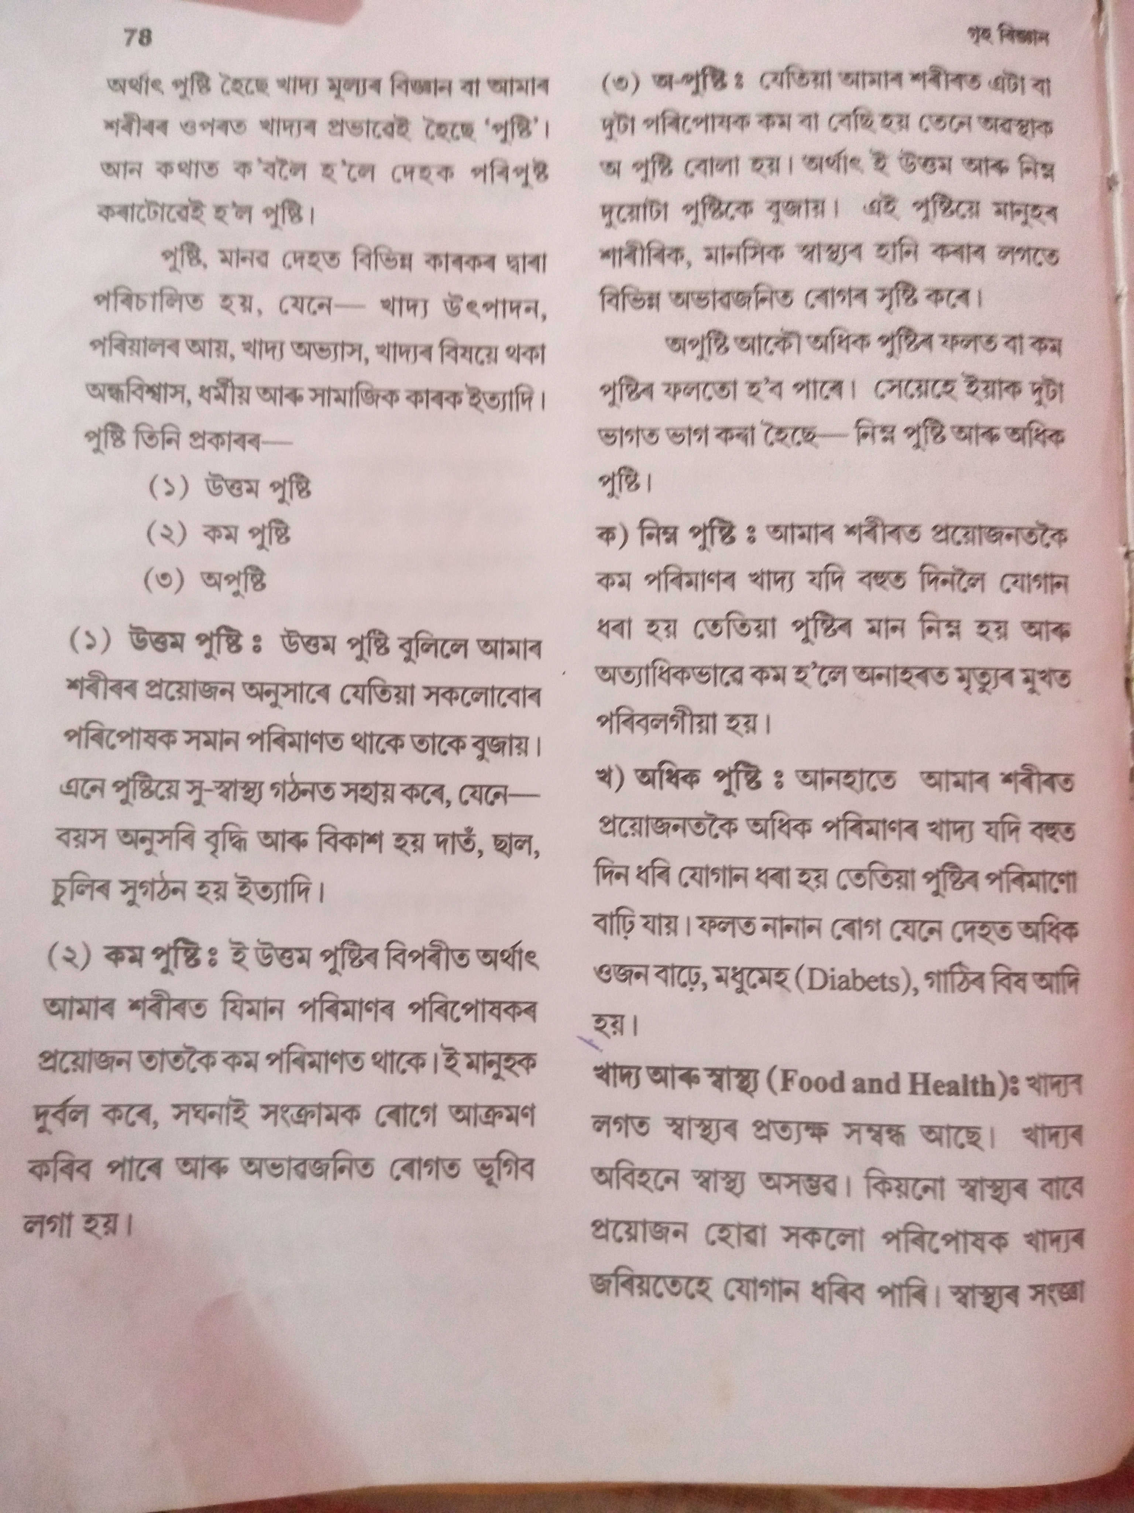

Slide 15
THANK YOU

