Slide 1
A,D, E, K
FUNTIONS
FOOD SOURCES
Deficiency Disease
Daily requirment

Slide 2
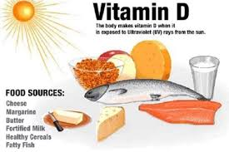
Dr. Swapna Dutta
HoD, Dept. of Home Science

Slide 3
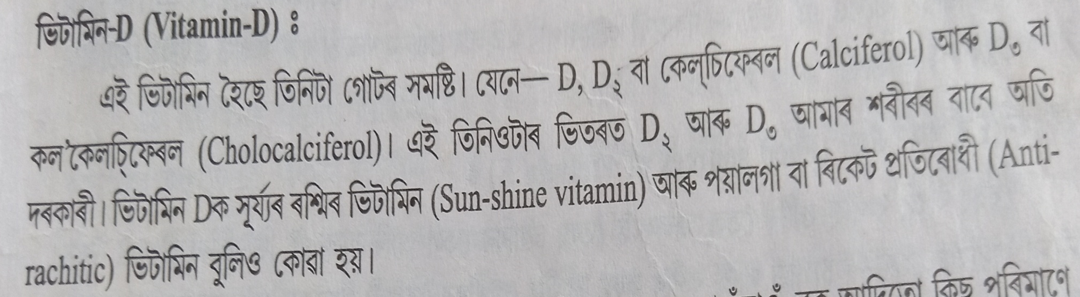


Slide 4
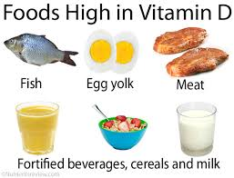
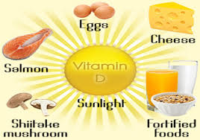

Slide 5
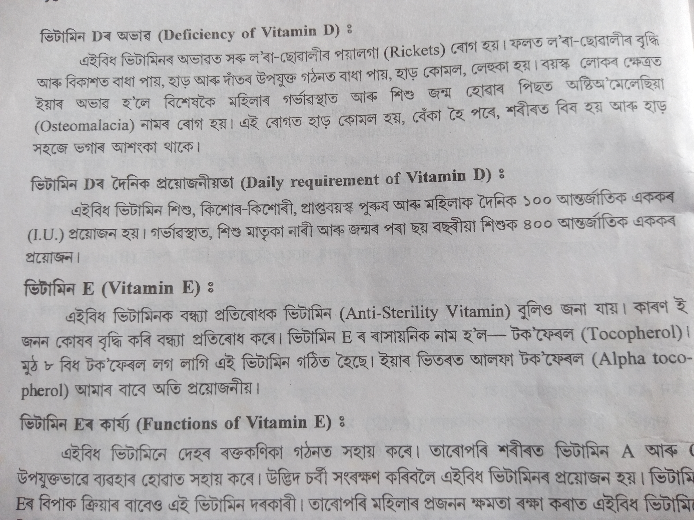
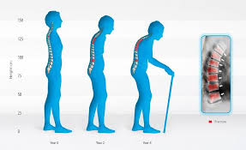
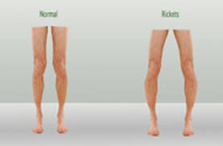

Slide 6
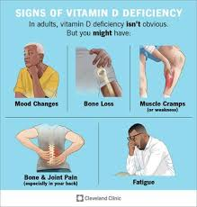

Slide 7
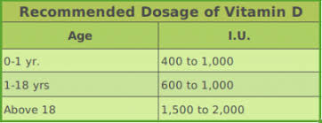

Slide 8
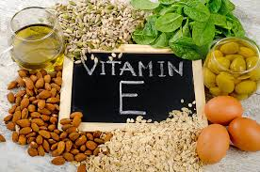
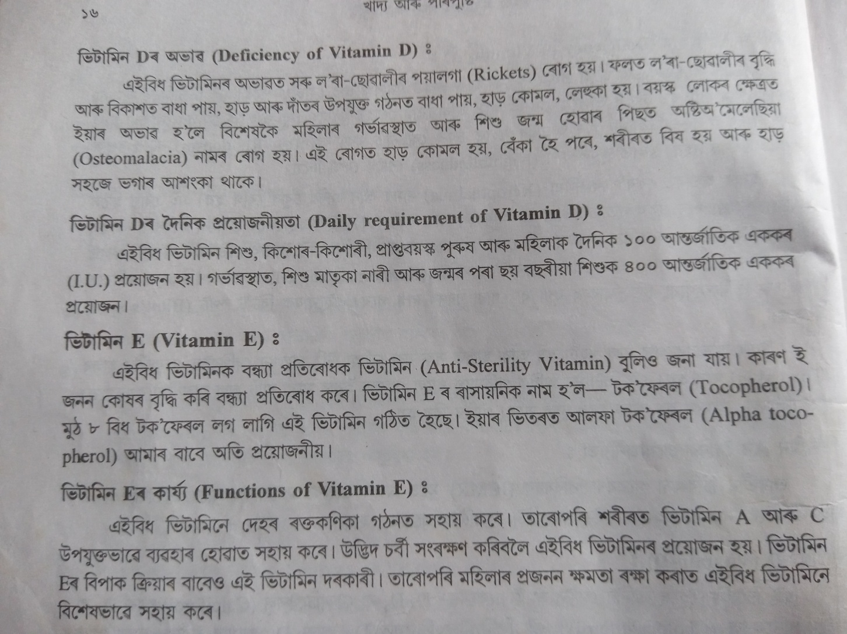
VITAMIN E

Slide 9

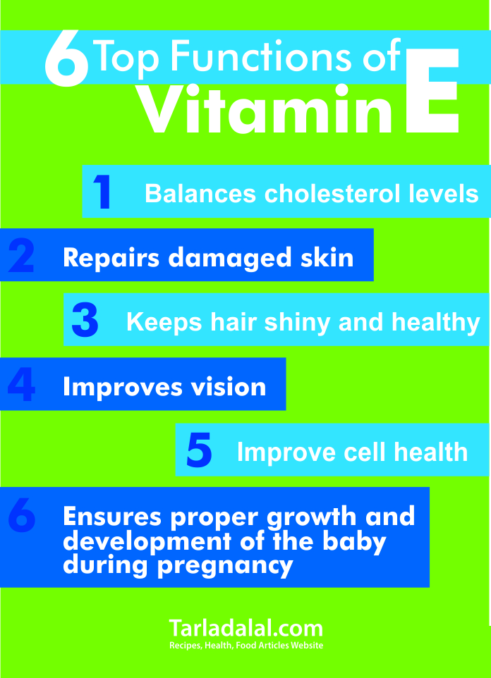


Slide 10
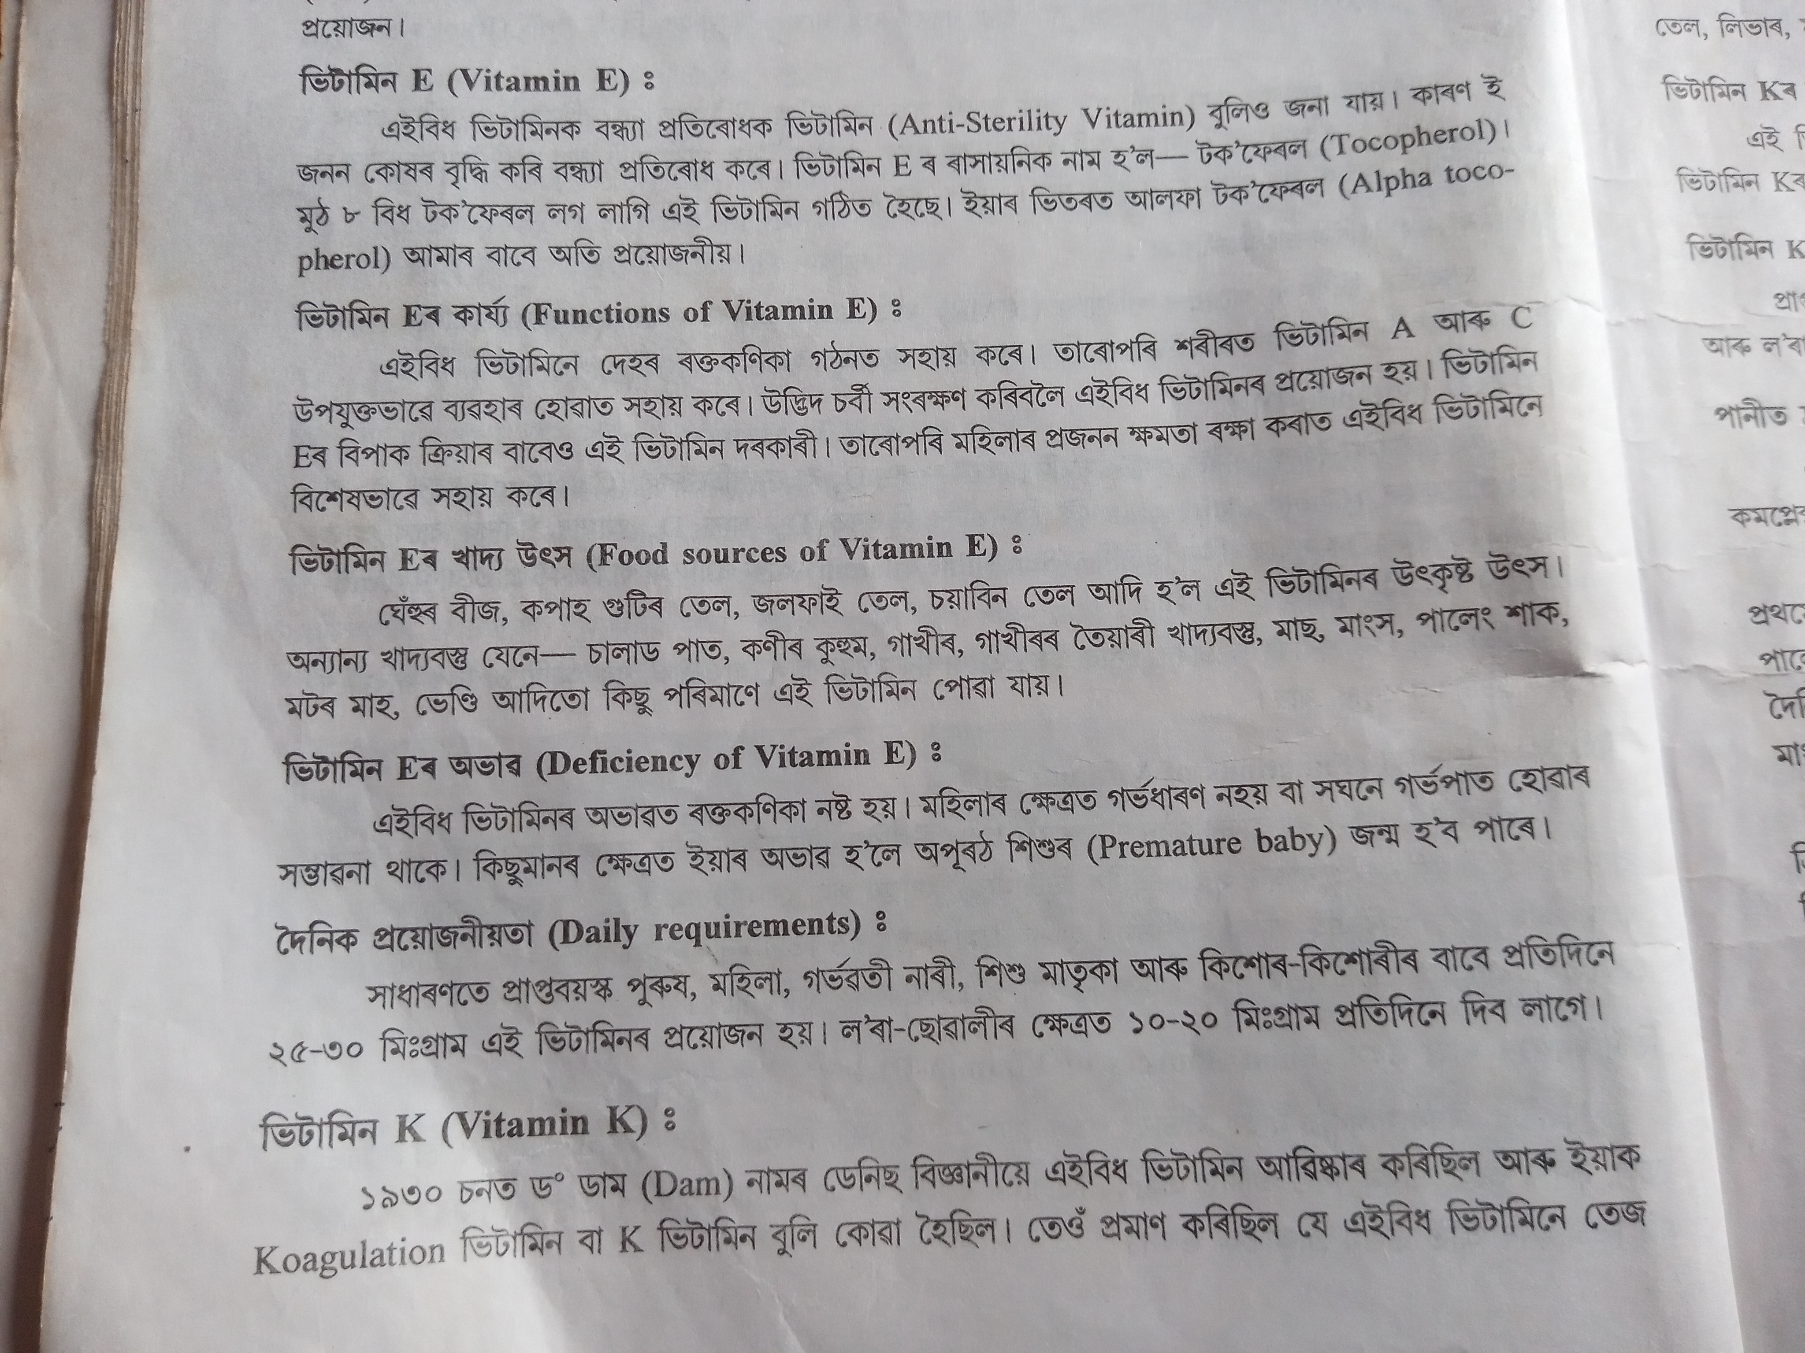
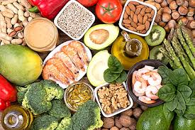
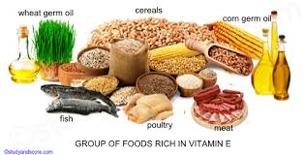
SOURCES OF VITAMIN E

Slide 11
DEFICIENCY DISEASE & DAILY REQUIRMENT

Slide 12

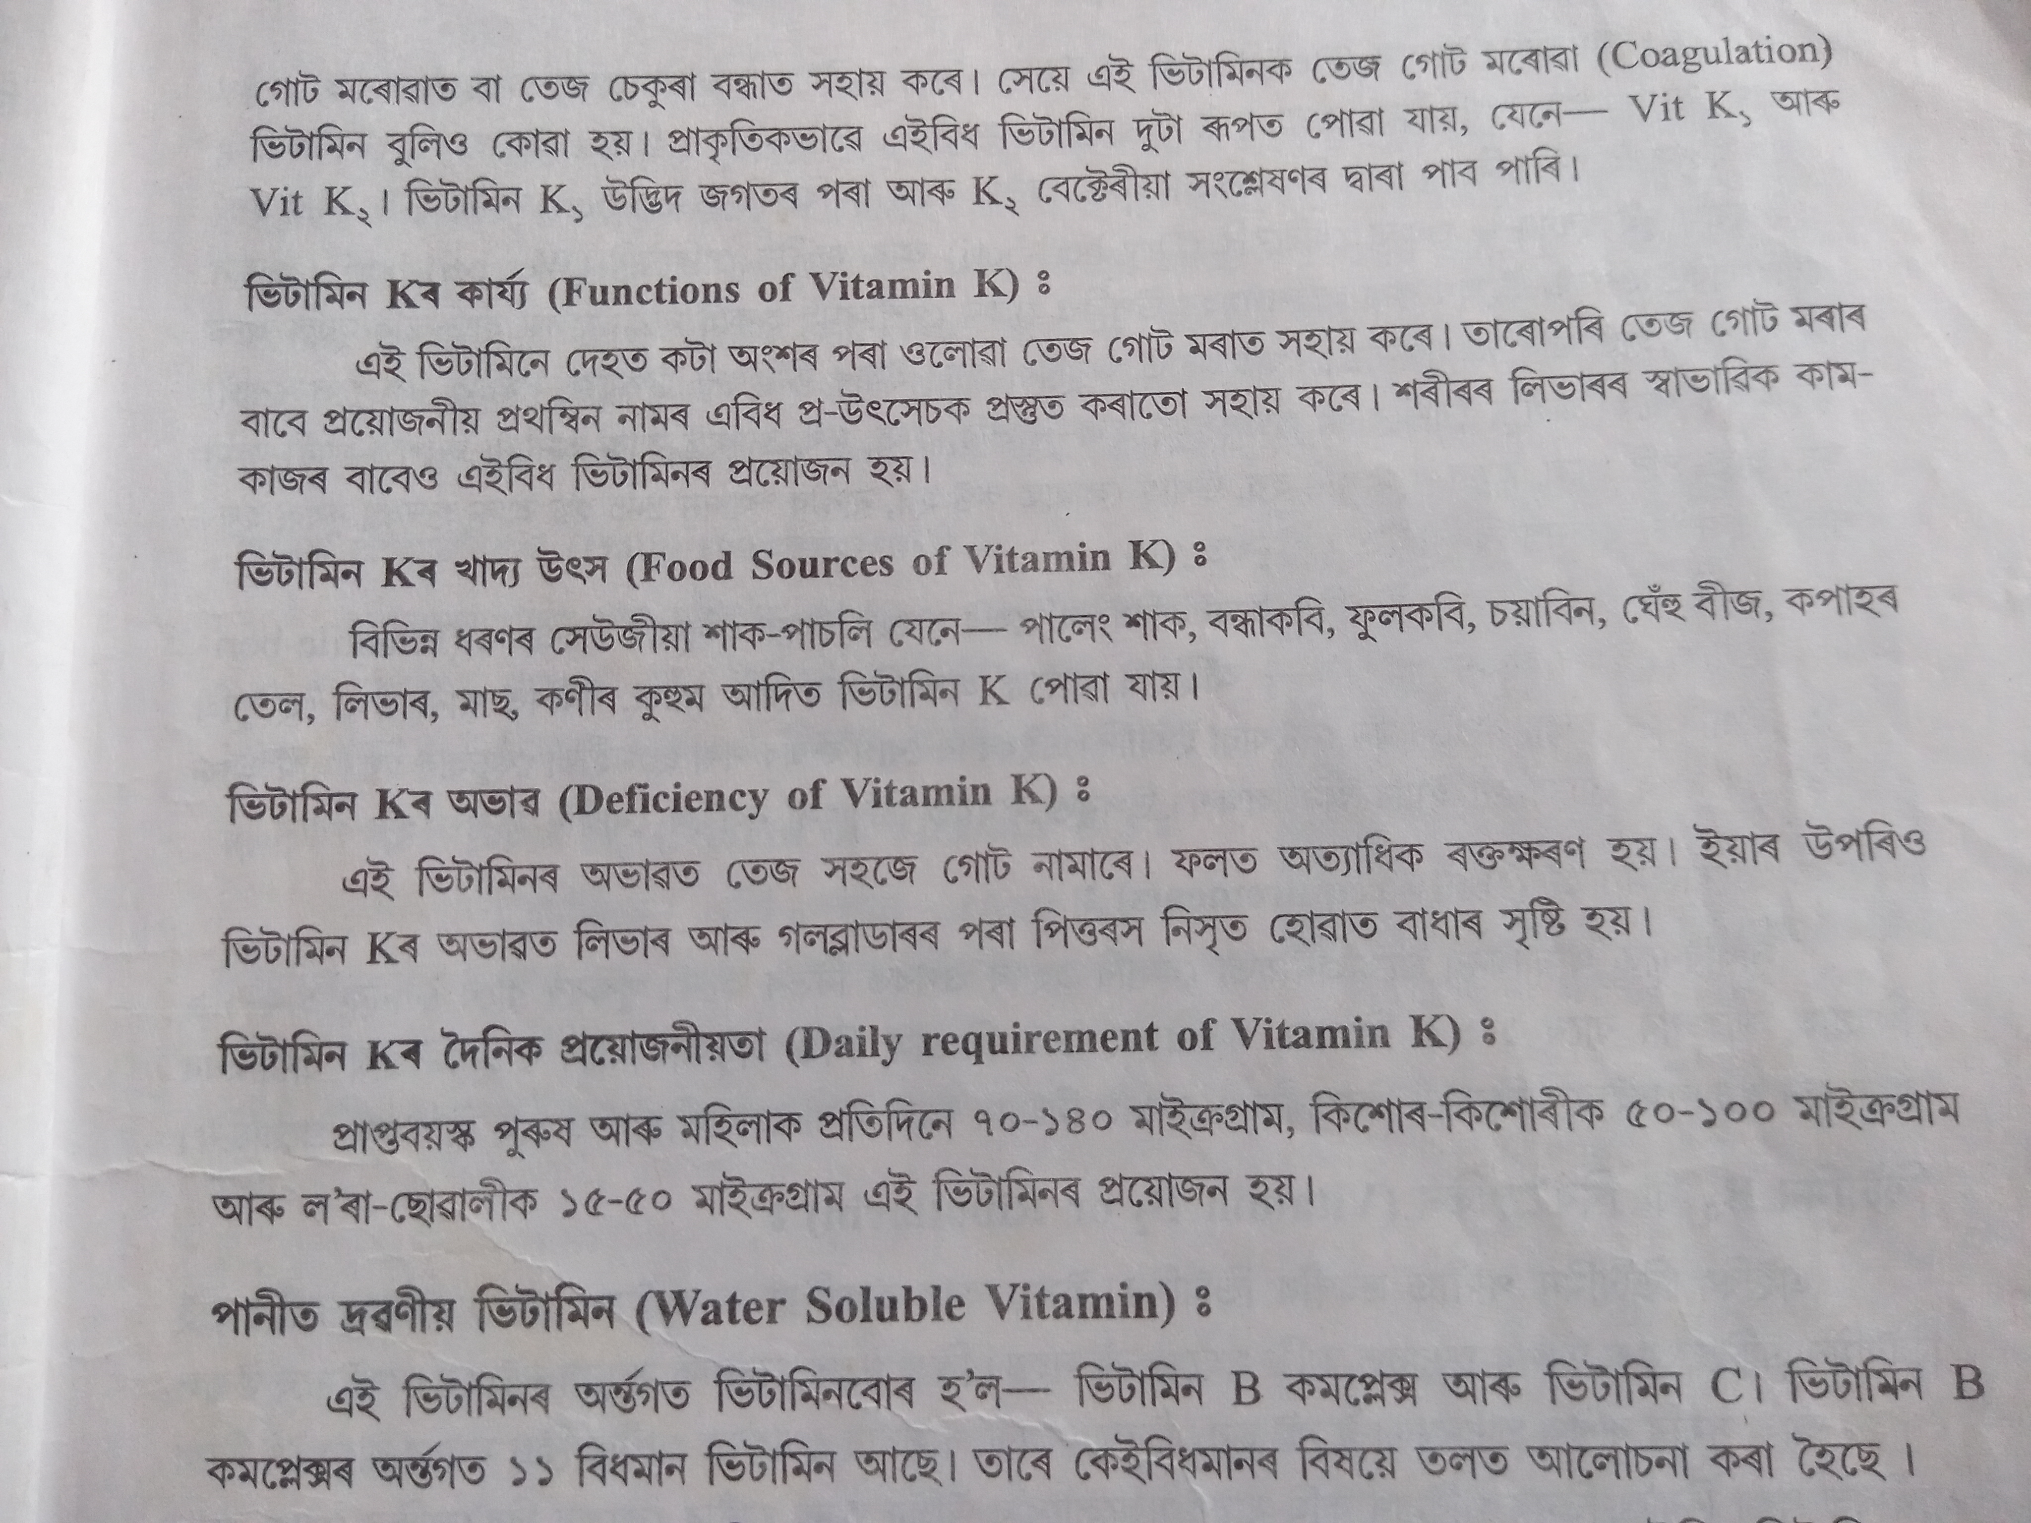
VITAMIN K

Slide 13
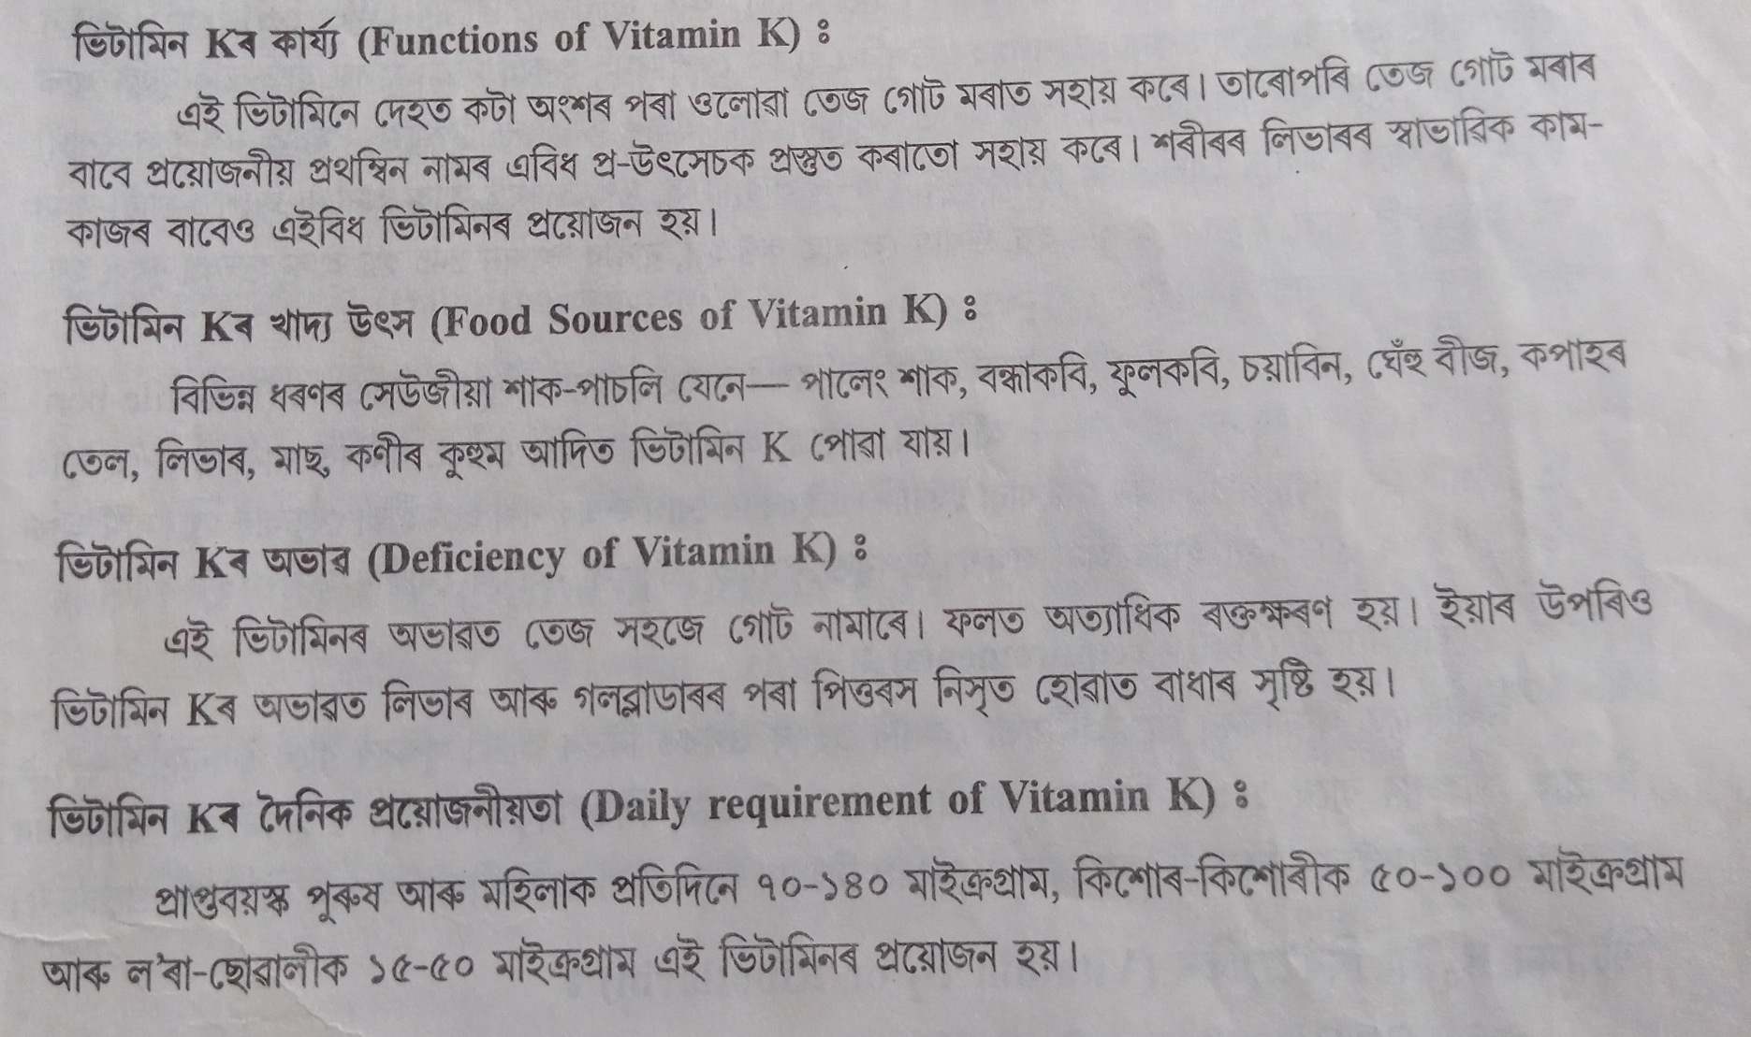
FUNCTIONS, SOURCES, DEFICIENCY DISEASE & DAILY REQUIRMENT

Slide 14
THANK YOU

