Slide 1
Extrema of functions of two variables 3rd semester
PRESENTING BY – Manash Protim Borah HoD, Dept. of Mathematics LTK College

Slide 2
INTRODUCTION
To find extrema of functions of two variables, first find the critical points, then calculate the discriminant and apply the second derivative test.

Slide 3
DERIVATIVES TEST FOR LOCAL EXTREME VALUE
To find the local extreme values of a function of asingle variable we look for points where the graph has a horizontal tangent plane . For a function $f$($x$,$y$) of two variables we look for points where the surface z $=$$f$($x$,$y$) has a horizontal tangent plane . For a function $f$($x$,$y$) for two variables we look for points where the surface z $=$$f$($x$,$y$) has a horizontal tangent plane . At such points , we then look local maxima , local minima and saddle points.

Slide 4
DEFINITIONS
LOCAL MAXIMUM : A function $f$($x$,$y$) is said to have local maxima value at ($a$,$b$) if there exist a small neighbourhood of$a$, $b$such that $f$($a$,$b$) >$f$($a+h$, $b+k$) where $h$, $k$ are constant
LOCAL MINIMUM : A function $f$($x$,$y$) is said to have a local minimum value at ($a$,$b$) if there exist a small neighbourhood of$a$ , $b$ such that $f$($a$,$b$) <$f$($a+h$, $b+k$) where $h$, $k$ are constant

Slide 5
DEFINITIONS
CRITICAL POINT : As interior point of the domain of a function $f$($x$,$y$) where both $f_{x}$and $f_{y}$ are zero or where one or both of $f_{x}$ and $f_{y}$ do not exist is called a critical point.
SADDLE POINT : A saddle point or minimax point is a point on the surface of the graph of a function where the slopes in orthogonal directions are all zero ,but which is not local extremum of the function.

Slide 6
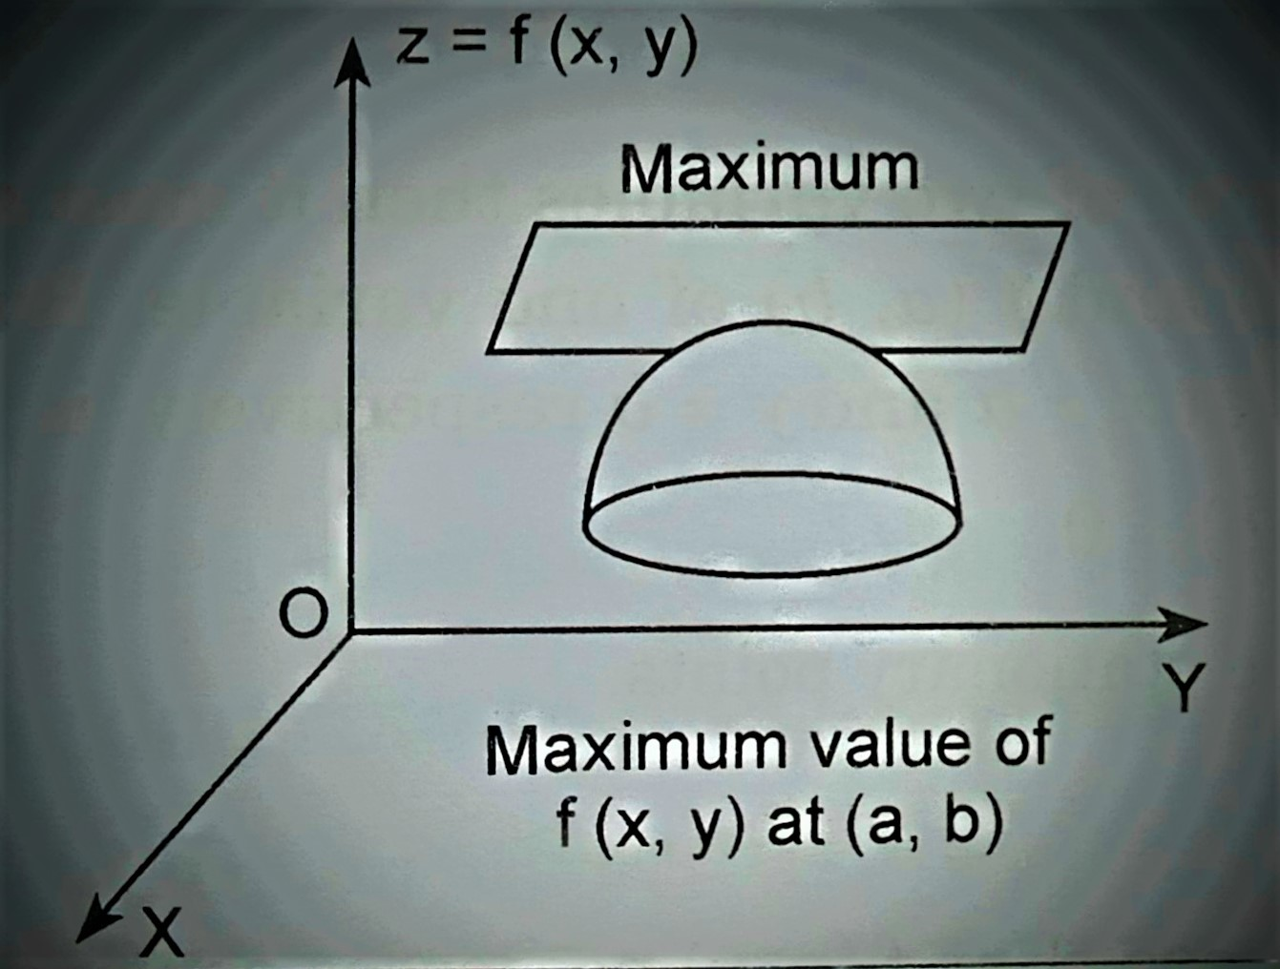
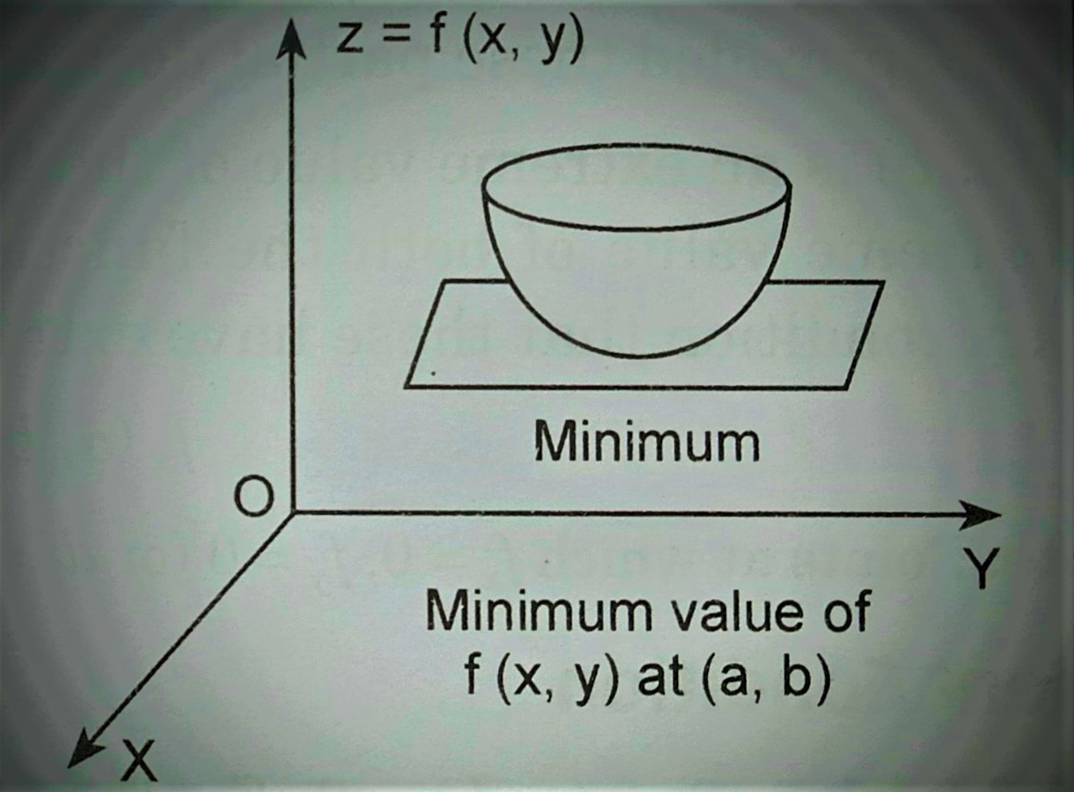
FIG – DIAGRAM OF MAXIMUM AND MINIMUM FIG – DIAGRAM OF MAXIMUM AND MINIMUM

Slide 7
WORKING RULES
Differentiate$f$($x$,$y$) and find out $f_{x}$,$f_{y}$ ,$f_{xx }$,$f_{yy}$ , $f_{xy}$ . Put $f_{x}$$=$ 0 and $f_{y}$$=$ 0 and solve these equations for $x$ and $y$ . Let ($a$,$b$) be the values of ($x$,$y$). Evaluate r $={ f}_{xx }$, s $=$$f_{xy }$. t$=$$f_{yy}$at($a$,$b$). If $rt \text{–} s^{2}$>0 and a) r < 0 then $f$($x$,$y$)has a local minimum value . b) r > 0 then $f$($x$,$y$) has a local minimum value . If $rt$– $s$< 0 then $f$($x$,$y$) has no extremum value at the point ($a$,$b$). If $rt$– $s$$=$ 0 then the case doubtful and needs further investigation.

Slide 8
Discuss the maximum and minimum of $x^{2}+$$y^{2}+$ 6$x+$ 12
Solution: Given $f$($x$,$y$) $=$$x^{2}+$$y^{2}+$6$x$$+$12 Therefore$f_{x}$$=$$\frac{∂f}{∂x} =$2$x$$+$6, $f_{y}$$=$$\frac{∂f}{∂y} =$2$y$ , $f_{xx}$$=$$\frac{∂^{2}f}{{∂x}^{2}}$$=$2 , $f_{yy}$$=$$\frac{∂^{2}f}{{∂y}^{2}}$$=$2 , and$f_{xy}$$=\frac{∂^{2}f}{∂x ∂y}$$=$0 For maxima and minima $\frac{∂f}{∂x}$$=$0, $\frac{∂f}{∂y}=$0 Or, 2$x+$6$=$0 and 2$y$$=$0 Or, $x$$=$ – 3and$y$$=$0 Therefore, At (–3,$\text{0}$)$rt \text{–} s^{2}$$=$ 2 × 2 – ${\text{0}}^{2}$$=$ 4 > 0 and r $=$ 2 > 0 Hence $f$($x$,$y$) has a minimum value at x $=\text{–}$3 and y$=$ 0 Therefore, Minimum value $=$$f$(–$3$,$0$)$=$ ($\text{–}{ 3)}^{2}+$$0^{2}+$6 × (–3) $+$12$=$3.

Slide 9
conclusion
In calculus, any point at which the value of a function is largest (a maximum) or smallest (a minimum). There are both absolute and relative (or local) maxima and minima. Extreme value theory (EVT) has been applied in fields such as hydrology and insurance. It is a tool used to consider probabilities associated with extreme and thus rare events. EVT is useful in modelling the impact of crashes or situations of extreme stress on investor portfolios.

Slide 10
THANK YOU

