Slide 1
    KELVIN’S MINIMUM ENERGY THEOREM
    BERNOULLI’S EQUATION
6th Sem- Fluid Dynamics
Presented by
MANASH PROTIM BORAH
HoD
D e p t .of MATHEMATICS)

Slide 2
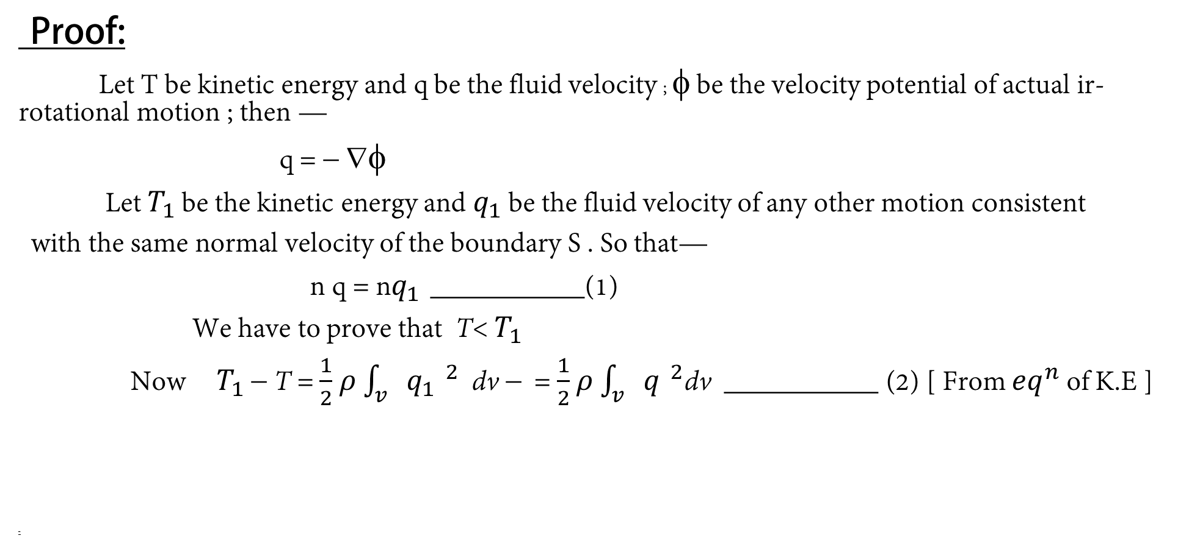
STATEMENT:-
The ir-rotational motion of a liquid occupying a simple connected region has less kinetic energy than any other motion consistent with the same .
Proof:
Let T be kinetic energy and q be the fluid velocity ; φ be the velocity potential of actual ir-rotational motion ; then —
q = − ∇φ
Let $T_{1}$ be the kinetic energy and $q_{1}$ be the fluid velocity of any other motion consistent
with the same normal velocity of the boundary S . So that—
n q = n$q_{1 }$___________(1)
We have to prove that T<$T_{1}$
Now $T_{1}$− T = $\frac{1}{2}$$ρ$$\int_{v}{{q_{1 }}^{2}}$dv−= $\frac{1}{2}$$ρ$$\int_{v}{{q_{ }}^{2}}$dv ___________ (2) [ From ${eq}^{n}$ of K.E ]
-

Slide 3
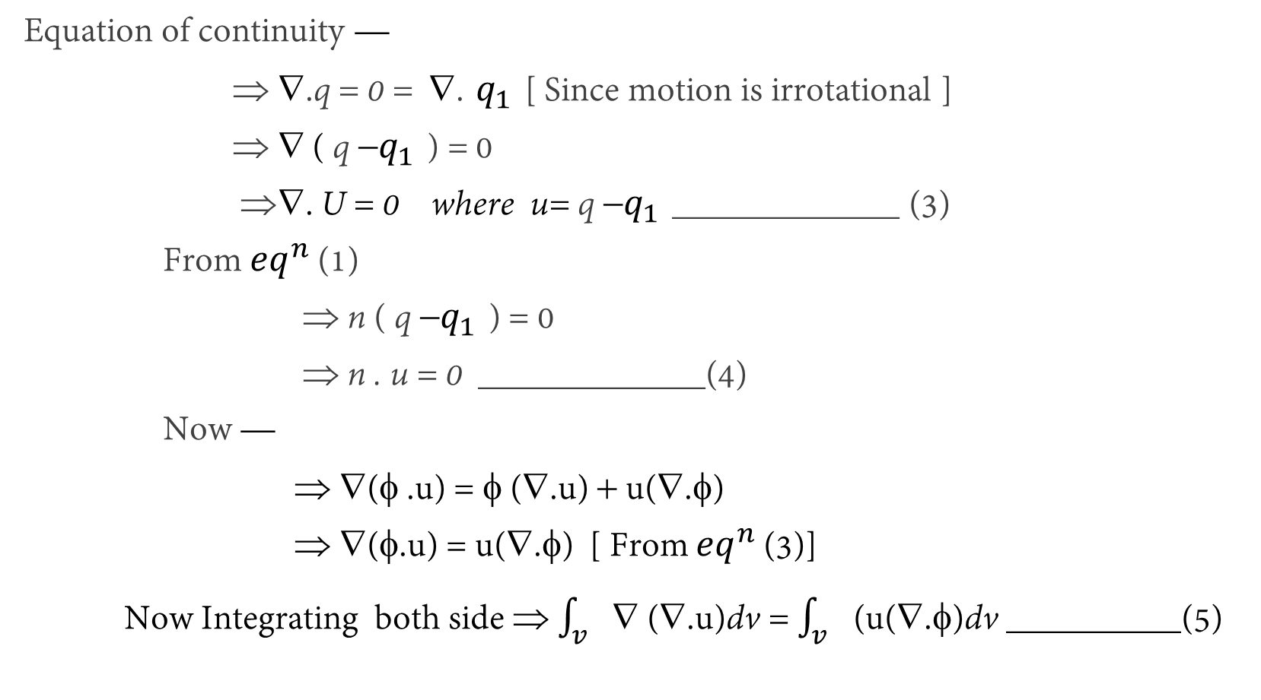
Equation of continuity —
⇒∇.q = 0 = ∇.$q_{1 }$[ Since motion is irrotational ]
⇒∇ ( q−$q_{1 }$) = 0
⇒∇. U = 0 where u= q−$q_{1 }$_____________ (3)
From ${eq}^{n}$ (1)
⇒ n ( q−$q_{1 }$) = 0
⇒ n . u = 0 _____________(4)
Now —
⇒ ∇(φ .u) = φ (∇.u) + u(∇.φ)
⇒ ∇(φ.u) = u(∇.φ) [ From${eq}^{n}$ (3)]
Now Integrating both side ⇒ $\int_{v}{∇ }$(∇.u)dv = $\int_{v}{ }$(u(∇.φ)dv __________(5)

Slide 4

By the equation of kinetic energy ⇒$T_{1}$= $\frac{1}{2}$ρ$\int_{v}{{q_{1 }}^{2}}$dv
⇒$T_{1}$= $\frac{1}{2}$ρ$\int_{v}{{(q−u)}^{2}}$dv [ $∵$u = q−$q_{1 }$]
⇒$T_{1}$= $\frac{1}{2}$ρ$\int_{v}{(}q^{2}$+$u^{2}$−2q.u)dv
⇒$T_{1}$= $\frac{1}{2}$ρ$\int_{v}{q^{2}}$dv+$\frac{1}{2}$ρ$\int_{v}{u^{2}}dv$−ρ$\int_{v}{q}$.u dv
⇒$T_{1}$= T+ $\frac{1}{2}$ρ$\int_{v}{u^{2}dv}+$ρ$\int_{v}{(∇φ)}$u dv [$∵$q =−∇φ]
⇒ $T_{1}$−T= $\frac{1}{2}$ρ$\int_{v}{u^{2}}dv$−ρ$\int_{s}{n.(φ.u)}$ds [ By Div. ${Th}^{m}$]
⇒ $T_{1}$−T= $\frac{1}{2}$ρ$\int_{v}{u^{2}}dv$−0 > 0 [$∵$ nu=0 ]
⇒ $T_{1}$−T > 0
⇒ $T_{1}$>T
Hence Proved.

Slide 5
THANK YOU

